Slide 1
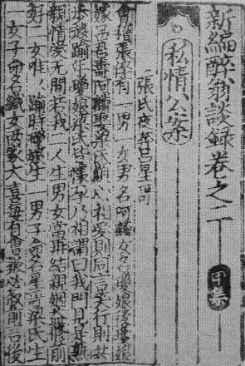
The Production and Circulation of ‘Written Notes’ (biji) –Tables and Figures
Hilde De Weerdt
University of Oxford
2009-2010, upd. 2011

Slide 2
Introduction
This slideshow presents accompanying data for Hilde De Weerdt, “The Production and Circulation of ‘Written Notes’ (biji),” in Michela Bussotti and Jean-Pierre Drège, eds., Imprimer autrement: Le livre non commercial dans la Chine impériale, Paris: l'Ecole française d'Extrême-Orient, 2012, forthcoming.
It introduces data compiled in Hilde De Weerdt’s “Biji in Print Database.” The database will be available online in early 2012.
It presents an overview of the kinds of chronological, geographical, and topical analysis that the database sustains; it also demonstrates how these data can be combined with the prosopographical data contained in China Biographical Database (CBDB) to conduct analyses of the sociopolitical backgrounds of biji authors and producers. The original report also discussed the changing nature of the network ties among authors and producers; these results will be published in the future.

Slide 3
References and Credits
Hilde De Weerdt. “The Production and Circulation of ‘Written Notes’ (biji).” In Michela Bussotti and Jean-Pierre Drège, eds., Imprimer autrement: Le livre non commercial dans la Chine impériale, Paris: l'Ecole française d'Extrême-Orient, 2012, forthcoming.
Hilde De Weerdt. Biji in Print Database. Website under development and available in 2012. Check http://www.orinst.ox.ac.uk/staff/ea/chinese/hdeweerdt.html for further information.
Peter Bol et al. Hartwell China History Project GIS (1992-2001); and id., China Historical GIS (2001-). Data available at http://www.fas.harvard.edu/~chgis/ (last accessed Oct. 30, 2009)
Peter Bol et al. China Biographical Database Project (CBDB) (2004-). Data available at http://isites.harvard.edu/icb/icb.do?keyword=k16229&pageid=icb.page129708 (updated edition dated July 5, 2011)

Slide 4
Table 1: Sample survey
Number of printed editions | Number of unique titles | Number of unique titles extant in Song print
121 | 83 | 53

Slide 5
Table 2. Number of biji imprints by dynastic period
Northern Song prints | Southern Song prints | Song prints
2 | 115 | 4

Slide 6
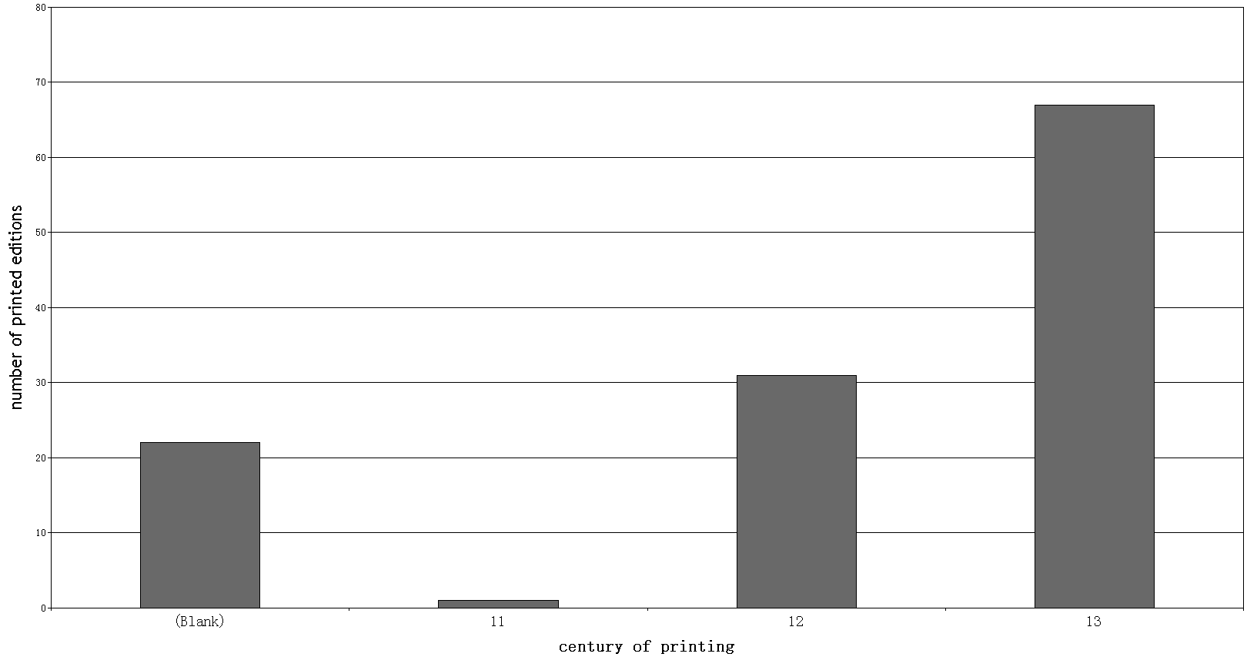
Table 3. Song biji printed editions by century in which they were printed
The vertical axis shows the number of printed editions; the horizontal axis the century of printing (blank indicates that the century of printing is unknown). Here and elsewhere throughout this essay thirteenth-century editions only include Song editions printed before the end of Song rule in 1279.

Slide 7
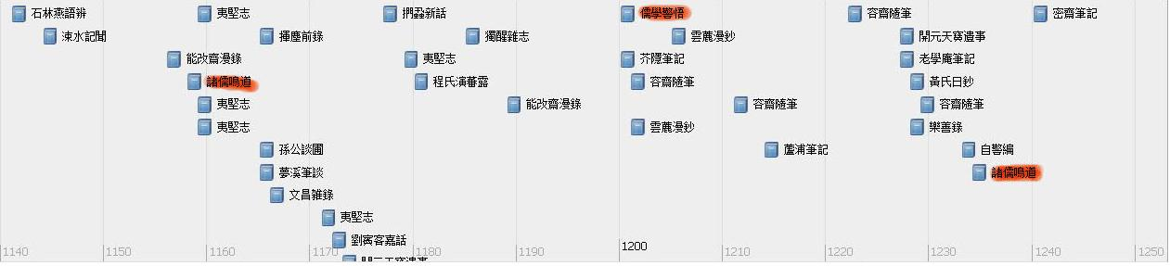
Figure 1. Timeline of datable biji printed editions, 1150-1250. Series are highlighted in red

Slide 8
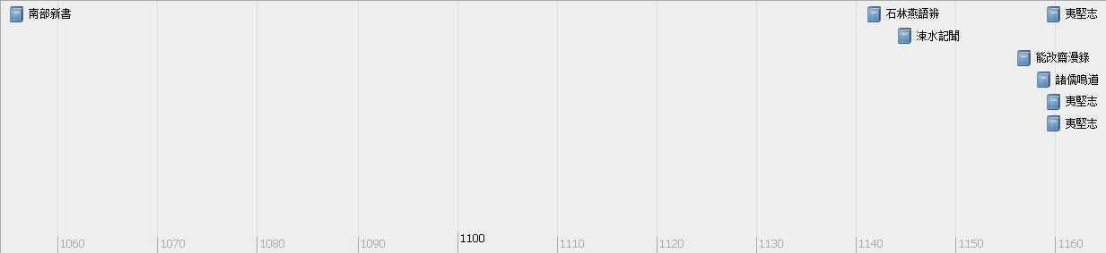
Figure 2. Timeline of datable biji printed editions,
1050-1160

Slide 9
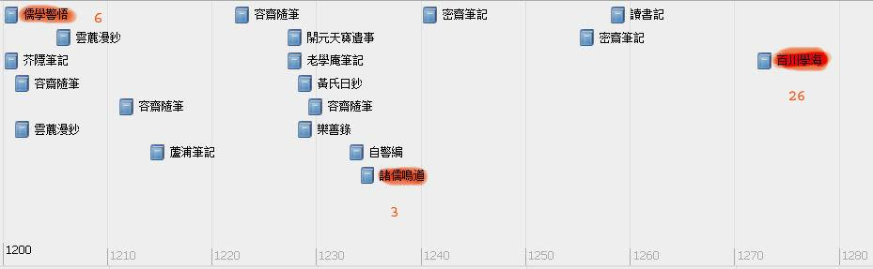
Figure 3. Timeline of datable biji printed editions,
1200-1280
Note: Series are highlighted and the number of biji in them is noted in red .

Slide 10
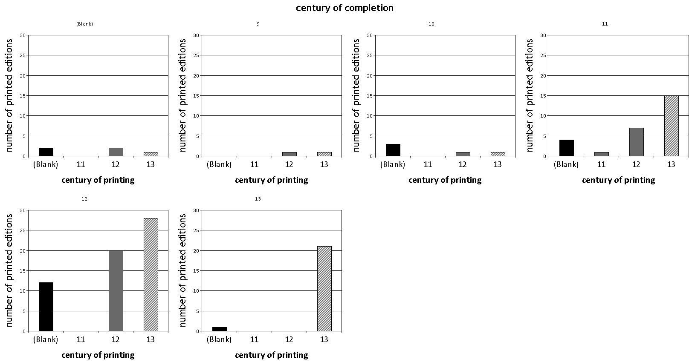
Table 4. Correlation between century of completion and century of printing for biji printed editions
Note: The horizontal axis shows the century of printing in all sub-tables; each sub-table charts the data for all titles completed in the century listed in the top bar. Blank indicates that the century of printing or completion is unknown

Slide 11
Table 5. Southern Song biji imprints by first publication date of the title
Tang | 2
Wudai | 4
Northern Song | 27
NS-SS transition | 6
Southern Song | 75

Slide 12
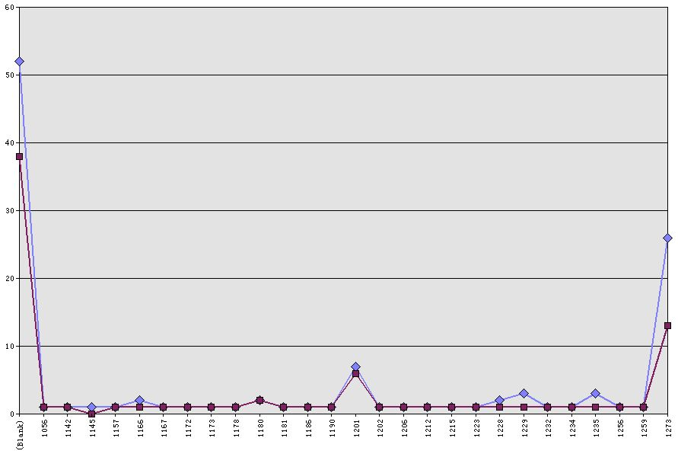
Table 6. Biji titles by year of completion and year of printing
Note: The upper curve traces the number of titles by year of printing; the lower one shows the number of titles by year of completion.

Slide 13
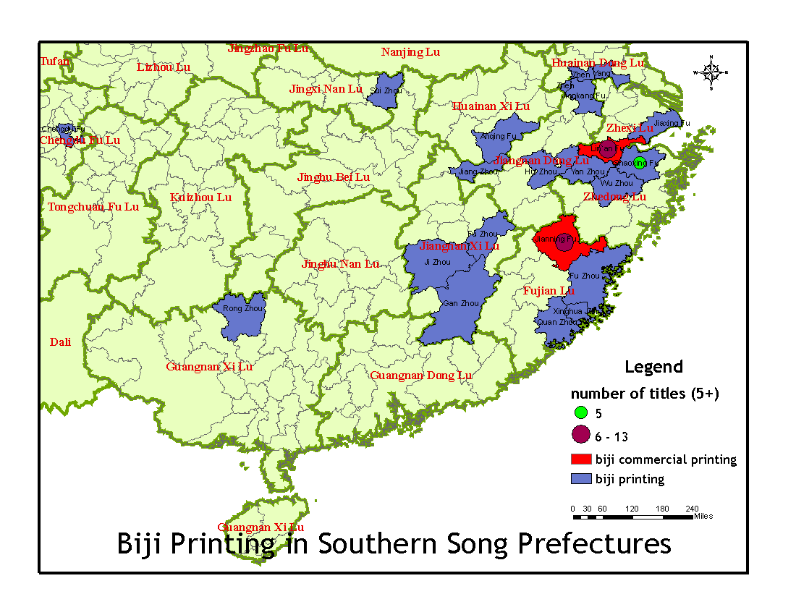
Figure 4. Map of Southern Song prefectures where biji were printed
Note: Circles mark prefectures where 5 or more titles were printed. Prefectures where commercial printers published biji are shown in red.

Slide 14
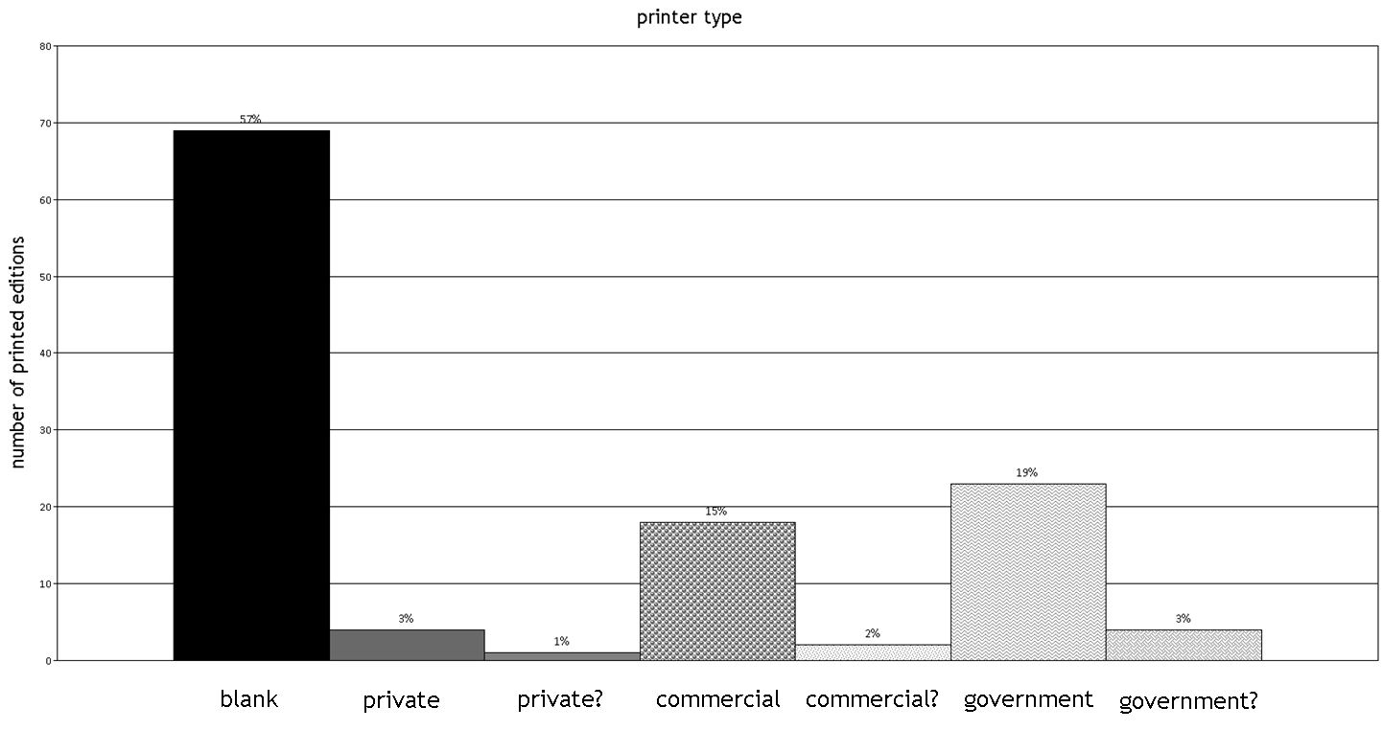
Table 7. Distribution of editions by type of printer

Slide 15
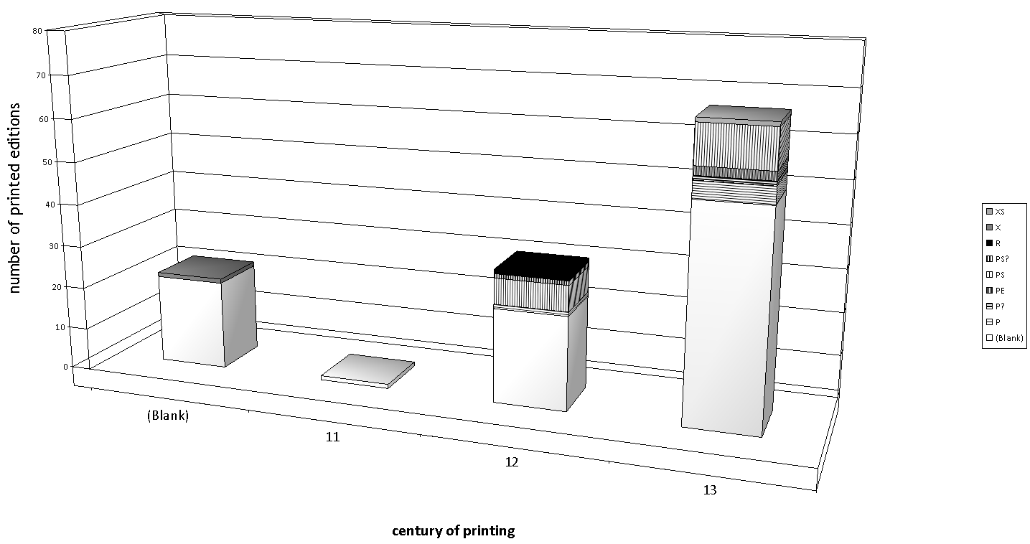
Table 8. Number of government imprints by century of printing showing sub-type of government printer
Note: X stands for county; XS for county school; PS for prefectural school; PE for prefectural education officer(s); P for prefecture or prefectural magistrate.

Slide 16
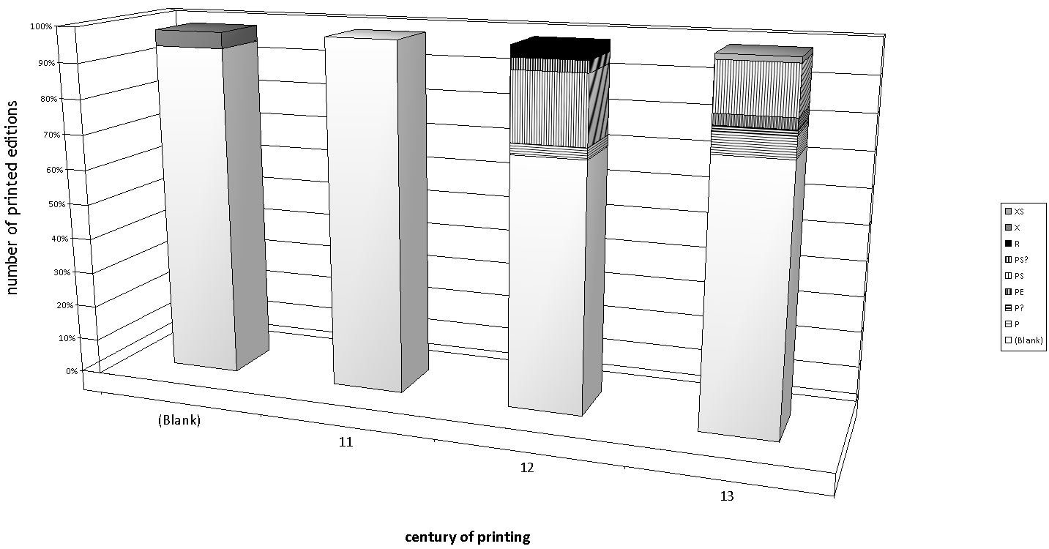
Table 9. Percentage of government imprints in total of printed editions by century of printing
Note: X stands for county; XS for county school; PS for prefectural school; PE for prefectural education officer(s); P for prefecture or prefectural magistrate.

Slide 17
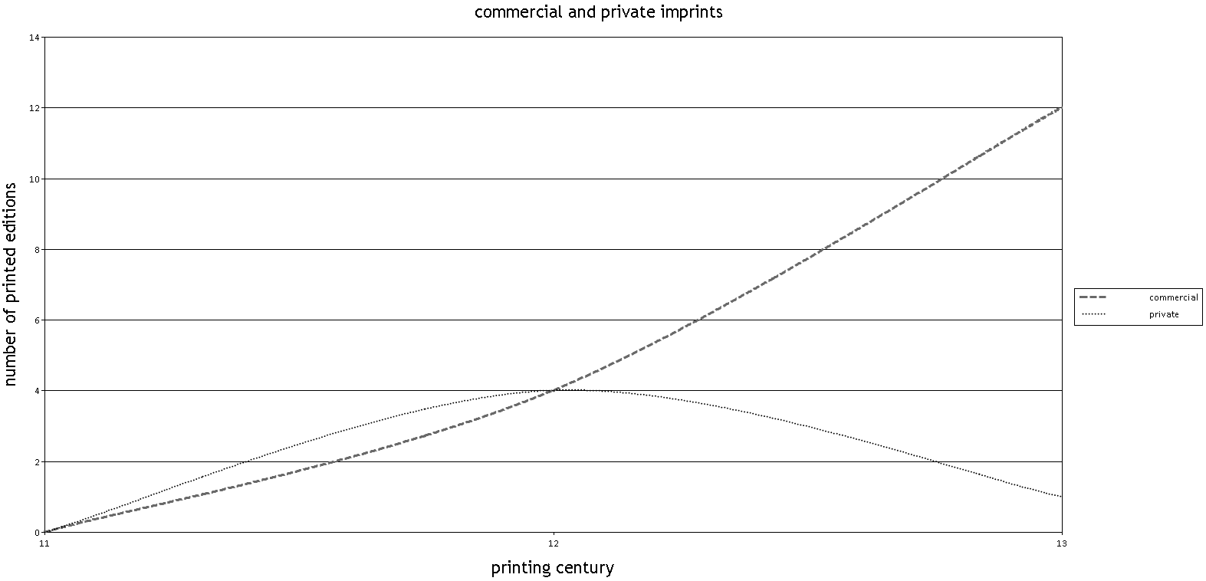
Table 10. Comparison of numbers of commercial and private imprints by century of printing

Slide 18
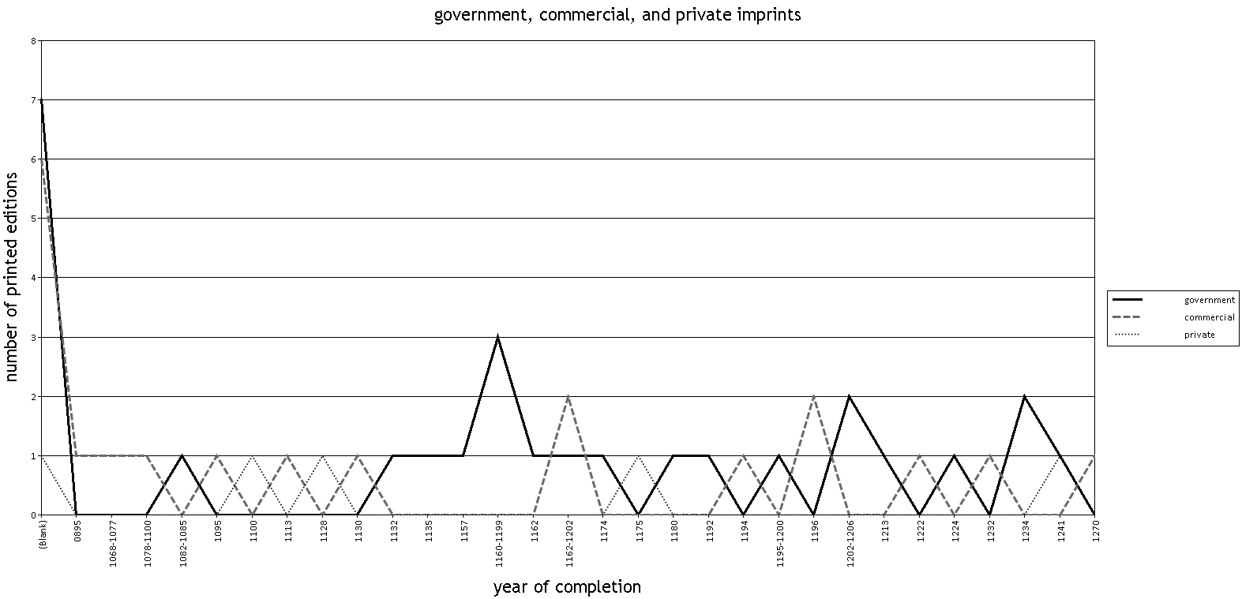
Table 11. Comparison of numbers of government, commercial, and private imprints for titles with known completion dates
Note: Time ranges for completion dates are listed by the earliest year in the range.

Slide 19
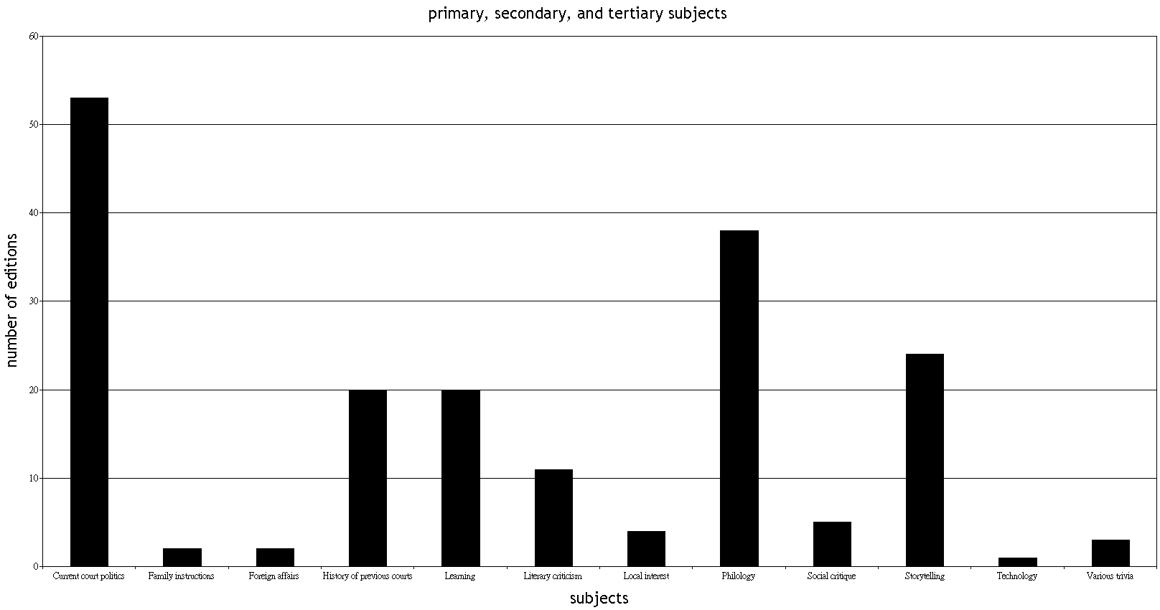
Table 12. Topical coverage (including primary, secondary, and tertiary topical areas) of biji printed in Song times

Slide 20
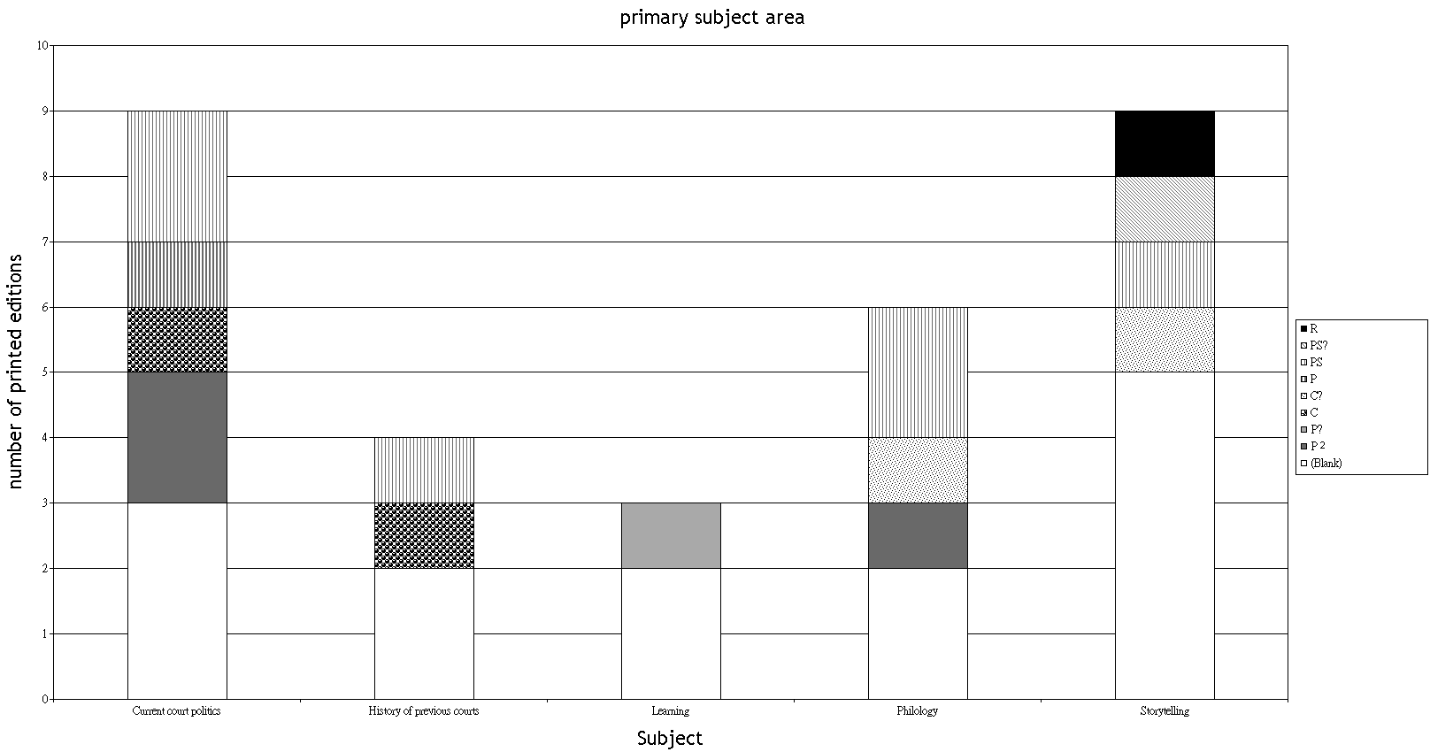
Table 13. Topical coverage (primary area of interest) for biji titles printed in the twelfth century
Note: PS stands for prefectural school; P for prefecture or prefectural magistrate; P for private printer; C for commercial printer; C? suggests that a commercial printer is likely.

Slide 21
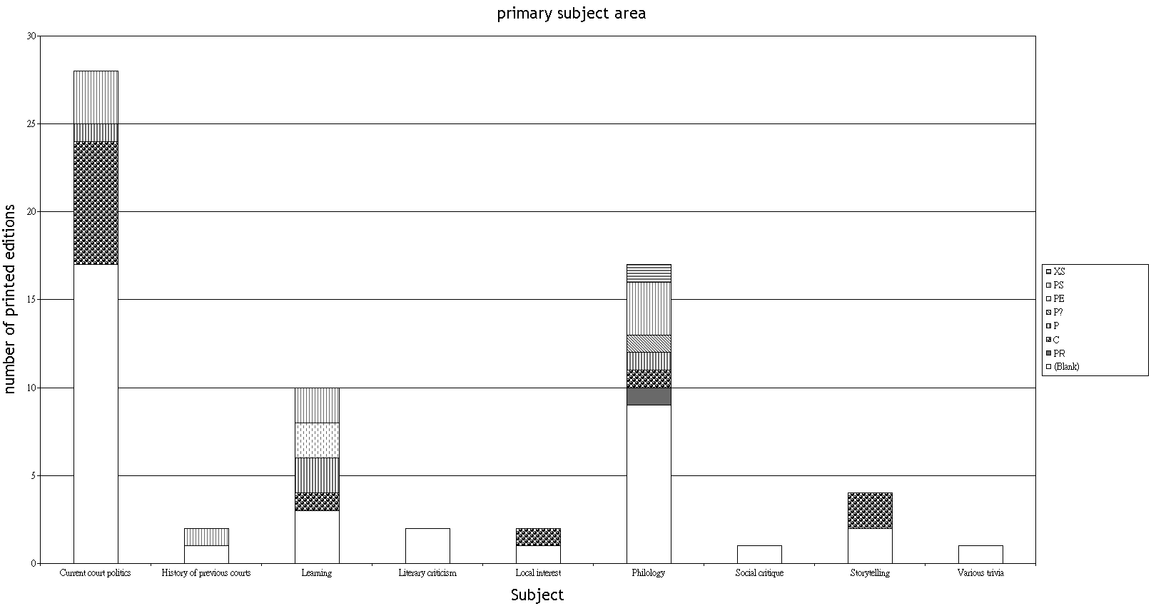
Table 14. Topical coverage (primary area of interest) for biji titles printed in the thirteenth century
Note: XS stands for county school; PS for prefectural school; PE for prefectural education officer(s); P for prefecture or prefectural magistrate; P for private printer; C for commercial printer.

Slide 22
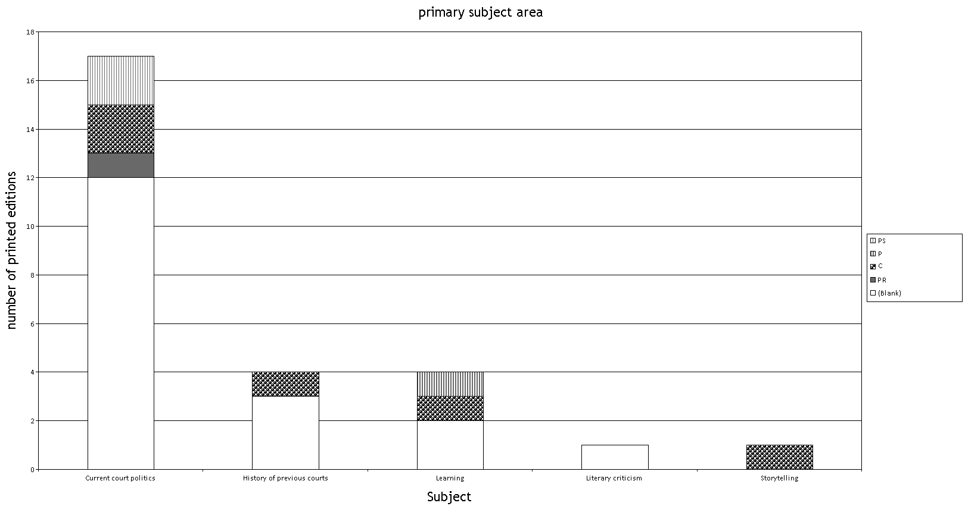
Table 15. Topical distribution (primary subject) of Song biji printed editions of eleventh-century titles, showing type of printer
Note: PS stands for prefectural school; P for prefecture or prefectural magistrate; P for private printer; C for commercial printer.

Slide 23
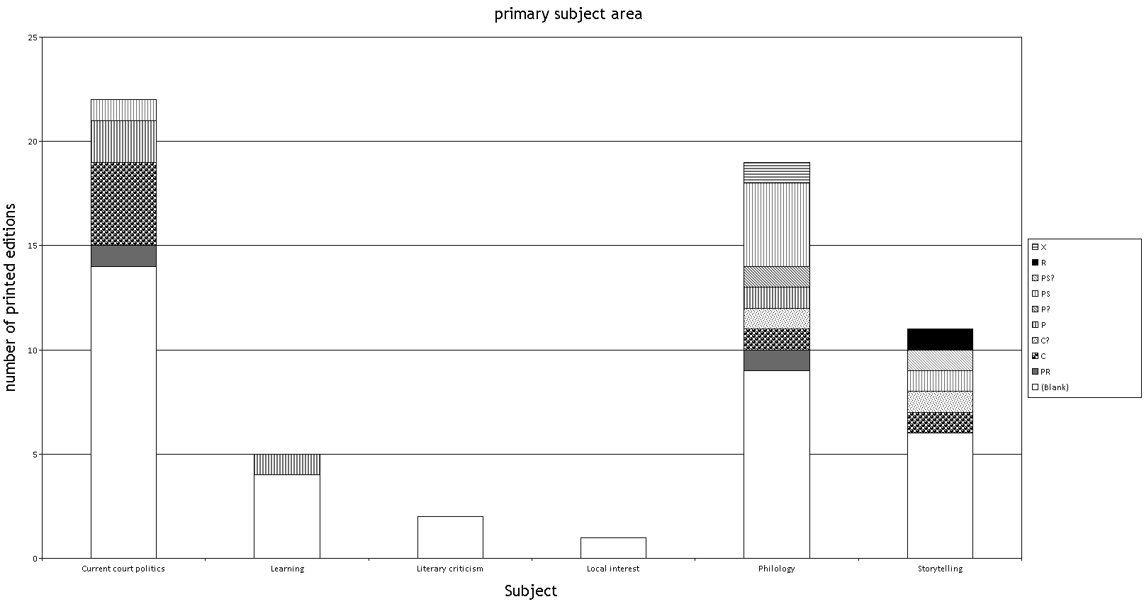
Table 16. Topical distribution (primary subject) of Song biji printed editions of twelfth-century titles, showing type of printer
Note: X stands for county; PS for prefectural school; P for prefecture or prefectural magistrate; P for private printer; C for commercial printer; C? suggests that a commercial printer is likely.

Slide 24
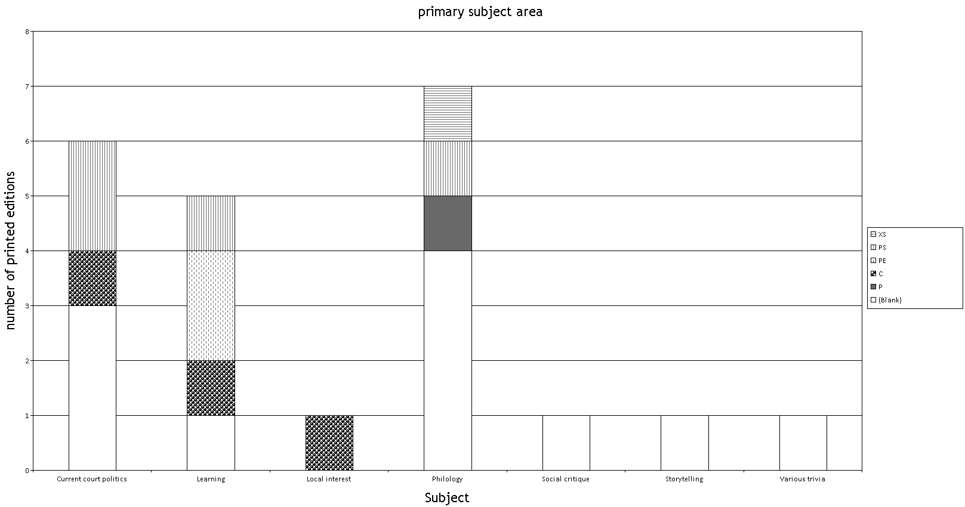
Table 17. Topical distribution (primary subject) of Song biji printed editions of thirteenth-century titles, showing type of printer
Note: XS stands for county school; PS for prefectural school; PE for prefectural education officer(s); P for private printer; C for commercial printer.

Slide 25
Table 18. Topical coverage (primary, secondary, and tertiary areas of interest) for biji titles printed in the twelfth century
Note: R stands for route (circuit); PS for prefectural school; P for prefecture or prefectural magistrate; PR for private printer and P? for a likely private printer; C for commercial printer; in other cases the suffix ? suggests that the relevant type of printer is likely.

Slide 26
Table 19. Topical coverage (primary, secondary, and tertiary areas of interest) for biji titles printed in the thirteenth century
Note: XS stands for county school; PS for prefectural school; PE for prefectural education officer(s); P for prefecture or prefectural magistrate and P? for a likely prefectural printer; PR for private printer; C for commercial printer; in other cases the suffix ? suggests that the relevant type of printer is likely.

Slide 27
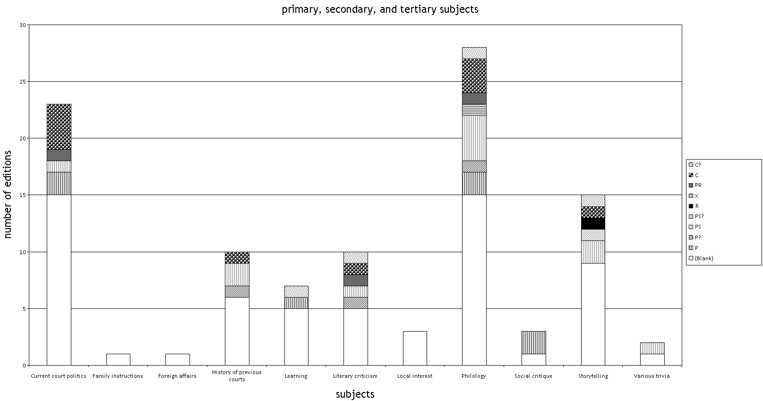
Table 20. Topical distribution (including primary, secondary, and tertiary subjects) of Song biji printed editions of twelfth-century titles showing type of printer
Note. R stands for route; X for county; PS for prefectural school; P for prefecture or prefectural magistrate; PR for private printer; C for commercial printer; the ? suffix suggests that the relevant type of printer is likely.

Slide 28
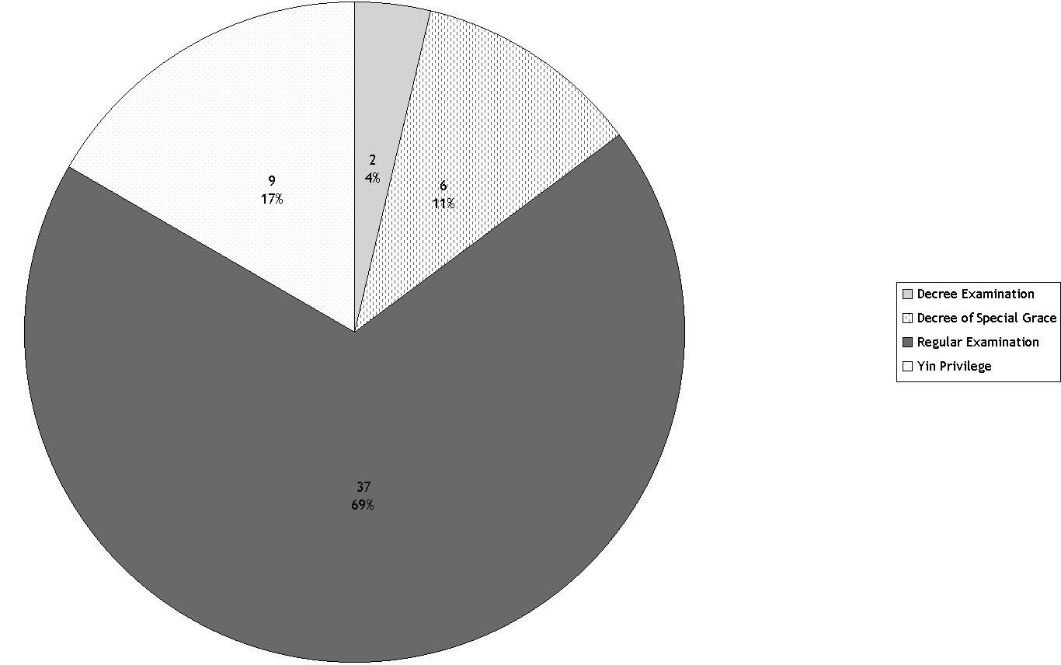
Table 21. Methods used to qualify for officialdom among Song notebook takers by percentage
Note. Absolute numbers are listed in the top row of the data labels on the chart. Methods used only in one case (including religious qualifications and recommendation) are not included (five instances); pre-Song authors (five in total with qualifications mentioned in only one case (regular and decree examinations)) are also excluded. As suggested by the latter example, authors could use multiple avenues to officialdom; the table therefore includes in some cases multiple methods for the same author.

Slide 29
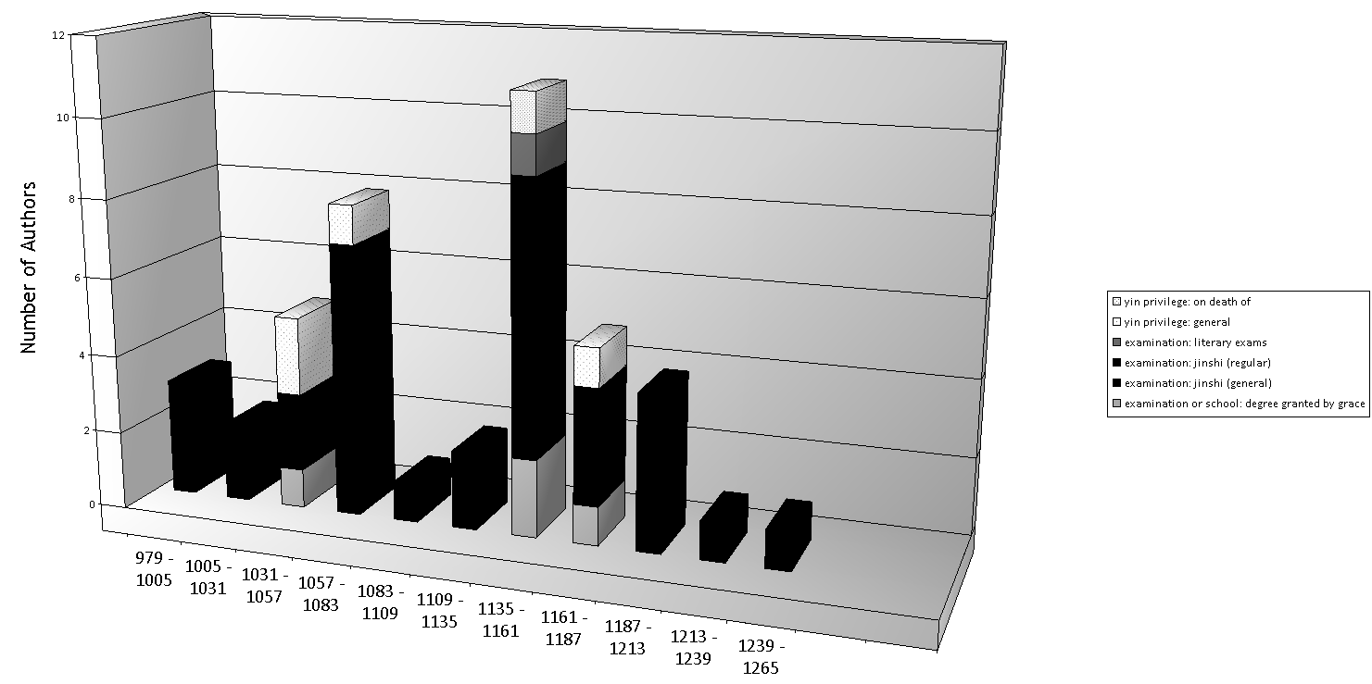
Table 22. Number of biji authors by type of entry into officialdom shown by date of entry

Slide 30
Table 23. Zhang Hui’s data on the official careers of Song biji authors (Reproduced from张晖, 宋代笔记研究, p. 47.)
 | Number of biji included | Official rank | Jinshi degree | Songshi bio
NS | 40 | 30 | 23 (22+1) | 25
NS-SS | 20 | 10 | 6 (5+1) | 2
SS | 67 | 40 | 17 (14+3) | 10
Total | 127 | 80 | 46 (41+5) | 37

Slide 31
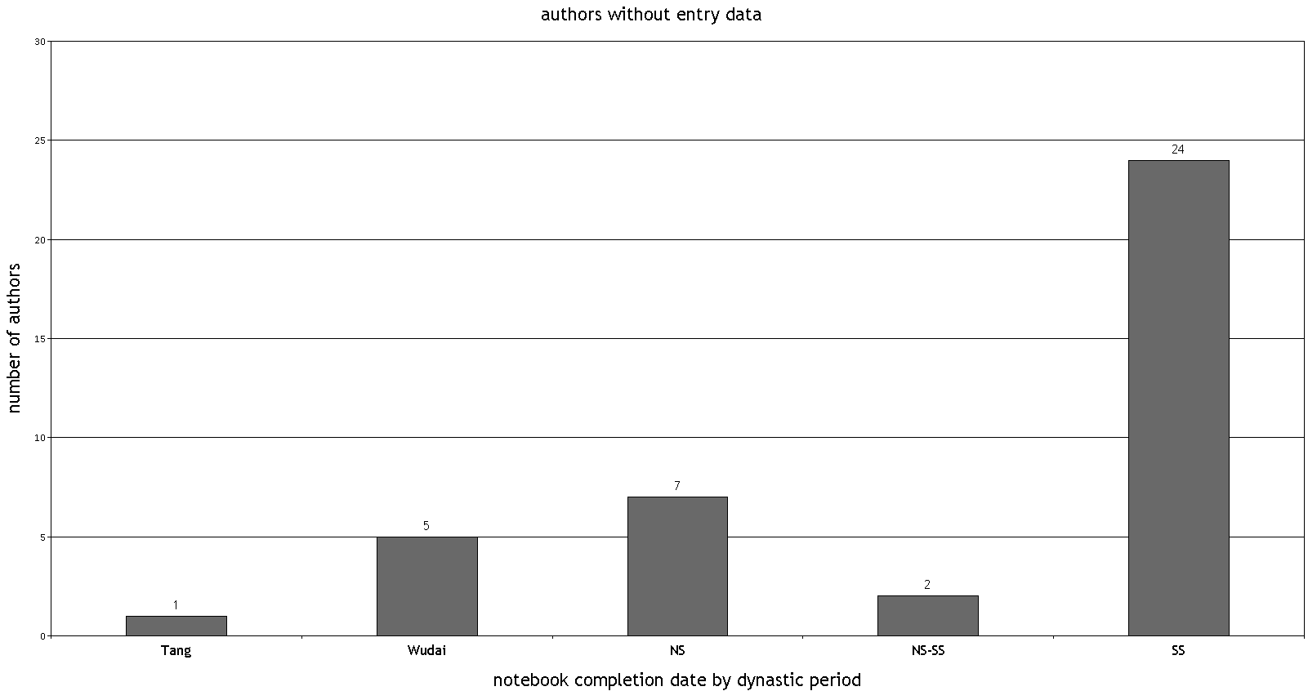
Table 24. Numbers of biji authors printed in Song times for whom no entry data exist in CBDB

Slide 32
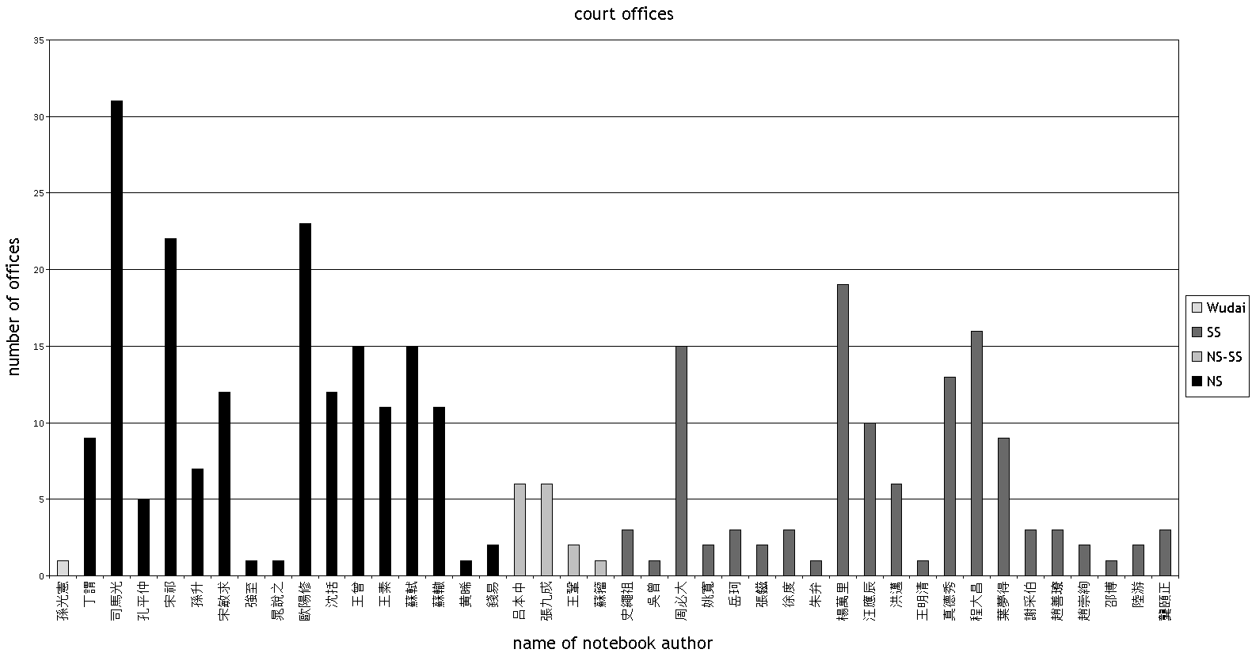
Table 25. Numbers of court offices held by authors of notebooks printed in the Song period arranged by author and color-coded on the basis of time on period of completion of notebooks included in Song Biji in Print

Slide 33
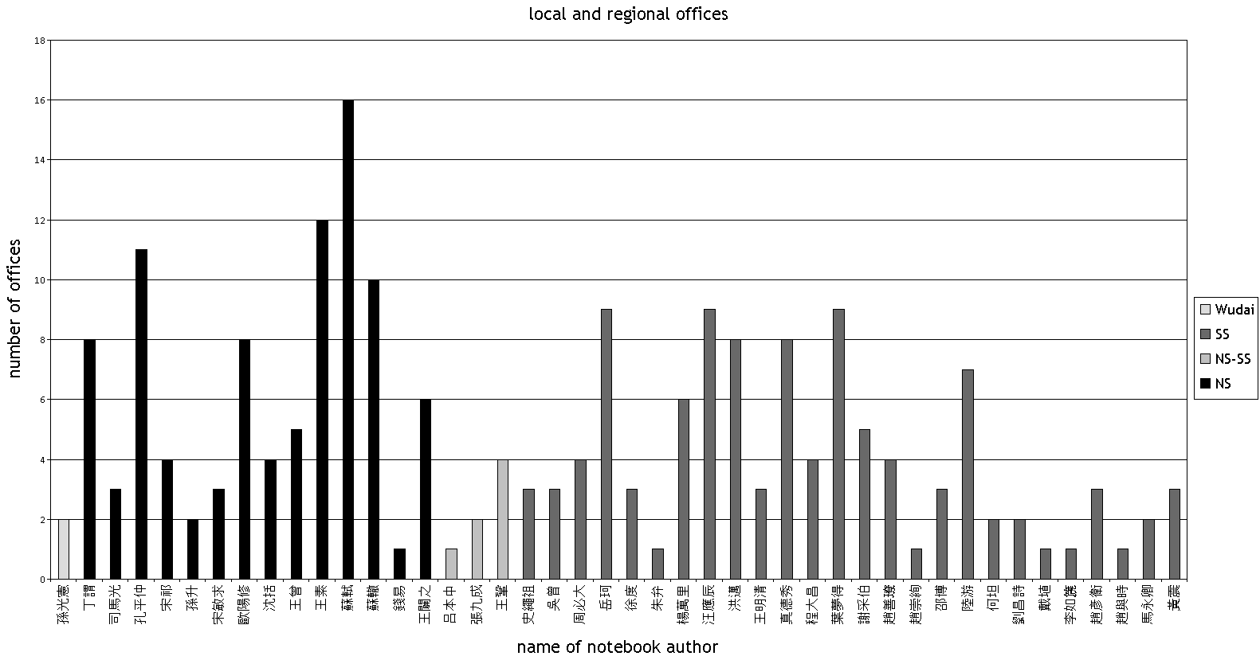
Table 26. Numbers of regional and local offices held by authors of notebooks printed in the Song period arranged by author and color-coded on the basis of time on period of completion of notebooks included in Song Biji in Print

