Slide 1
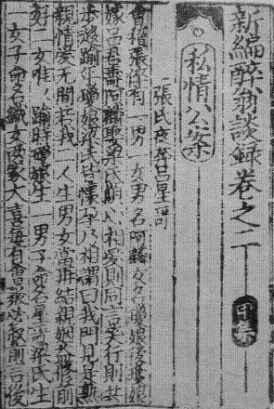
The Production and Circulation of ‘Written Notes’ (biji) –Tables and Figures
Hilde De Weerdt
University of Oxford
2009-2010

Slide 2
Introduction
This slideshow presents accompanying data for Hilde De Weerdt’s report, “The Production and Circulation of ‘Written Notes’ (biji),” in Michela Bussotti and Jean-Pierre Drège, eds., Imprimer autrement: Le livre non commercial dans la Chine impériale, forthcoming, 2010.
It introduces data compiled in Hilde De Weerdt’s “Biji in Print Database.” The database is a work in progress.
It presents an overview of the kinds of chronological, geographical, and topical analysis that the database sustains; it also demonstrates how these data can be combined with the prosopographical data contained in China Biographical Database (CBDB) to conduct analyses of the sociopolitical backgrounds of biji authors and producers. The original report also discussed the changing nature of the network ties among authors and producers; these results will be published in the future.

Slide 3
References and Credits
Hilde De Weerdt. “The Production and Circulation of ‘Written Notes’ (biji).” In Michela Bussotti and Jean-Pierre Drège, eds., Imprimer autrement: Le livre non commercial dans la Chine impériale, forthcoming, 2010.
Hilde De Weerdt. Biji in Print Database. Website under development.
Peter Bol et al. Hartwell China History Project GIS (1992-2001); and id., China Historical GIS (2001-). Data available at http://www.fas.harvard.edu/~chgis/ (last accessed Oct. 30, 2009)
Peter Bol et al. China Biographical Database Project (CBDB) (2004-). Data available at http://isites.harvard.edu/icb/icb.do?keyword=k16229&pageid=icb.page129708 (last accessed Nov. 22, 2009)

Slide 4
Table 1: Sample survey
Number of printed editions | Number of unique titles | Number of unique titles extant in Song print
117 | 83 | 53

Slide 5
Table 2. Number of biji imprints by dynastic period
Northern Song prints | Southern Song prints | Song prints
2 | 111 | 4

Slide 6
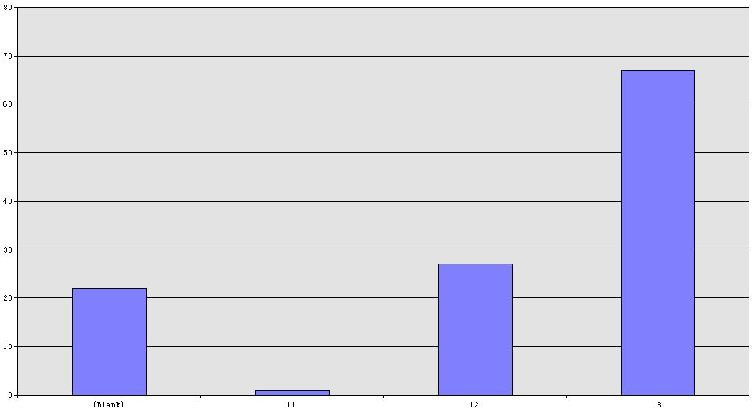
Table 3. Song biji printed editions by century in which they were printed
The vertical axis shows the number of printed editions; the horizontal axis the century of printing (blank indicates that the century of printing is unknown).

Slide 7
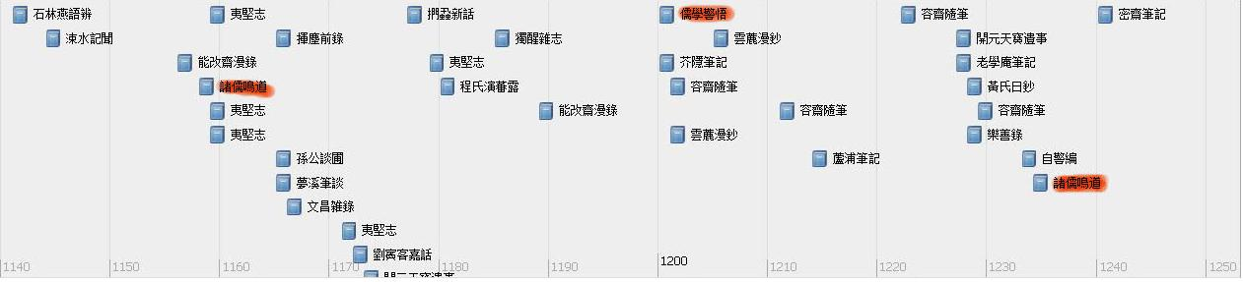
Figure 1. Timeline of datable biji printed editions, 1150-1250. Series are highlighted in red

Slide 8
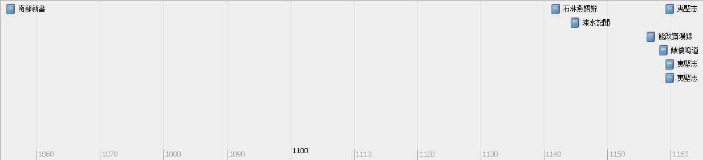
Figure 2. Timeline of datable biji printed editions, 1050-1160

Slide 9
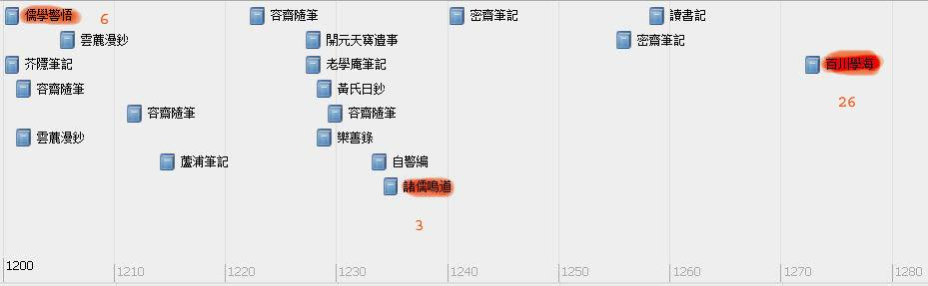
Figure 3. Timeline of datable biji printed editions, 1200-1280
Note: Series are highlighted and the number of biji in them is noted in red .

Slide 10
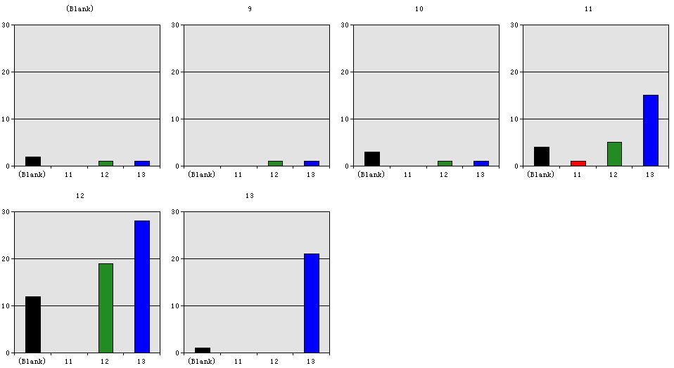
Table 4. Correlation between century of completion and century of printing for biji printed editions
Note: The horizontal axis shows the century of printing in all sub-tables; each sub-table charts the data for all titles completed in the century listed in the top bar. Blank indicates that the century of printing or completion is unknown

Slide 11
Table 5. Southern Song biji imprints by first publication date of the title
Tang | 2
Wudai | 4
Northern Song | 25
NS-SS transition | 6
Southern Song | 74

Slide 12
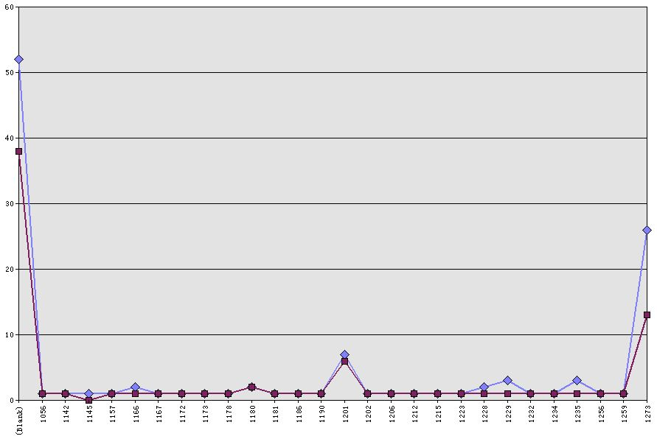
Table 6. Biji titles by year of completion and year of printing
Note: The upper curve traces the number of titles by year of printing; the lower one shows the number of titles by year of completion.

Slide 13
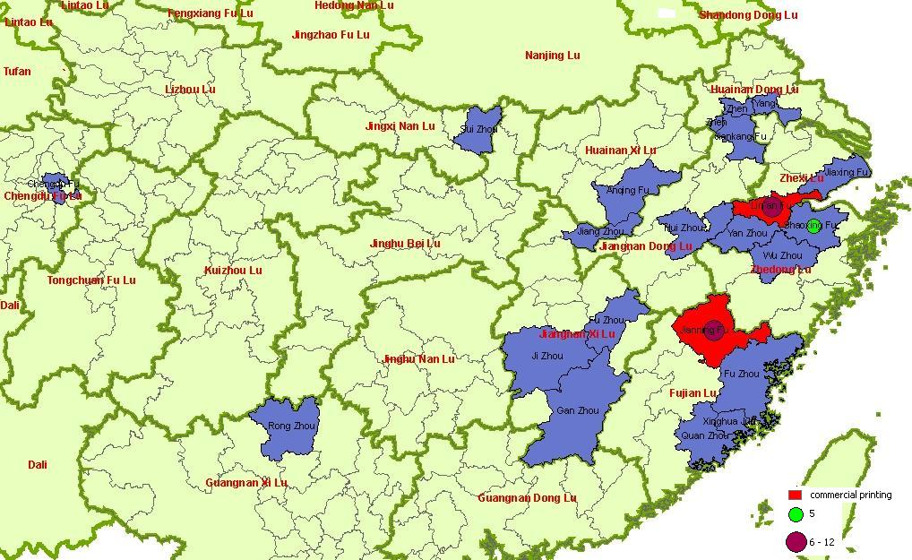
Figure 4. Map of Southern Song prefectures where biji were printed
Note: Circles mark prefectures where 5 or more titles were printed. Prefectures where commercial printers published biji are shown in red.

Slide 14
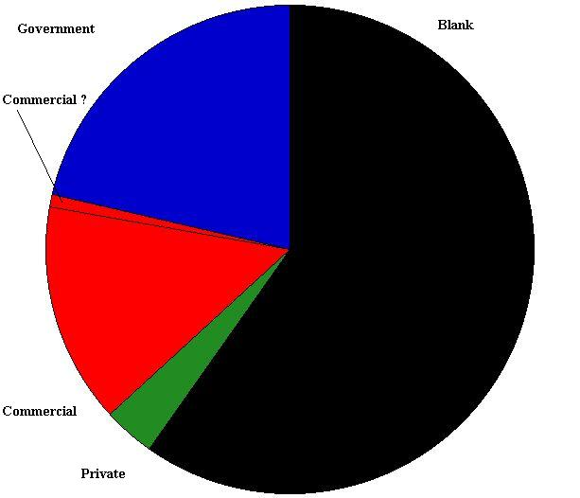
Table 7. Distribution of editions by type of printer

Slide 15
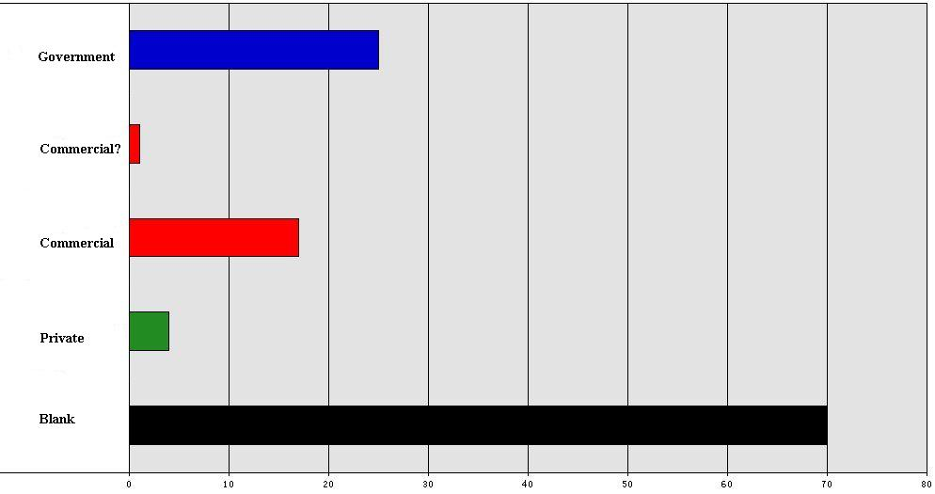
Table 8. Distribution of editions by type of printer
Note: The type of printer is unknown for the majority of editions.

Slide 16
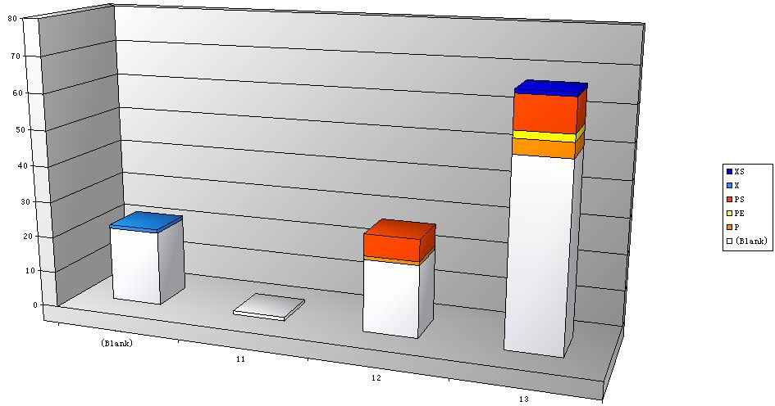
Table 9. Number of government imprints by century of printing showing sub-type of government printer
Note: X stands for county; XS for county school; PS for prefectural school; PE for prefectural education officer(s); P for prefecture or prefectural magistrate.

Slide 17
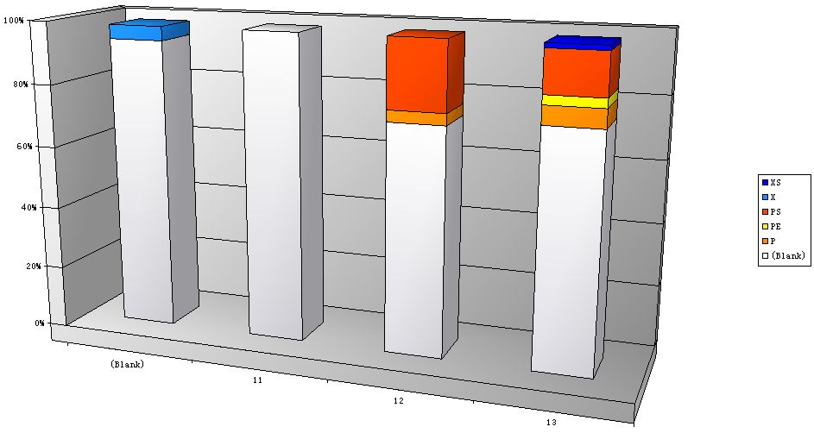
Table 10. Percentage of government imprints in total of printed editions by century of printing
Note: X stands for county; XS for county school; PS for prefectural school; PE for prefectural education officer(s); P for prefecture or prefectural magistrate.

Slide 18
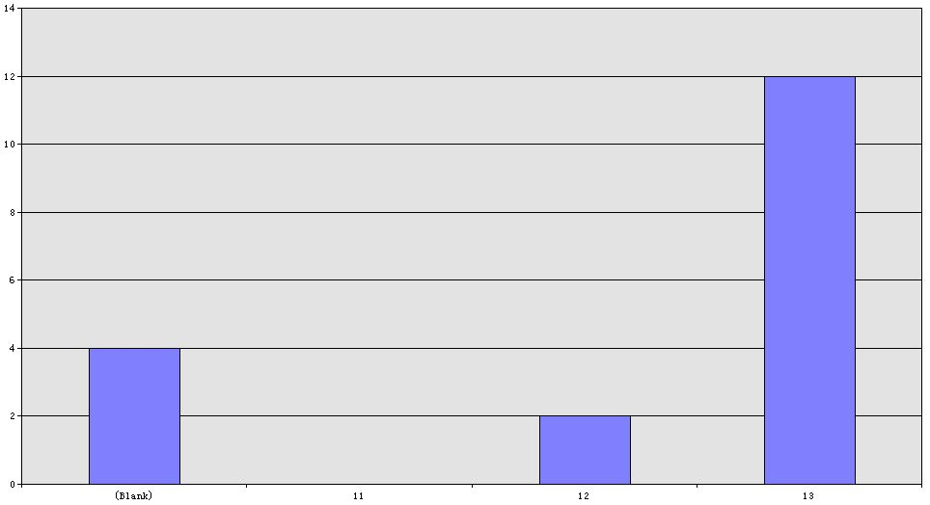
Table 11. Numbers of commercial imprints of biji by century of printing

Slide 19
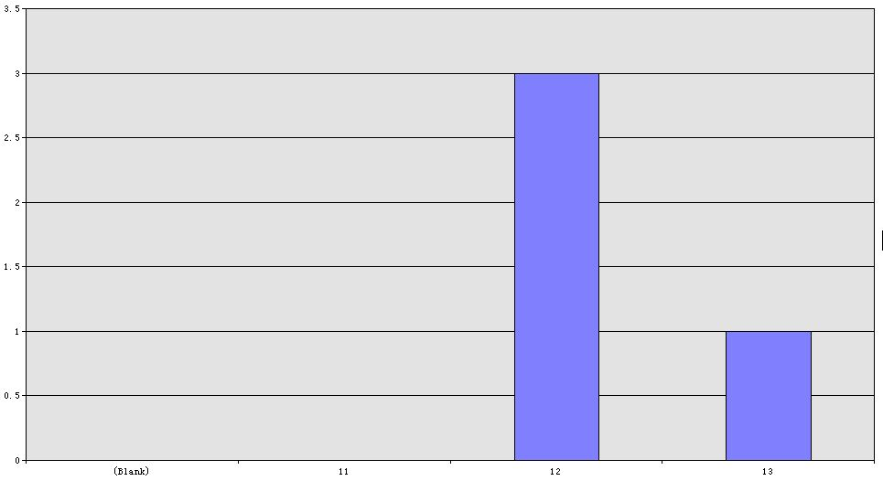
Table 12. Numbers of private imprints of biji by century of printing

Slide 20
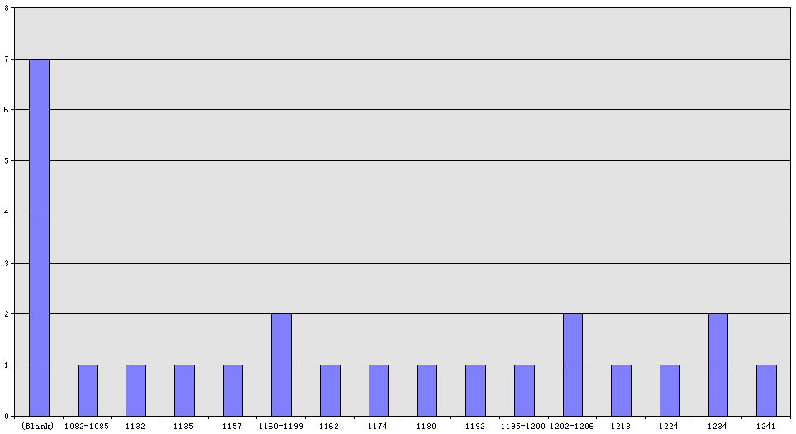
Table 13. Government imprints of biji by year of each title’s completion

Slide 21
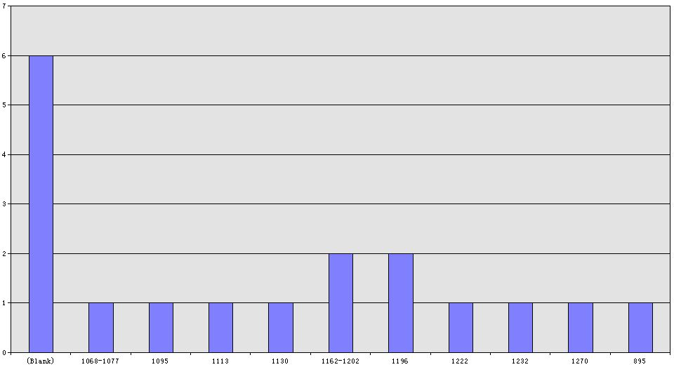
Table 14. Commercial imprints of biji by year of each title’s completion

Slide 22
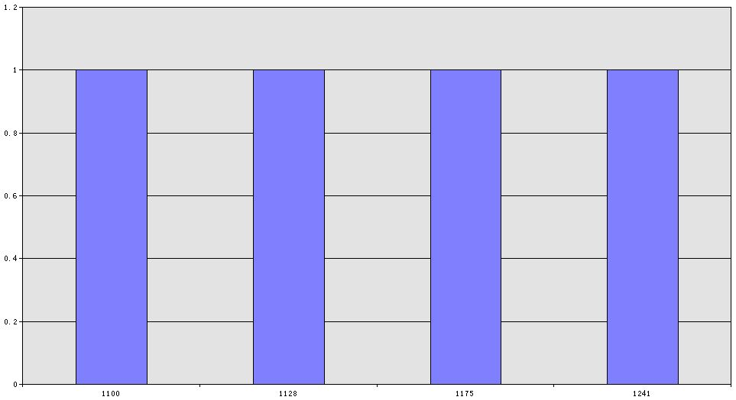
Table 15. Private imprints of biji by year of each title’s completion

Slide 23
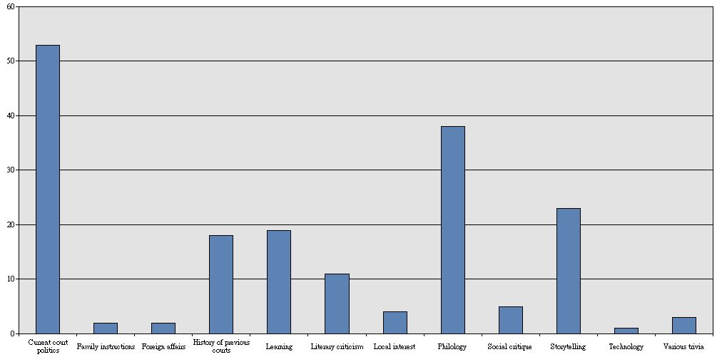
Table 16. Topical coverage (including primary, secondary, and tertiary topical areas) of biji printed in Song times

Slide 24
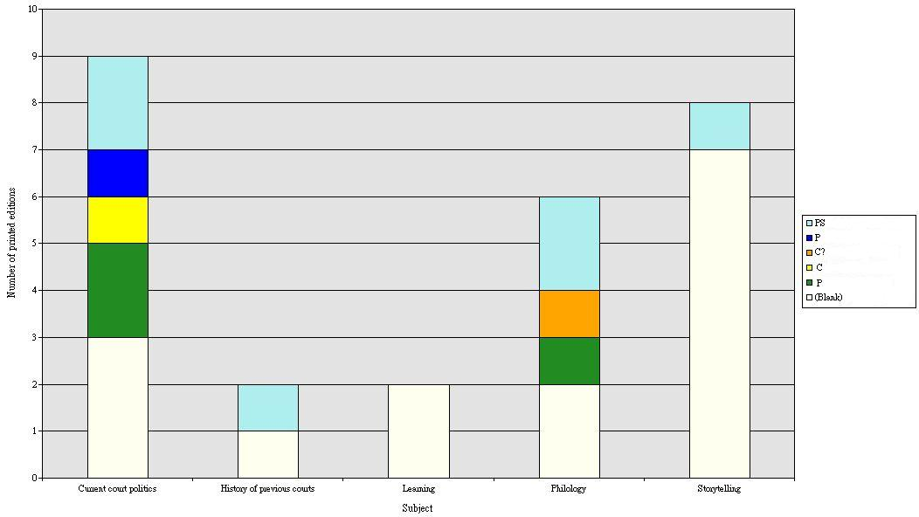
Table 17. Topical coverage (primary area of interest) for biji titles printed in the twelfth century
Note: PS stands for prefectural school; P for prefecture or prefectural magistrate; P for private printer; C for commercial printer; C? suggests that a commercial printer is likely.

Slide 25
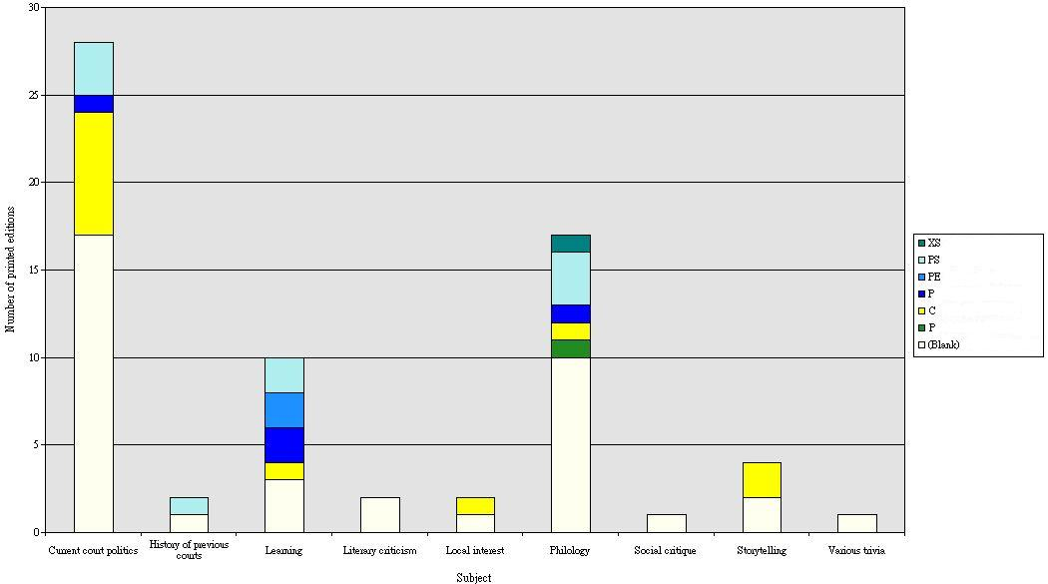
Table 18. Topical coverage (primary area of interest) for biji titles printed in the thirteenth century
Note: XS stands for county school; PS for prefectural school; PE for prefectural education officer(s); P for prefecture or prefectural magistrate; P for private printer; C for commercial printer.

Slide 26
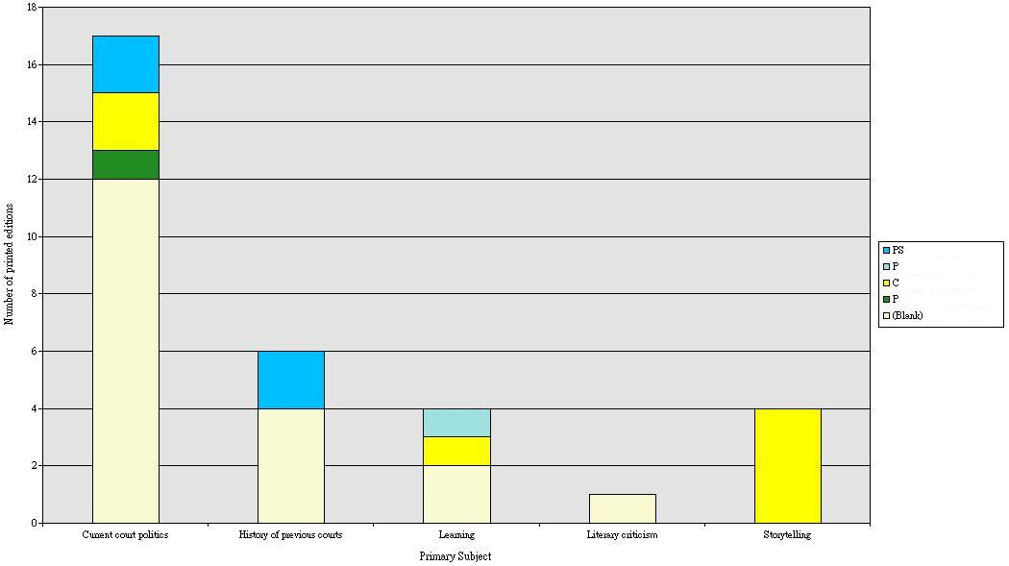
Table 19. Topical distribution of Song biji printed editions of eleventh-century titles, showing type of printer
Note: PS stands for prefectural school; P for prefecture or prefectural magistrate; P for private printer; C for commercial printer.

Slide 27
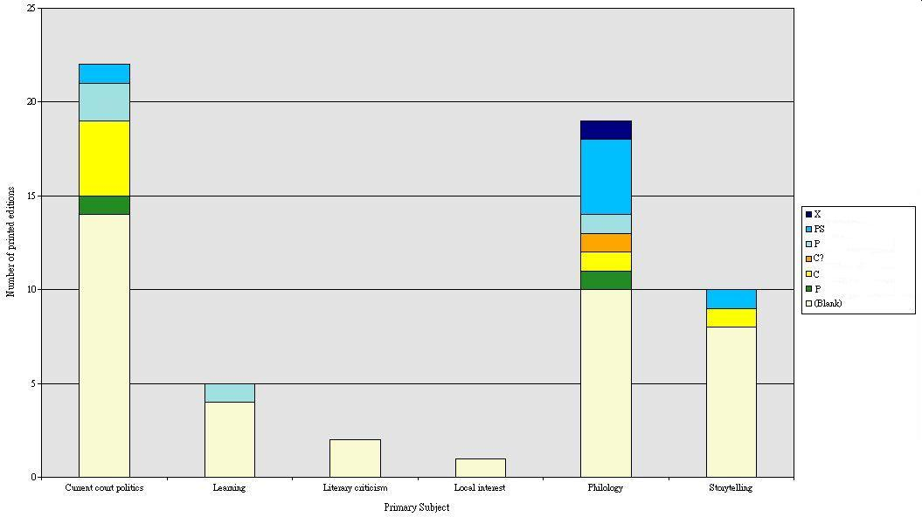
Table 20. Topical distribution of Song biji printed editions of twelfth-century titles, showing type of printer
Note: X stands for county; PS for prefectural school; P for prefecture or prefectural magistrate; P for private printer; C for commercial printer; C? suggests that a commercial printer is likely.

Slide 28
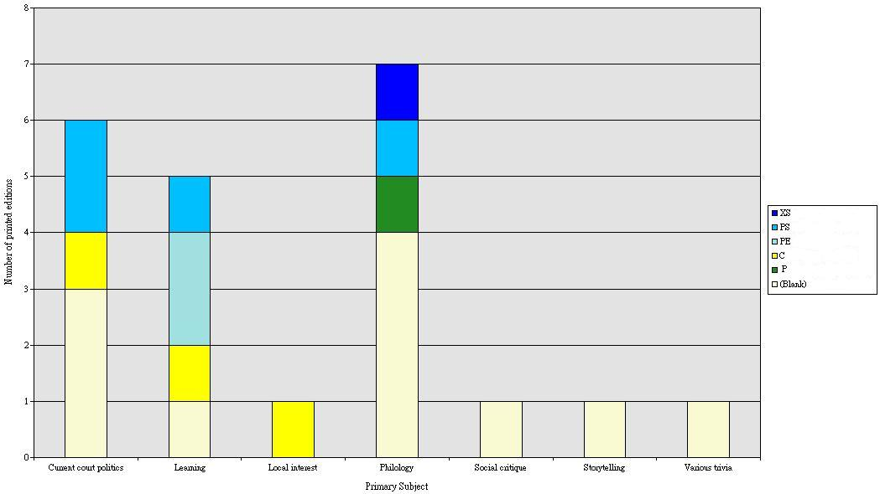
Table 21. Topical distribution of Song biji printed editions of thirteenth-century titles, showing type of printer
Note: XS stands for county school; PS for prefectural school; PE for prefectural education officer(s); P for private printer; C for commercial printer.

Slide 29
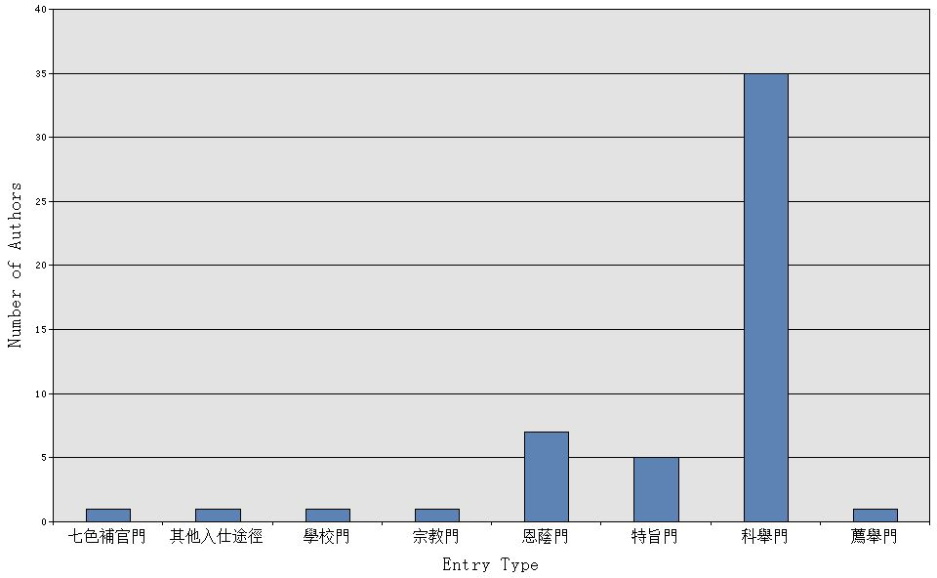
Table 22. Number of biji authors by type of entry into officialdom

Slide 30
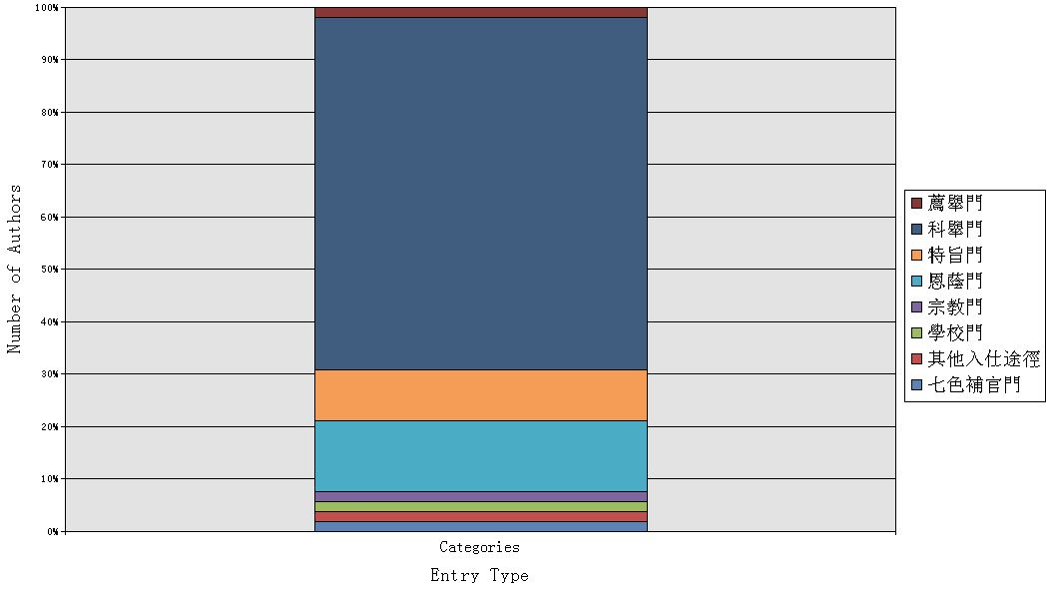
Table 23. Percentage of methods of entry into officialdom for Song biji authors

Slide 31
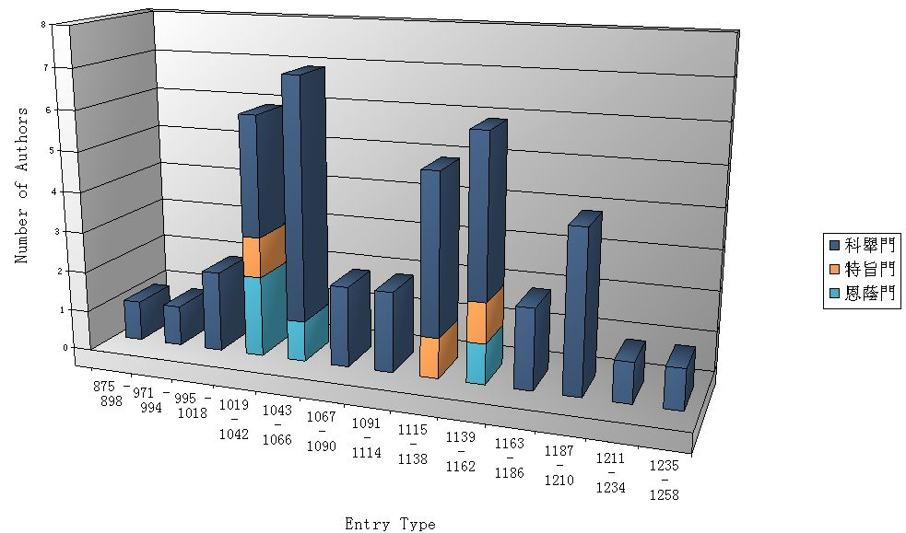
Table 24. Number of biji authors by type of entry into officialdom shown by date of entry

Slide 32
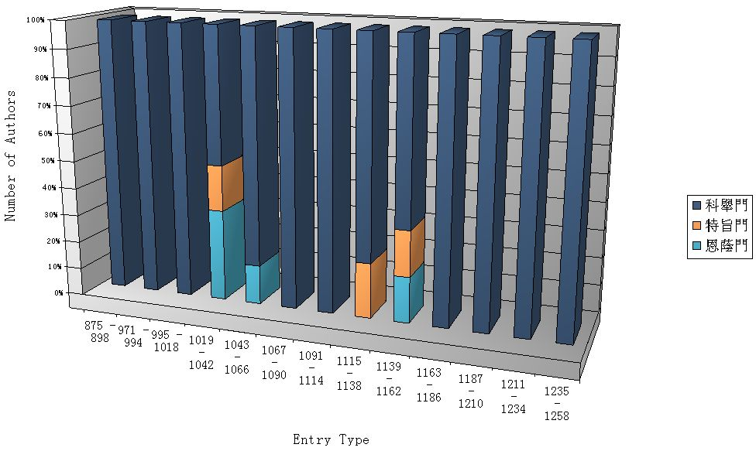
Table 25. Percentage of methods of entry into officialdom for Song biji authors by date of entry

Slide 33
Table 26. Zhang Hui’s data on the official careers of Song biji authors. (Reproduced from张晖, 宋代笔记研究, p. 47.)
 | Number of biji included | Official rank | Jinshi degree | Songshi bio
NS | 40 | 30 | 23 (22+1) | 25
NS-SS | 20 | 10 | 6 (5+1) | 2
SS | 67 | 40 | 17 (14+3) | 10
Total | 127 | 80 | 46 (41+5) | 37

Slide 34
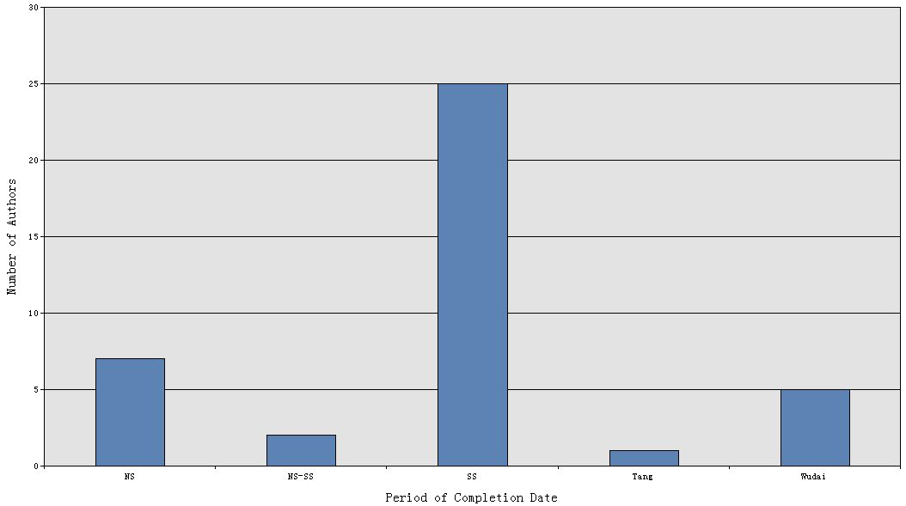
Table 27. Numbers of biji authors printed in Song times for whom no entry data exist in CBDB.

Slide 35
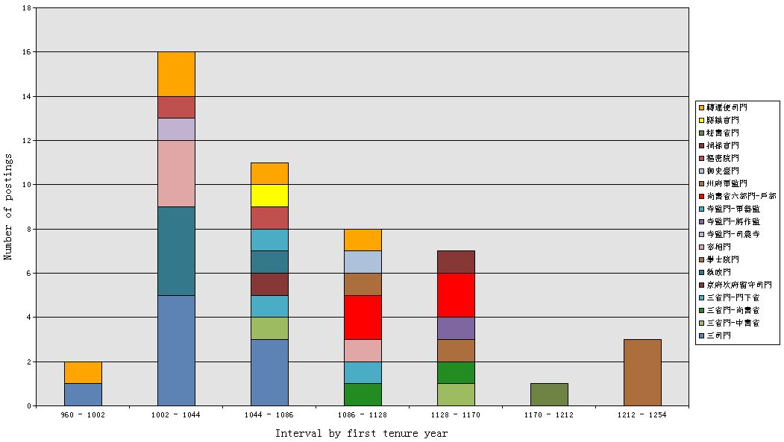
Table 28a. Number of court, regional, and local postings of printed Song biji authors in CBDB shown by the year in which the tenure commenced

Slide 36
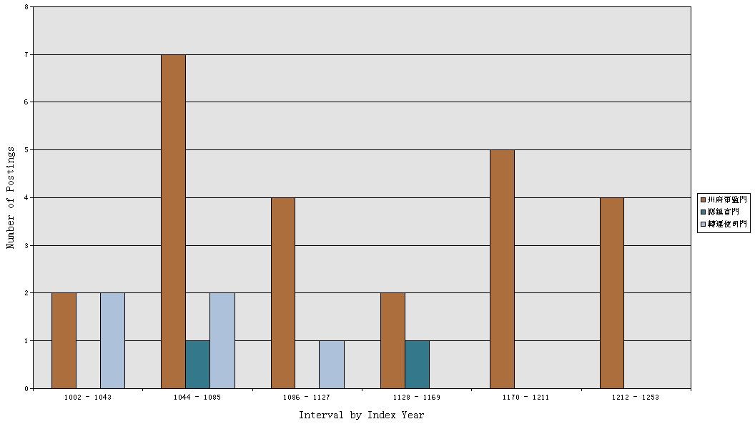
Table 28b. Number of regional and local postings by author’s CBDB index year

