Slide 1
Skills for IT specialists in digital preservation: a fourth lens for DigCurV?
VALA 2018, Melbourne
13 February 2018
Sarah Mason, Bodleian Libraries
Digital Preservation at Oxford and Cambridge, #DP0C

Slide 2


Notes:
Now when you hear Bodleian Libraries – you probably think I work in maybe one of these buildings – the ones that feature on the brochures and websites – the old buildings of Oxford
In reality….

Slide 3

Notes:
I work outside the main centre of town in this building – where most of the libraries’ major digital services are located – such at Bodleian Digital Library System and Services (where I work) – collections management team (cataloguing, acquisitions, including e-legal deposit)
We’re located along a section of the Thames known at the Isis – so we get a good view of the narrowboats going by. This is just for some context – also currently all of those trees are bare as it’s the middle of winter

Slide 4

What I am going to cover today
Digital Preservation at Oxford and Cambridge project
DigCurV and Skills for the Information Age (SFIA) frameworks
Job descriptions for IT specialists in digital preservations
Findings and gaps
Recommendations
Image source: CC Freepix.com
Notes:
And now – quick run through of what I will cover in next 20 mins
The project that I am a part of and where this research for the paper I am presenting today: Skills for IT specialists in digital preservation: a fourth lens for DigCurV
Then I am going to talk about the research I did for the paper, specifically the skills frameworks I looked at and the specific job descriptions I looked at for IT specialists
Then I will discuss what findings and gaps there were
And lastly some recommendations

Slide 5
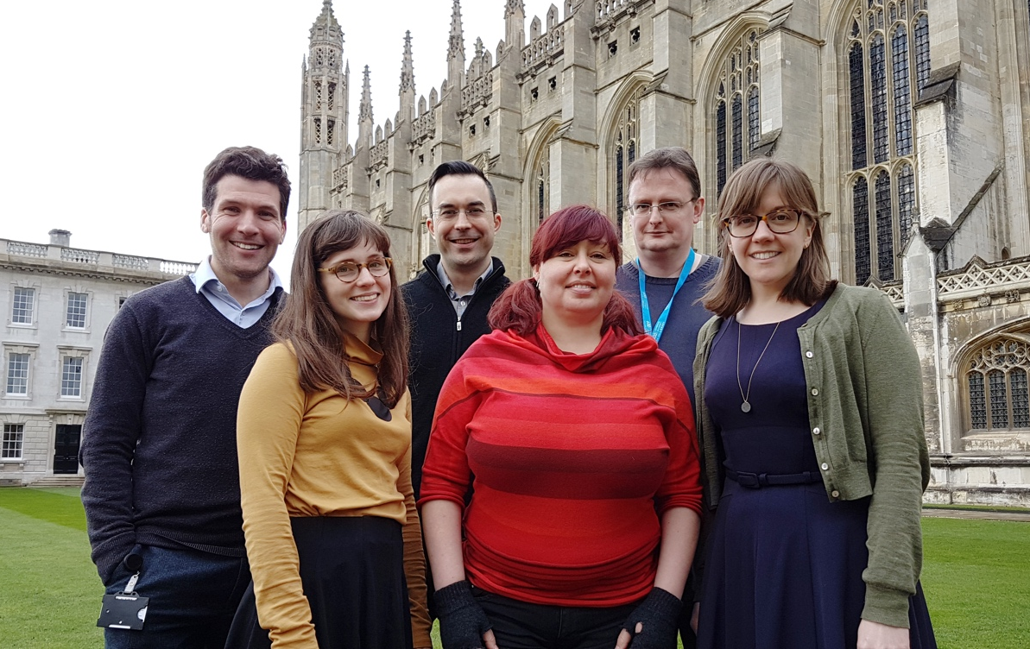
Digital Preservation at Oxford and Cambridge (DPOC) project
2 year project funding by the Polonsky Foundation
3 Fellows mirrored at each institution
Policy & Planning
Outreach & Training
Technical
Notes:
A little background on the project where this skills research came from - DPOC
2 year project funded by the Polonsky Foundation, running from July 2016 to July of this year – address digital preservation challenges at Bod & CUL
The idea was first discussed with the Polonsky Foundation after they had funded a number of large digitisation projects at each library – a worry over the long-term preservation and accessibility of their investment in these digital assets.
There are 3 Fellows mirrored at each institution (roles & name)

Slide 6
DPOC project outcomes
Policy and planning development and implementation
Development of expertise and training based on findings from skills audits and community outreach
Specification and implementation of technical tools and workflows that underpin digital preservation activities
Notes:
And those roles are specifically tied these major project outcomes
This approach to the project was unique, because the roles were designed to view digital preservation challenges holistically, rather than assuming the challenges and solutions were merely technical.
It recognizes that an out of the box technical solution is not digital preservation – it also addresses the organizational and resourcing issues are equally important. For my part role, this includes recruiting staff with the right skills, training existing staff for new work and seeing that job descriptions reflect digital preservation activities.

Slide 7
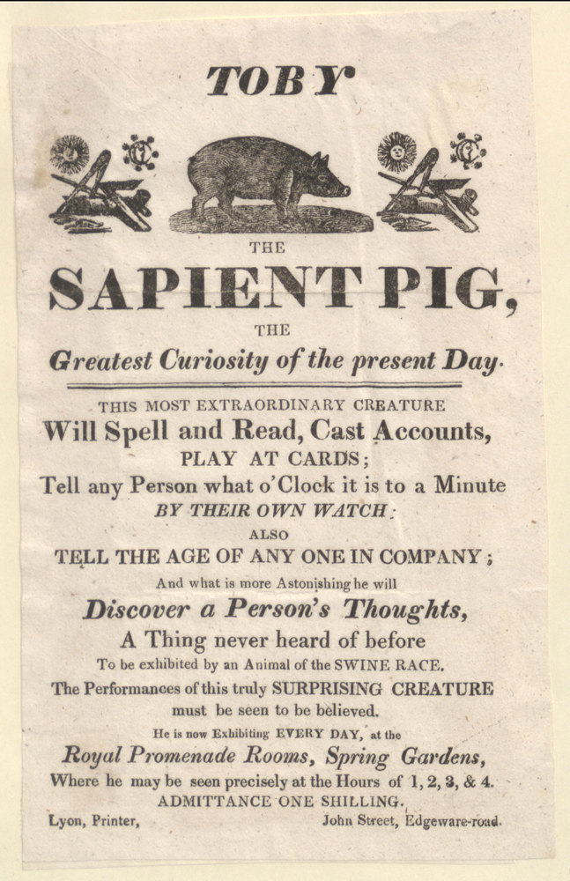
DPOC project phases
Phase 1: Auditing
  Digital collections
  Staff skills
  Technical tools & workflows
Phase 2: Implementation
  Training
  Digital preservation policy
  Workflow & tool recommendations
Image source: https://treasures.bodleian.ox.ac.uk/treasures/sapient-pig/
Notes:
In order to meet those project outcomes, the project has been split into two phases – an auditing phase and an implementation phase. We are currently near the end of the implementation phase
But, it’s not exactly an implementation phase anymore – it’s been more about trialing and piloting solutions, making recommendations for immediate workflow changes and business cases for longer-term work (hard to lead cultural change in 2 years)
But the work I am talking about today took place in the auditing phase – particularly the section about auditing staff skills, which not only include librarians & archivists, but IT specialists working with collections in BDLSS (many work on repository & access services)
it was during this phase where I developed skills audit surveys & interviews – and where I found the gaps in skills frameworks when it comes to understanding skills needed for IT specialists in digital preservation

Slide 8
Research goal – Phase 1
Understand the skills needed for digital preservation
Review reports & recent journal articles
Review existing skill frameworks
Review available job descriptions
Notes:
Now the main research goal carried out in the auditing phase was simple (CLICK) – and I started with looking at the skills for librarians & archivists
(CLICK) I started with the usual literature review
(CLICK) expanded on it through a review of existing skills frameworks, including ones from professional organisations including Chartered Institute of Library and Information Professionals and Archives and Records Association (UK centric) – they are very specific to their fields and they did not adequately reflect digital preservation skills and knowledge – however, a more specific framework that did cover digital preservation skills was the DigCurV curriculum framework (cover in a moment)
(CLICK) however, once I began scoping my interviewees, I began to realise that I needed to also look at skills for IT specialists, because they made up a part of the digital collection teams & services - so I reviewed available job descriptions to see what skills were most commonly sought after by orgs for these types of roles –

Slide 9
DigCurV curriculum Framework
Notes:
DigCurV - Digital Curator Vocational Education Europe - was an EC-funded lifelong learning initiative that ran until 2013
The aim was to support and extend vocational training for digital curation and preservation staff in libraries, archives and museums.
3 lenses: Executive, Manager, Practitioner (see it here) – that focuses on skills for associated roles – based on job responsibilities, NOT job title – there are progression pathways through the different lenses (hands-on, project, strategic)
110 different skills and attributes are spread across the different lenses in DigCurV under 4 skill categories: Knowledge/Intellectual Abilities, Personal Qualities, Professional Conduct, Management/Quality Assurance

Slide 10
Level of competency required per skill
Skill descriptor and definition
Notes:
The skills are are assigned to the different lens reflect the level of expertise required for the role – ranging from awareness, to understanding to being able to do
Each skill is assigned a unique code or skill descriptor (you can see KIA 1.1 and 1.2 right there)
Skills descriptors are also given a definition to help provide additional context of each skills
Fairly good basis for the skills audits with librarians/archivists and the other more traditional roles in Bodleian

Slide 11

But what about IT staff?
Does DigCurV work for them?
Notes:
As we know digital collections are changing the relationship between librarians, archivists and IT staff – IT specialists are often responsible for the development and maintainence of digital repositories and access web applications – both of these rely on digital preservation principles and activities to support long-term accessibility – these roles range from devs & software engineers, to sys admins, front end/UX devs and technical analysts.
Therefore, to get the best out of our digital services, IT specialists not only need to work with librarians and archivists closely (especially those with digital preservation expertise), but they also need to have an understanding of the core concepts, tools, lifecycles and activities that encompass digital preservation.
Does DigCurV really fit that? Well, based on my research, I concluded not really.

Slide 12
Job descriptions
Sample number | Year | Institution | Job title
1 | 2017 | Cambridge University Library | Senior Software Developer
2 | n.d. | DuraSpace | Senior Software Developer
3 | 2017 | Preservica | Senior Java Developer
4 | 2017 | University of Virginia Library | Senior Developer, Scholar's Lab
5 | 2016 | British Library | Technical Analyst
6 | 2017 | Wesleyan University Library | Associate University Librarian for Technical and Digital Services
7 | 2015 | Texas Digital Library | TDL Software Engineer
8 | 2017 | Wake Forest | Developer for Digital Scholarship
9 | 2017 | Virginia Tech | Software Engineer (Lecturer)
10 | 2017 | University of Hull | City of Culture Digital Archive Software Developer
11 | 2016 | National Library of Wales | ARCW Software Developer
12 | 2016 | Stanford University Libraries | Digital Library Software Engineer - Linked data engineer
13 | 2017 | University of Colorado | Digital Library Software Architect
14 | 2017 | Boston Public Library | Digital Repository Developer
15 | 2018 | Oregon Health & Science University | Repository Librarian
16 | 2018 | Emory University | Software Engineer
17 | 2018 | Hamilton College | Discovery & Delivery Systems Analyst
18 | 2018 | University of British Columbia | Programmer Analyst I
19 | 2017 | Rhizome | Senior Backend Developer
20 | 2017 | MOMA | Digital Repository Specialist
Notes:
This is where job descriptions were useful – because it helped to determine the suitability of DigCurV for assessing IT staff skills
I originally looked at 14 positions, but since the original paper – another 6 have been reviewed (total of 20). They were selected if they:
involved working with a digital repository,
working on the development of web applications for accessing digital materials,
in commercial enterprise developing digital preservation software, or
the job descriptions involved some combination of these criteria.
I used them to assess the usefulness of using DigCurV as a basis for a skills audit framework for IT specialist staff at BDLSS…this would provide me with information to identify gaps where training would help ready them for more digital preservaiton work

Slide 13
DigCurV for IT skills
Notes:
So, what I found in the assessment was that some sections that were useful, but that a lot was missing:
This chart shows the number of times a DigCurV category was present in the essential and desirable criteria for each job descriptions – some categories showed up multiple times (a single selection criterion could contain multiple skills as well):
100% of jobs had at least some kind of communication component – presenting at meetings, writing communications to all staff, managing stakeholder relationships or communicating technical ideas to a non-technical audience
Information skills (KIA 4, orange) was high because of the high number of developer descriptions involved with we applications for accessing and searching digital collections
45% of jobs listed familiarity or experience with various metadata standards in the selection criteria
36% had a training component
Resource management was also high because every role at least had one skill related to project management
Subject knowledge was the highest, not least because of the previous experience, but for another reason -

Slide 14
DigCurV for IT skills
KIA 1.8: Select appropriate technological solutions
KIA 1.9: Apply appropriate technological solutions
KIA 1.15: Information technology definitions and skills
Notes:
The reason for the high number selection criteria matching to KIA 1: Subject knowledge is that it was the only category to explicitly discussion technical skills – however they fall into these three broad categories you see here.
Most skills had to be pigeon holed into these three categories because there was nothing more granular – surprisingly, not more of those technical data skills related to data skills, which includes understanding database structures in it – it is possible that these would be required, but not listed in the selection criteria for some reason.
Due to the lack of granularity or suitability of the skill descriptors for IT skills there was a high subject knowledge count – and led me to think that it might not be suitable for forming the basis for the skills audit – some of the selection criteria were not suitable for mapping to DigCurV either and were not included in the mapping (skills like problem solving, adaptability & continuous learning/responsbility over own professional development)

Slide 15
If not DigCurV then what?
Notes:
So if DigCurV doesn’t work, what might?
Enter the Skills for the Information Age (SFIA) Framework

Slide 16
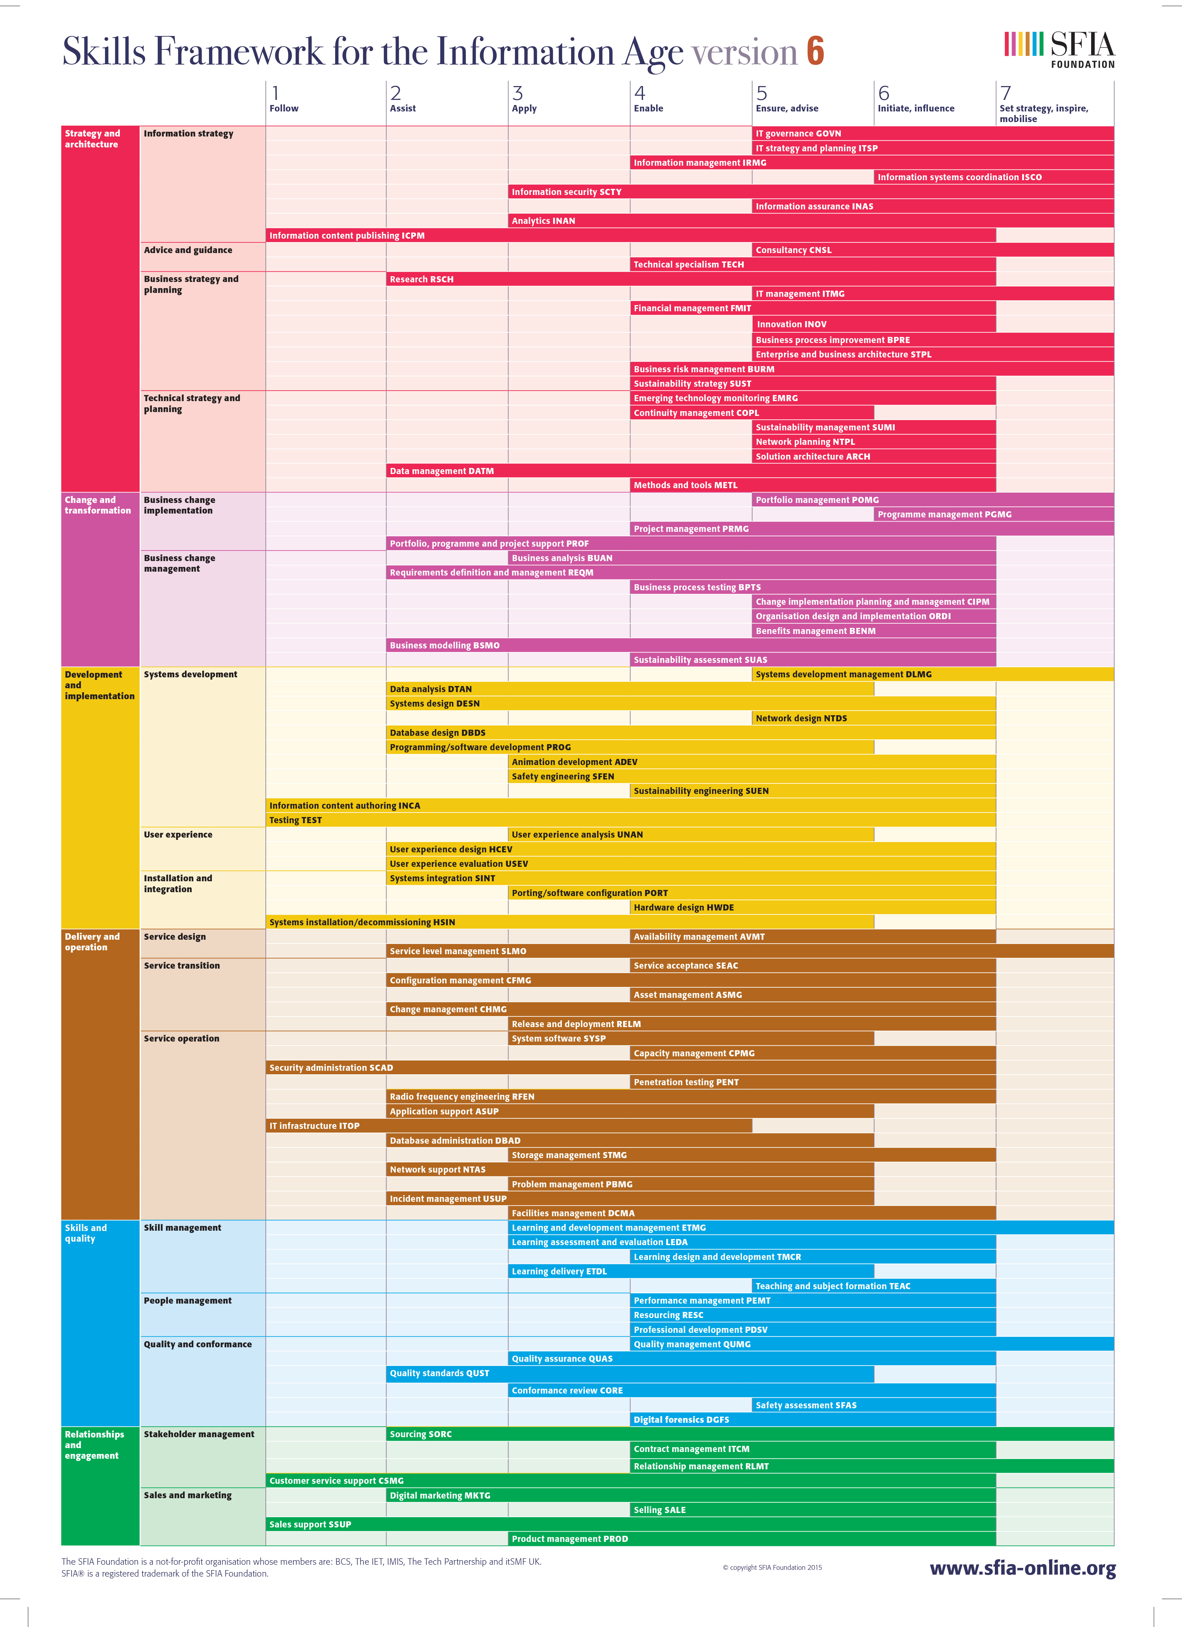
SFIA 6 Framework
Six Skill Categories
Seven Levels of Responsibility
Notes:
The SFIA Framework was created by the non-profit SFIA Foundation in 2003 – now in version 6.It is intended as a competency framework for people who “manage or work in information systems-related roles of any type” – so one could conclude that it might be suitable for jobs with a digital preservation component in libraries and archives (CLICK)
The SFIA framework forms the foundation of other frameworks worldwide including – the BCS (Chartered institute for IT), the Australian Computing Society and the IEEE computer society uses the framework to define professional skill levels for their educational products. It is a well used framework for writing job descriptions in government agencies, such as the National Records of Scotland
There are 97 skills in six categories and 17 subcategories – and like DigCurV not all skills correspond to every level of responsibility - instead of 3 lenses, 7 levels – each skill has a unique code (like DigCurv) & comprehensive descriptions of the skill and what it should be like at each level

Slide 17
Comparing the Frameworks
 | SFIA 6 | DigCurV
Skill and code | Digital forensics (DGFS) | Is able to execute analysis of and forensic procedures on digital objects (KIA 5.4)
Definition | The collection, processing, preserving, analysing, and presenting of computer-related evidence in support of security vulnerability mitigation and/or criminal, fraud, counterintelligence, or law enforcement investigations. | PRONOM & DROID Library of Congress directory of digital formats Technical metadata extraction practice and tools such as JHOVE, JHOVE2 National Library of New Zealand metadata extractor Apache Tika
Level(s) or Lens | Level 4: contribute to investigations, process and analyse evidence Level 5: conducts investigations, communicates findings to stakeholders Level 6: sets policies and standards | Practitioner lens only (is able to)
No analysis of digital objects – pure forensics
What about forensics?
Notes:
There was some overlap when the frameworks were mapped together. But it was limited in part to DigCurV’s generic view of technical skills and SFIA’s very in-depth look at technical skills.
Quite a bit of synchronization with DigCurv’s Risk Management and Resource Management sections – unsurprisingly
But as you can see in the example, mapping was sometimes problematic – at first glance they are almost the same thing right? Both about digital forensics
BUT DigCurV also mentions analysis of digital objects – meaning looking at the files, validating, characterising, extracting important metadata, identifying the file, not just using forensic methods to preserve the authenticity of the digital object
SFIA is only concerned about the methods for evidentiary value, mainly for legal reasons – archival principles don’t factor into it

Slide 18
Comparing the Frameworks
 | SFIA 6 | DigCurV
Skill and code | Digital analysis (DTAN) | Is able to execute analysis of and forensic procedures on digital objects (KIA 5.4)
Definition | The investigation, evaluation, interpretation and classification of data, in order to define and clarify information structures which describe the relationships between real world entities. Such structures facilitate the development of software systems, links between systems and retrieval activities. | PRONOM & DROID Library of Congress directory of digital formats Technical metadata extraction practice and tools such as JHOVE, JHOVE2 National Library of New Zealand metadata extractor Apache Tika
Level(s) or Lens | Level 2: applies data analysis and data modelling Level 3: applies data analysis and data modelling; advises database engineers Level 4: investigates data requirements, ensures compliance Level 5: sets tools standards, manages investigations | Practitioner lens only (is able to)
Lacking preservation planning
No data modelling (KIA 5.3)
Notes:
And then trying to match DigCurV 5.4 with SFIA’s data analysis skill isn’t much better – You would assume it would map well because DigCurV is about analysing the data after all
Yes, but SFIA is slightly different – data analysis has an aim to be used for data modelling – managing the relationships between the data and real world entities – it is not about the analysis the technical aspects of data for preservation planning – or about understanding the risks of caring for that particular file over time (what is the file format, compression, etc)
On the other hand DigCurV does not explicitly address data modelling – the closet it comes is in database structures and types in KIA 5.3 (another data skill)

Slide 19
Findings - gaps
DigCurV | SFIA 6
Framework does not consider IT specialist roles Skills can be very vague & not all of them have definitions to provide clarity Progression pathways are not always clear Lacks common personal qualities Problem solving Managing own learning & development Not regularly updated
Notes:
When comparing the frameworks, a number of gaps appeared:
DigCurV is really aimed at CEOs, librarians/digital archivists, research data managers and research data librarians - where are the IT staff that heavily support the services?
Skills like (KIA 1.9: apply appropriate technology – are far too general, even if that is the intention – also many lack clarity from definitions
Progression between lenses is not clear – for example Managers should understand digital curation tools, but Practitioners do not? Are they not the ones using them
Lack skills found in over 64% of IT specialist job descriptions – meaning additions would certainly need to be made
Hasn’t been updated since 2013 – no plans to

Slide 20
Findings - gaps
DigCurV | SFIA 6
Framework does not consider IT specialist roles Skills can be very vague & not all of them have definitions to provide clarity Progression pathways are not always clear Lacks common personal qualities Problem solving Managing own learning & development Not regularly updated | Lacks specific references to digital preservation Data Management (DATM) skill only references managing in-house, in-use information No references to the management of collected data that will be used & managed in a way different from creation
Notes:
When comparing the frameworks, a number of gaps appeared:
SFIA clearly lacks any references to digital preservation and does not acknowledge any of the terminology or go into enough detail around data skills, such as analyzing, validating & characterizing file format types
While the data management skill has some references that would align well with digital preservation skills – they only refer to the management of in-house, in-use information
No references anywhere about the management of collected data - This collected data is used and managed in a way different than it was originally intended; this needs to be reflected in standards and processes that make it slightly different to data management
DP is a jargon heavy field – said time and time again. SFIA could be lacking in digital preservation terms/concepts because the concepts are more obscure when translated into the language of the SFIA network – meaning something is lost if we cannot translate it better than we do.

Slide 21
So what can we do?
Notes:
I have 4 reccommendations

Slide 22
Changes to DigCurV
DigCurV skill descriptor | Current Practitioner Lens level | Proposed Practitioner – Technical Lens level
KIA 4.2: how to support information access and sharing | Understands | Is able to
KIA 2.3: articulate benefits and long-term value of collections | Is able to | Is aware of
MQA3.11: plan and implement sound staff training and development | (Manager lens only) | Is able to
KIA 5.3: database types and structures | Understands | Is able to (create & manage)
PQ 2.9: communication protocols for designated community | Understands | Is able to (initiate & apply)
Notes:
Fourth lens have been suggested for DigCurV before – including IT specialists, records creators or recordkeepers
There is potential to explore a 4th lens for DigCurV – however, due to the strong overlap in many of the skills, a better proposal might be to add a technical level the existing lenses. This would also offer a progression pathway for librarians that want to move in to more IT focused roles in their digital collections.
But since DigCurV is not regularly updated – there have been no changes to it since project completion in 2013 – it might not be the most suitable place to explore digital preservation skills for IT specialists

Slide 23
SFIA 7 consultation phase
Notes:
Since the SFIA framework is both commonly used in ICT professional development and in job descriptions and updated via public consultation regularly, it would be worth getting more people to lobby for the inclusion of more digital preservation specific skills and the amendment of some current skills to reflect more digital preservation activities.
They are currently developing SFIA 7 – and all comments and changes requests are open for review. You can sign up and have your say and comment on other change requests.
When you consider the digital preservation is not just a library issue – having more ICT staff with digital preservation knowledge will serve banks, businesses, hospitals, governments and archives as well.

Slide 24
Improving job descriptions
Sample number | Does it mention digital preservation? | In institutional background? | In selection criteria? | Required criteria? | Desired criteria?
1 | X |  | X |  | X
2 | X | X
3 | X | X
4
5 | X | X | X | X
6
7
8
9 | X | X
10 | X | X
11 | X | X
12 | X |  | X |  | X
13 | X | X | X | X
14 | X | X
15
16
17 | x
18
19
20 | x
Total | 12 | 8 | 4 | 2 | 2
Notes:
So many people tell me they cannot go on a training course – because it’s not in their job description. Conversely, I also have heard “don’t you do the digital preservation later?” when it comes to adding digital preservation activities into repository services – but it’s not, they have an active stake in it as well
60% of job adverts included digital preservation somewhere in the job description, but only 20% had any mention in selection criteria, that figure rises to 30% if you look at ones that mention skills that are heavily related to digital preservation (such as fixity, digital forensics)
Job descriptions that do not adequately reflect digital preservation in selection criteria means that those skills will not be recruited for. If digital preservation isn’t even mentioned in job responsibilities then staff will unlikely receive training and will unlikely consider it their responsibility– a lack of THIS is why developers and senior IT staff decide to turn off checksumming in a digital repository – because they don’t see it as important & only care about speed of service (but it does matter, those checksums are what we can use to prove our file remains unchanged)
JDs are how we recruit & how we provide need for training, they must adequately reflect the need for DP skills – otherwise what what good is DI is we don’t expect any staff to be responsible for it?

Slide 25

Higher education courses
Image source: Freepik.com
Notes:
Ultimately – as IT specialists and librarians work closer and closer together – we could aim to build these links earlier on in higher education to prepare the entire workforce for preserving the output of our digital world – as librarians, we are not the only ones who need to be responsible.
Computer science courses should contain a module on digital preservation in libraries, archives, businesses and government
Librarian courses should move away from foundational digital environment courses that teach only Web 2.0 to things that include more introductory computer science concepts – more hands on instruction would also be beneficial
Some courses are moving in this direction, but we need to advocate further – even get professional bodies involved – in many cases information management course already fall under the IT departments – so perhaps there should be greater student involvement - the sooner the two work together and build common languages, the better for digital libraries and digital preservation in general – the better for our digital collections

Slide 26
How do you think we can get IT specialists the necessary skills to ready them for digital preservation activities?
And how do you think we can give librarians the IT skills for digital preservation?
Notes:
So, these are my questions to leave you with -

Slide 27
Thank you:
Any questions?
Sarah.mason@bodleian.ox.ac.uk
@DigitallySarah @BDLSS #DP0C
www.dpoc.ac.uk

