Slide 1
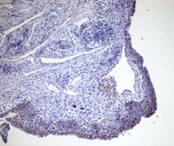
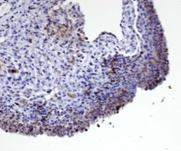
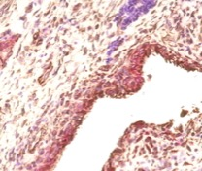
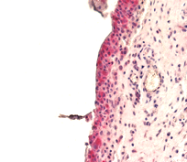
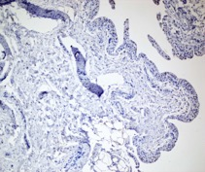
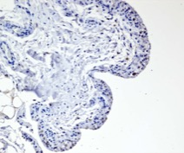
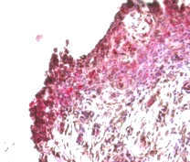

Figure 1
A
HK2x10
HK2x40
B
RA
RA
HK2 / VCAM1
HK2 / PDPN
OA
HK2 / Vimentin
C
D
RA1 FLS RA2 FLS
PDGF LPS PDGF LPS
0 12 24 48 12 24 48 0 12 24 48 12 24 48
TNF
Hypoxia
O 24 48 24 48
HK2
HK2
C
Actin
Tubulin
TNF
Hypoxia

Slide 2
















Figure 2
A
D
siRNA -
siRNA HK1
siRNA HK2
siRNA -
siRNA HK1
siRNA HK2
E
Ad-GFP
Ad-HK2
CTRL
B
Ad-GFP
Ad-HK1
Ad-HK2
7AAC
Ad-GFP
Ad-HK1
Ad-HK2
C

Slide 3
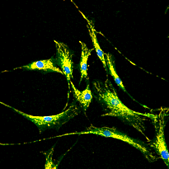
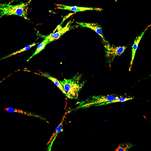
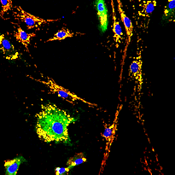
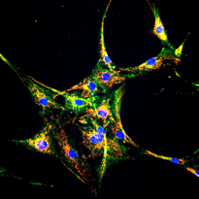
Figure 3
A
B
HK1
HK2
HK1
HK2
No Ad
C
Ad-GFP
Ad-HK2
Ad-HKs
PBS
Overlap
PDGF

Slide 4
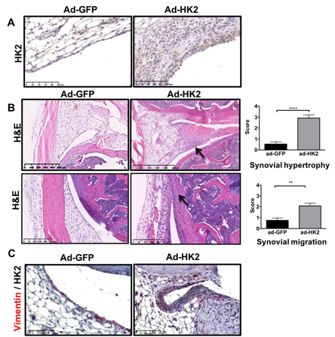
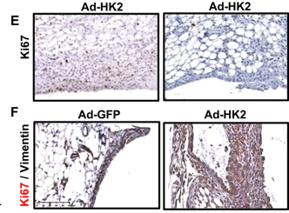
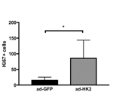
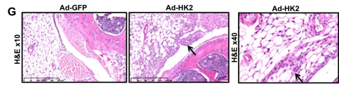
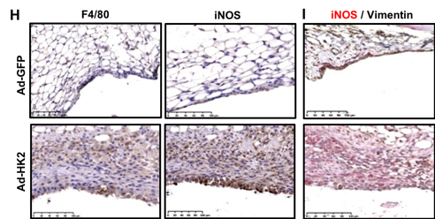
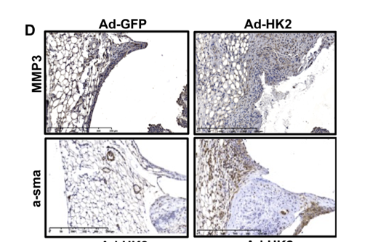
Figure 4

Slide 5

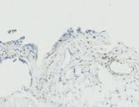
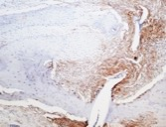

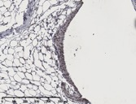
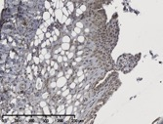

Figure 5
PDPN+/
PDPN-
A
B
D
E
Control
Arthritis
*
*
PDPNx40
#
SSC
FSC
C
Control
Arthritis
Single cells
Live cells
SSC-H
L/D
SSC-A
FSC
Fibroblasts
PDPN+
CD45
PDPN
CD31

Slide 6
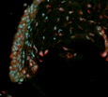
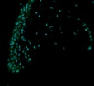
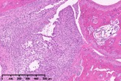
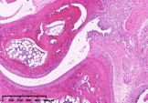
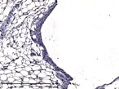
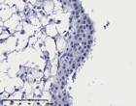
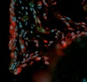
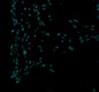
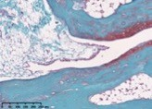
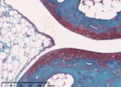
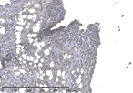
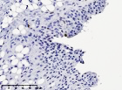
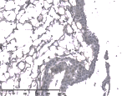
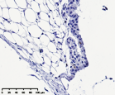
Figure 6
A
C
HK2^{F/F}
HK2^{Col1}
E
MMP3
Ki67
Vimen-1/HK2
HK2
H&E
HK2^{Col1}
HK2^{F/F}
HK2^{F/F}HK2^{Col1}
Safranin
HK2^{F/F}
B
D
CTRL
F

Slide 7
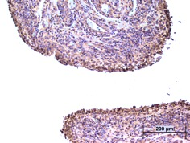
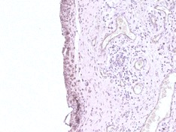
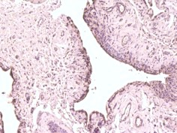
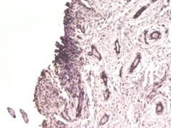
Supplementary Figure 1
A
HK1
B
OA
RA
1 2 3 4 5 1 2 3 4 5
HK2
RA
actin
C
TNF
Hypoxia
OA
Oh 24h 48h 24h 48h
HK2
Tubulin
OA FLS

Slide 8





Supplementary Figure 2
A
B
siRNA-
siHK1
siHK2
48h 72h
48h 72h
48h 72h
HK1
HK2
Tubulin
C
siRNAsc
siRNAHK1
siRNAHK2
siRNA
D

Slide 9






Supplementary Figure 3
A
C
Ad-GFP
Ad-HK1
Ad-HK2
B
RA1
RA2
RA3
Ad-
GFP
Ad-
HK1
Ad-
GFP
Ad-
HK1
Ad-
GFP
Ad-
HK1
HK1-V5tag
HK1
Tubulin
RA1
RA2
RA3
Overlap
Ad-
GFP
Ad-
HK2
Ad-
GFP
Ad-
HK2
Ad-
GFP
Ad-
HK2
HK2-V5tag
HK2
Tubulin

Slide 10
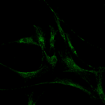
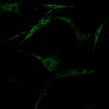
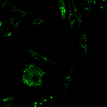
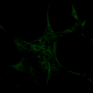
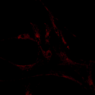
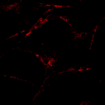
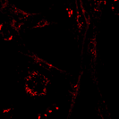
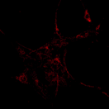
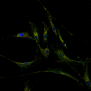
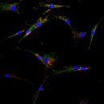
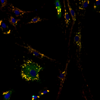

Supplementary Figure 4
A
Baseline
B
Adenovirus
HK1
HK2
HK1
HK2
HK
HK
TOM20
TOM20
Overlap
Overlap

Slide 11





Supplementary Figure 5
A
B
Ad-GFP
Ad-HK2
Ad-GFP
Ad- HK2
PBS
PBS
PDGF
PDGF

