Slide 1
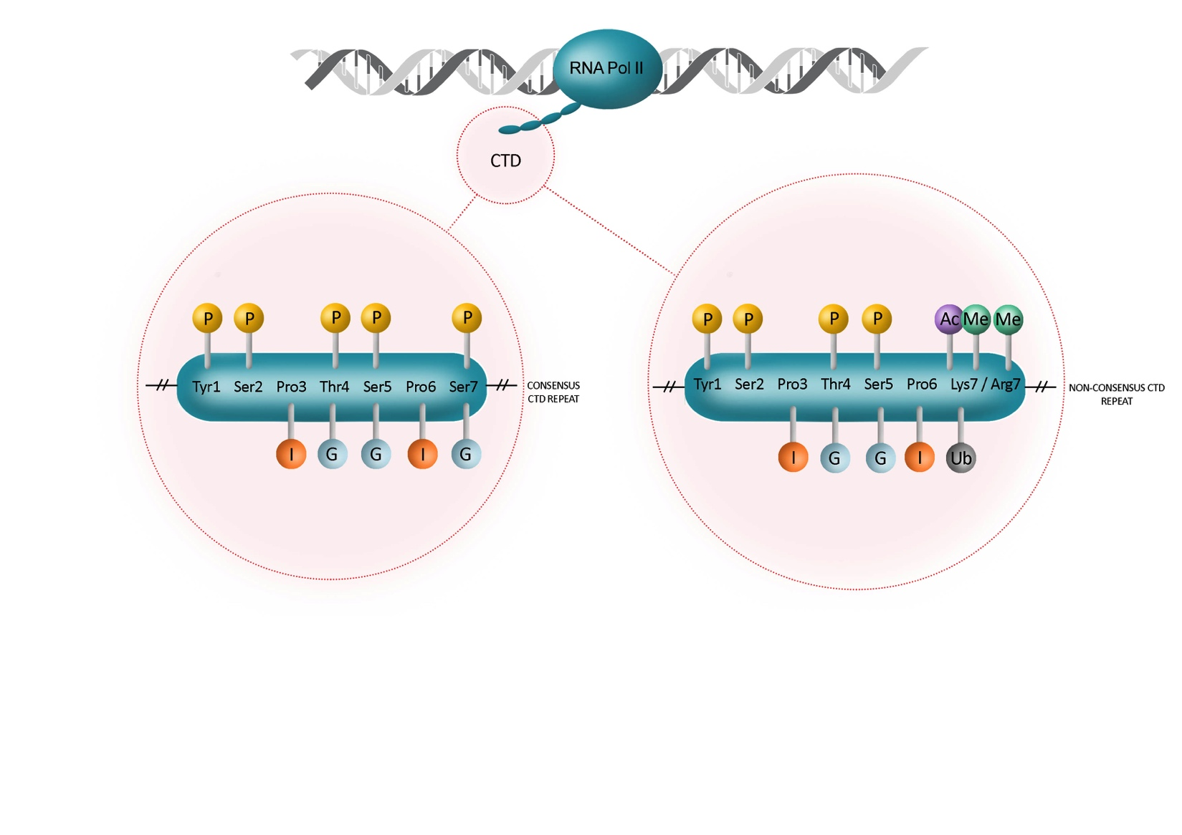

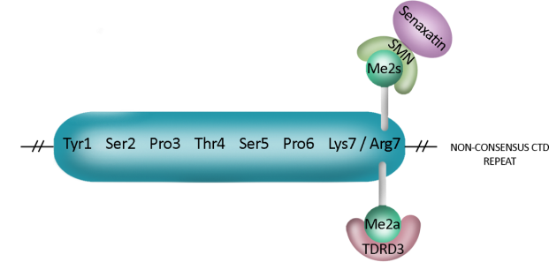
1
Tyr1
Aids recruitment of Spt6 (S.cerevisiae)
Impairs the binding of termination factors to the CTD (S.cerevisiae)
Important for pol II stability (chicken DT40 cells)
Associated with transcription of antisense promoters and active
enhancers (human)
Aids recruitment of splicing and polyadenylation factors
Regulates sexual differentiation (S.pombe)
Aids recruitment of Set2 (H3K36m³) and Spt6
Enhances pre-snRNA 3’ end formation (human)
Required for chromatin remodelling of genes involved in phosphate and galactose metabolism (S.cerevisiae)
Enhances 3’ end processing of histone transcripts
(chicken DT40 cells)
Associated with efficient transcription elongation (human)
Involved in M phase progression
Aids termination of transcription (S.cerevisiae)
Marks transcription initiation and splice sites (human and yeast)
Aids recruitment of the RNA 5’ end capping machinery
Aids recruitment of Set1 (H3K4m³)
Aids recruitment of the Nrd1/Nab3/Sen1 termination complex (S.cerevisiae)
Aids spliceosome recruitment and regulates splicing (S.cerevisiae)
Aids recruitment of Integrator and RPAP2 to snRNA genes (human)
Regulates the phosphate response pathway (S.Pombe)
could facilitate elongation and suppress cryptic transcription (S.cerevisiae)
Pcf11 binds to repeats with Ser2P and prolines in trans
Ssu72 and Nrd1 binds to repeats with Ser5P and prolines in cis
May regulate initiation of transcription
Box 1
Ser2
Mutation of Arg7 (R1810) causes misexpression
of snRNAs and snoRNAs and defects in
transcription termination
Symmetric dimethylation recruits SMN
Asymmetric dimethylation is recognized by TDRD3
Implicated in initiation and elongation of transcription
Required for transcription activation of c-Fos and Egr genes
Co-evolved with Metazoan lineages
Defines the early stages of transcription
Regulates expression of Rpb1 in embryonic stem cells
Thr4
Arg7
Ser5
Lys7
Lys7
Ser7
Lys7
Pro
t
c
CTD

Slide 2
Figure 1. Modifications of consensus and non-consensus CTD repeats and their functions.
Phosphorylation is indicated by yellow circles, glycosylation by blue circles, isomerization by orange circles, acetylation by purple circles, methylation by green circles, ubiquitylation by grey circles. The peptide bond between the proline and its preceding amino acid can exist in either the cis (c) or trans (t) configuration.
In Box1, the Arg7 CTD modification is highlighted. Symmetric dimethylation (Me2s) of Arg7 is recognised by the Tudor domain of survival of motor neuron (SMN), which in turn recruits the RNA/DNA hybrid helicase Senataxin. Asymmetric dimethylation of Arg1810 is recognised by the Tudor domain of TDRD3. The functional unit of the CTD is defined by the binding pockets of CTD interaction domains (CIDs) [^{1,4,6,8-11,16,17,53,66,78-86}].

Slide 3
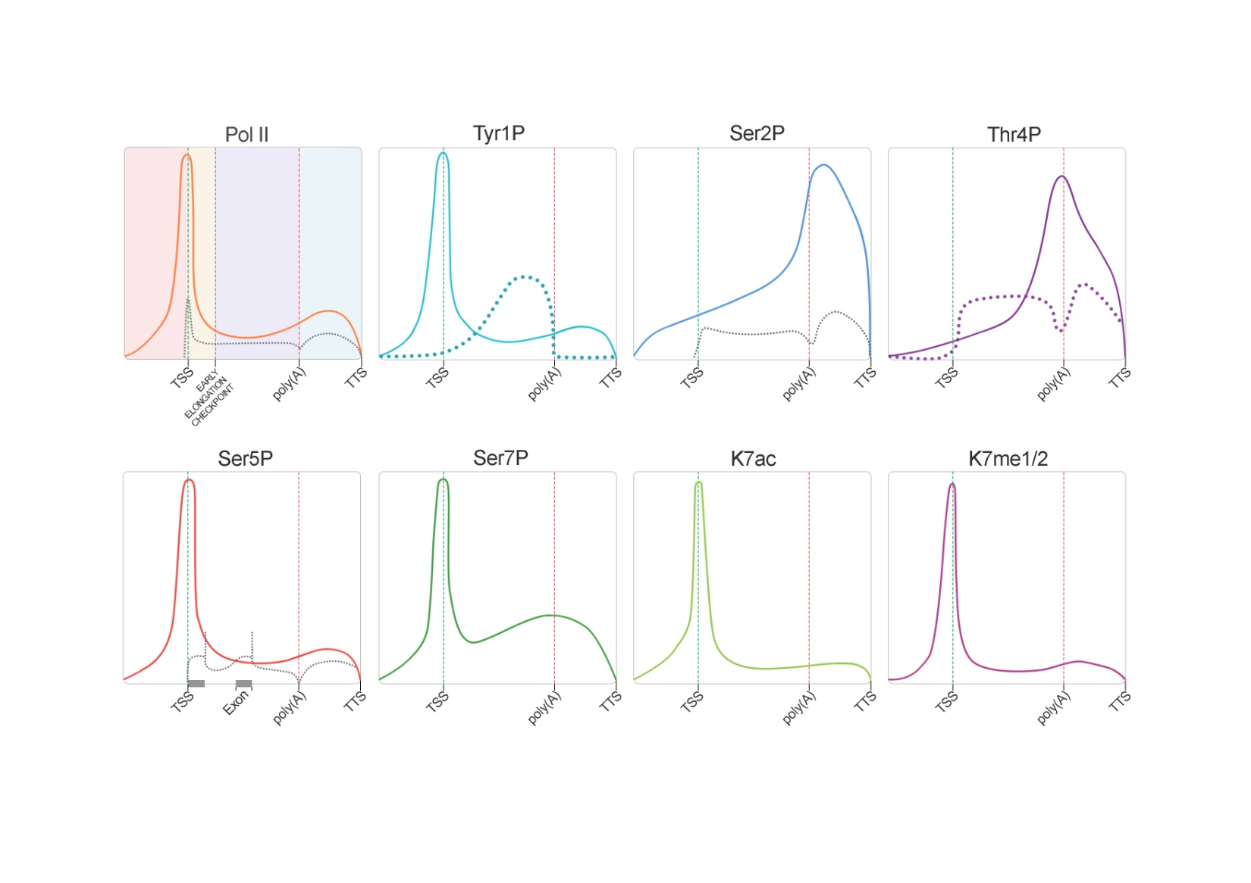
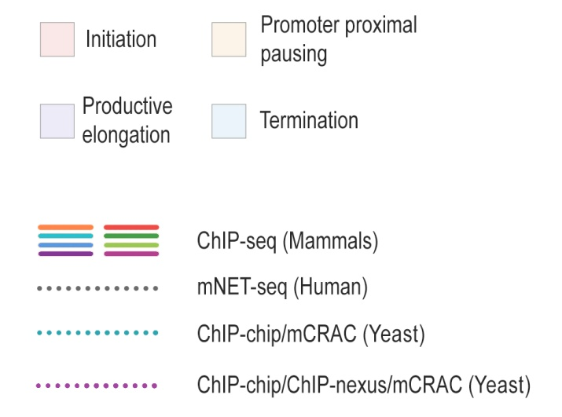
2
Figure 2. Patterns of CTD modification across protein-coding genes.
Schematic of the patterns of modification of the CTD in mammals as determined by ChIP-Seq (solid lines) or mNET-seq (dotted black line) (not-normalized to pol II). CTD modification patterns that differ significantly in S. cerevisaie are denoted by dotted blue and dotted purple lines. The transition points of the transcription cycle in mammals are indicated on the pol II schematic by shading [^{5,10-13,16,17}]. TSS = transcription start site, TTS = transcription termination site.

Slide 4
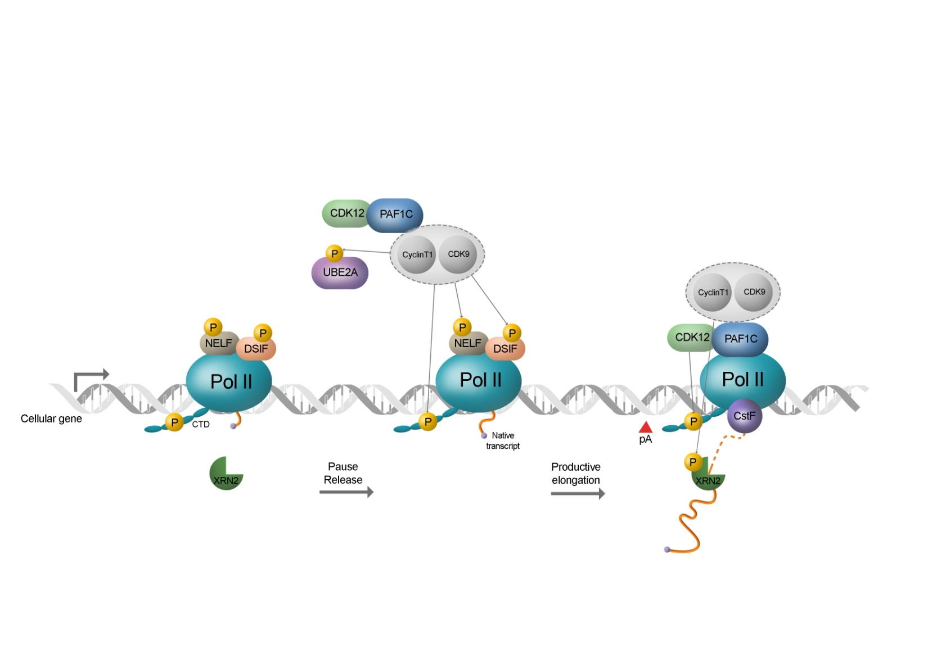
3
Figure 3. CDK9 as a master regulator driving transcription forward.
P-TEFb, comprising CDK9 and a Cyclin T1 subunit, regulates PAF1C recruitment and stimulates elongation through phosphorylation of the pol II CTD and two negative transcription elongation factors – DSIF and NELF. Phosphorylation converts DSIF from a repressor to an activator, whereas phosphorylated NELF leaves the elongation complex. CDK12 is recruited through interaction with PAF1C to phosphorylate Ser2 of the CTD⁴². Pausing of pol II upstream of the polyA signal (pA) may promote CDK12 activity and trigger further phosphorylation of Ser2. This increase in Ser2 phosphorylation could help to recruit polyadenylation factors and activate RNA 3’ end processing. P-TEFb phosphorylation of Xrn2 ensures efficient termination of transcription downstream of the poly(A) site [^{33,40,42,73}].

