Slide 1
Hate Crimes in West Yorkshire: Bradford and Calderdale
Note: This is a moderately revised version of the slideshow that was discussed with hate crime practitioners in Bradford and Calderdale
Jörg Friedrichs, University of Oxford
Ashley Burke, University of Oxford

Slide 2
The dataset
Bradford District: 11,168 entries since 2004
  Population estimate for mid-2018: 537,200. Quotient 0.021 (post-2004)
Calderdale District: 3,390 entries since 2004
  Population estimate for mid-2018: 210,100. Quotient 0.016 (post-2004)
Time (hour of day); place (ward)
Ethnicity of victim and offender
Gender of victim and offender
Offence type (e.g. violence against person) and outcome (e.g. charge/summons)
Religion:
  In rare cases: direct information on racial/religious nature of offence
  Even more rarely: information on religious targeting, e.g. “anti-Muslim”
  Compelled to rely on Pakistani/Bangladeshi ethnicity as shorthand for “Muslim”
  For the sake of convenience, we use “white” as a shorthand for “White British”.

Slide 3
Number of observations per year
Falls between 2007 and 2014, then rises sharply from 2015.
  To what extent is this due to better recording?
  To what extent is it due to a real rise in frequency?

Slide 4
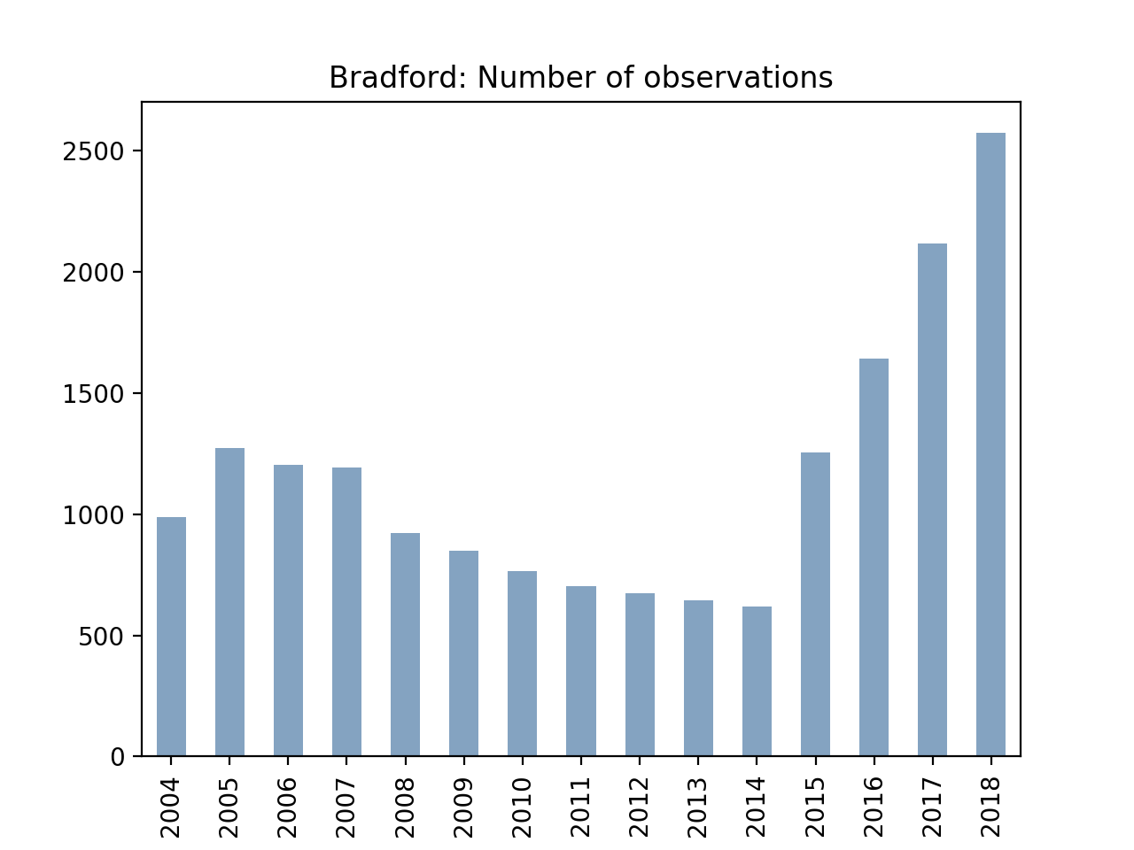
Notes:
Un-color code

Slide 5
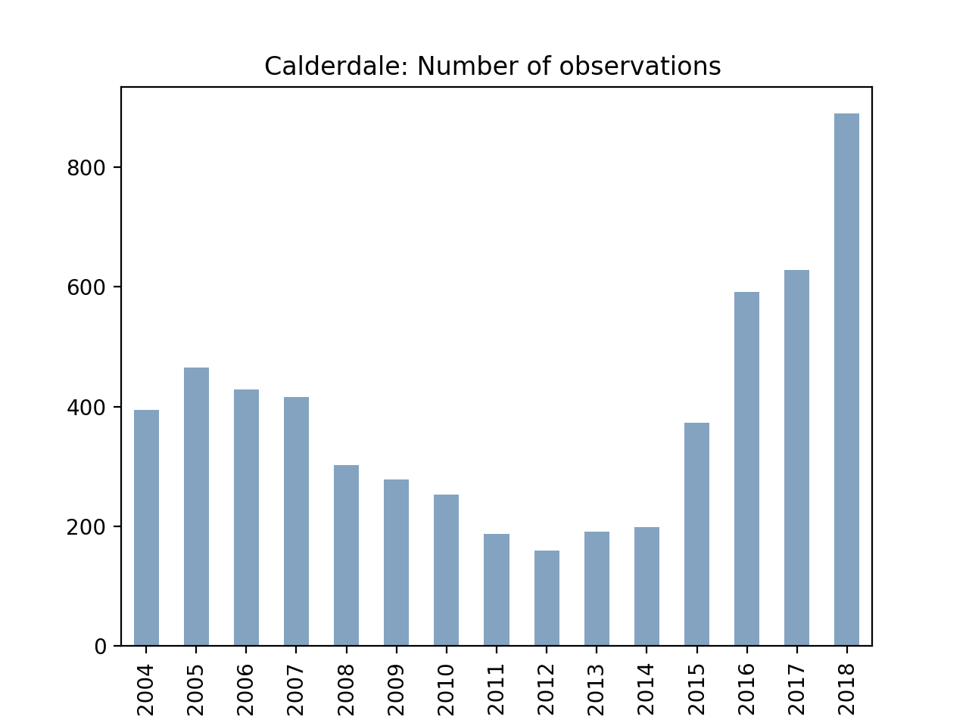
Notes:
Un-color code

Slide 6
Methodological approach
Large and interesting dataset, but many missing data
  Statistical inference difficult and risky under such circumstances
Therefore, quantitative-qualitative assemblage
  Data visualization rather than correlation analysis
  Sequential exploration of possible patterns rather than statistical controls
  Consulting experts with contextual knowledge in lieu of significance tests
    Would you please help us to tell real from spurious findings? “Is this finding real?”
    Please also help us with the interpretation of our findings. “If so, what’s going on?”

Slide 7
Religion/ethnicity in the 2011 Census
Bradford’s Muslim minority was large and dispersed.
  24.7% Muslims (77.9% of them Pakistani, 7.2% Bangladeshi)
  There were 8 Muslim-majority wards.
  There were several genuinely mixed wards.
Calderdale’s Muslim minority was smaller and more concentrated.
  7.3% Muslims (88% of them Pakistani, 3.5% Bangladeshi)
  65% of them lived in just one Muslim-majority ward (Park).
  There were significant Muslim minorities in adjacent wards.
    Mainly Warley (15.6%) and Skircoat (9.8%)
  The remaining 14 wards had only 10% Muslims altogether.
Any other important trends in ethno-religious demography?
  Especially recent trends (post-2011)?

Slide 8
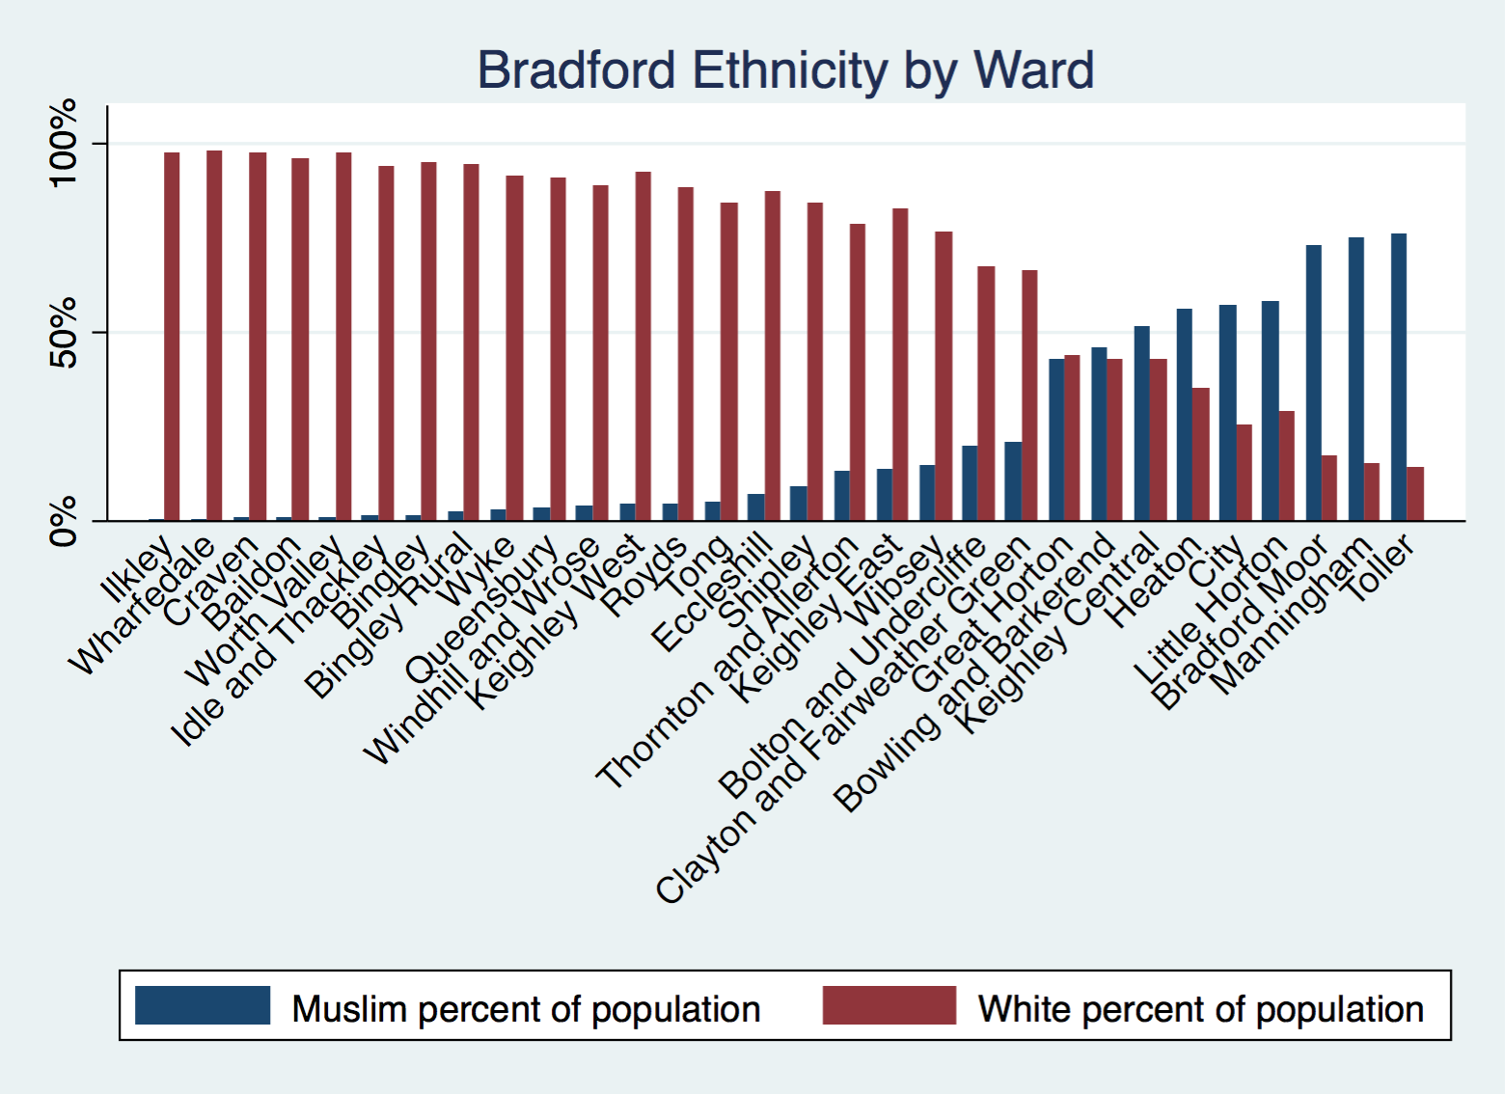

Slide 9
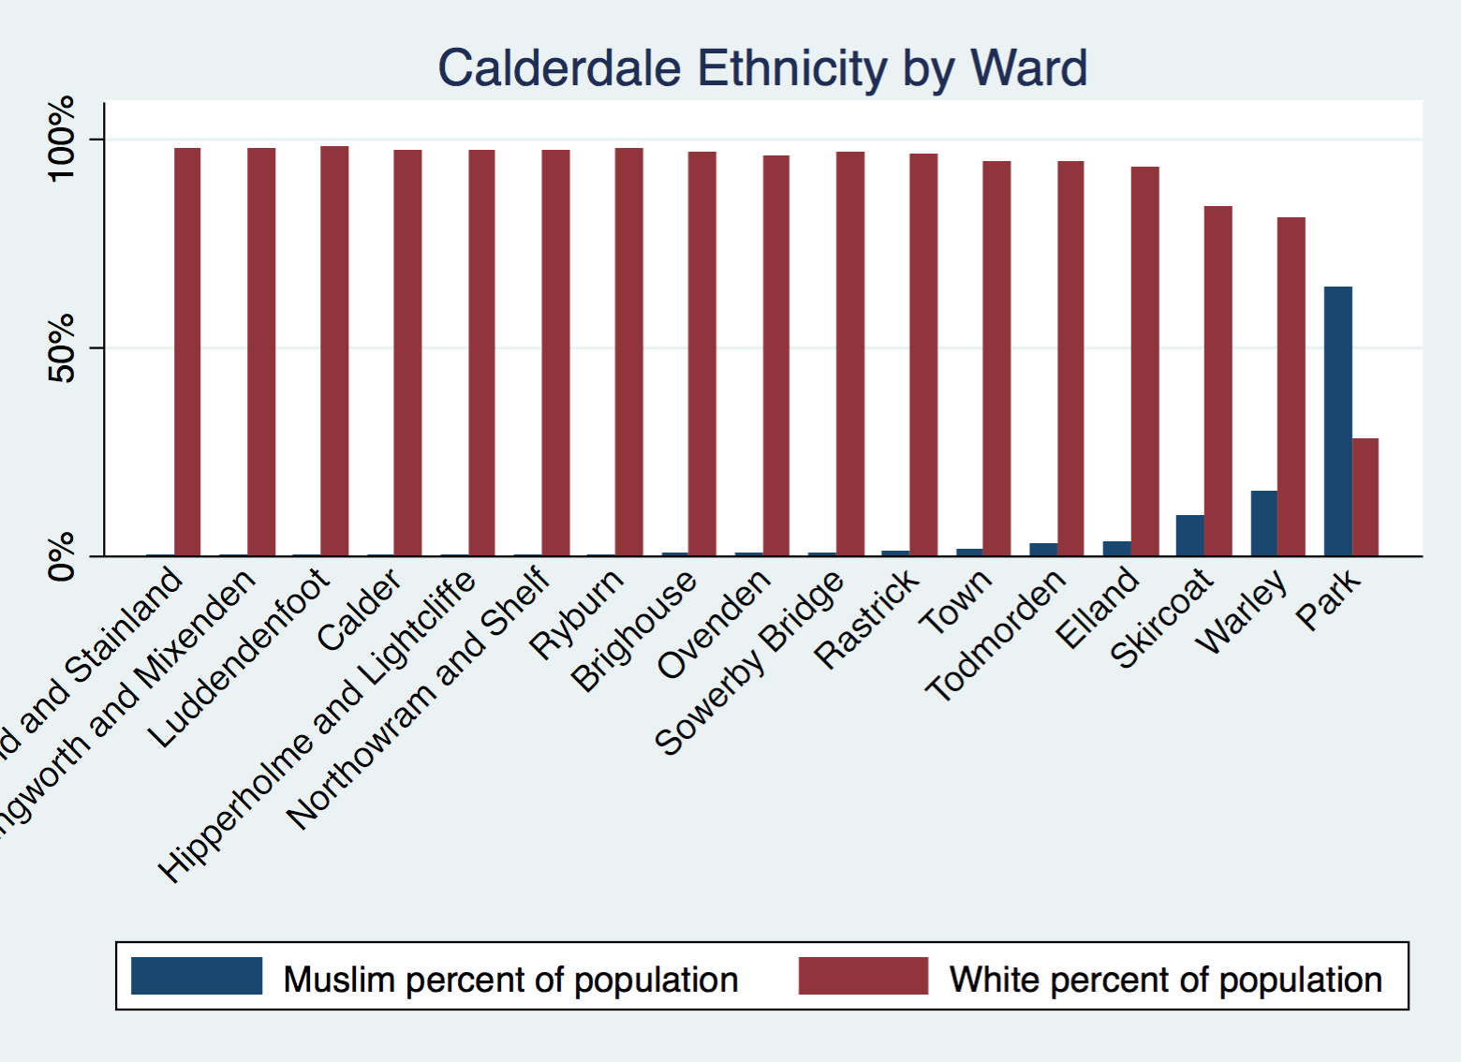

Slide 10
Missing data on ethnicity
In 50-55% of cases, neither offender nor victim ethnicity is recorded.
  This has grown since 2015 and stands at ca. 60%.
In 35-40% of cases, only victim ethnicity is recorded.
  This was slightly higher in the first few years than in the last few years.
In 4-8% of cases, only offender ethnicity is recorded.
  This has decreased to its lowest level in the last three years.
In 5-10% of cases, both offender and victim ethnicity is recorded
  This has decreased since 2014 and stands at ca. 2%.
Any comments?

Slide 11
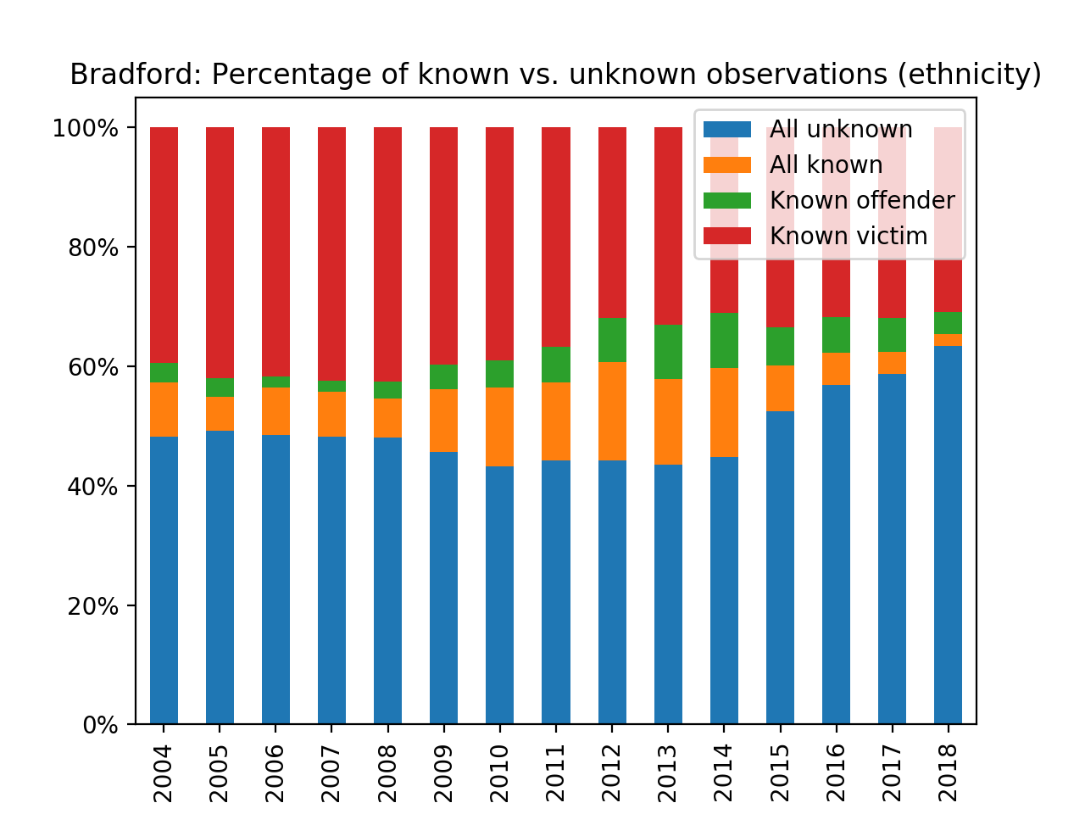

Slide 12
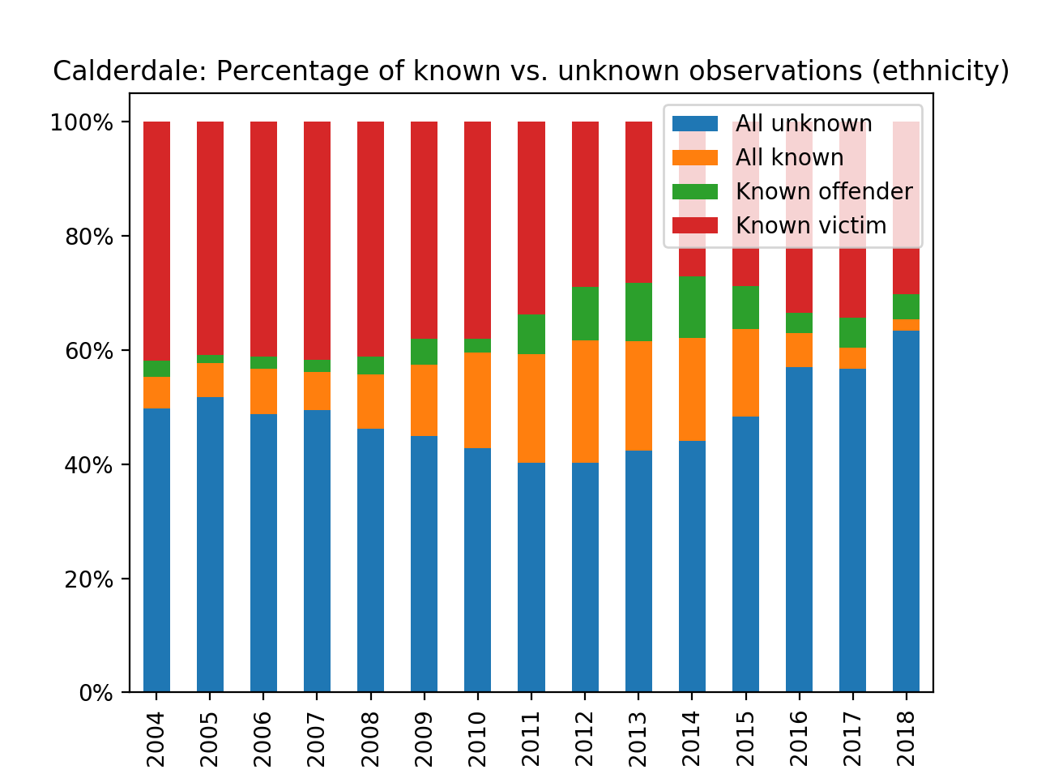

Slide 13
Missing data on gender
In 40-45% of cases, neither offender nor victim gender is recorded
In 40-45% of cases, only victim gender is recorded.
In 2-3% of cases, only offender gender is recorded.
In only 10-15% of cases, both victim and offender gender is recorded.
There are fewer missing data for gender than for ethnicity.
  Presumably, this is because it is easier to establish gender than ethnicity?
  Why, then, is offender gender still known in only about 15% of the cases?

Slide 14
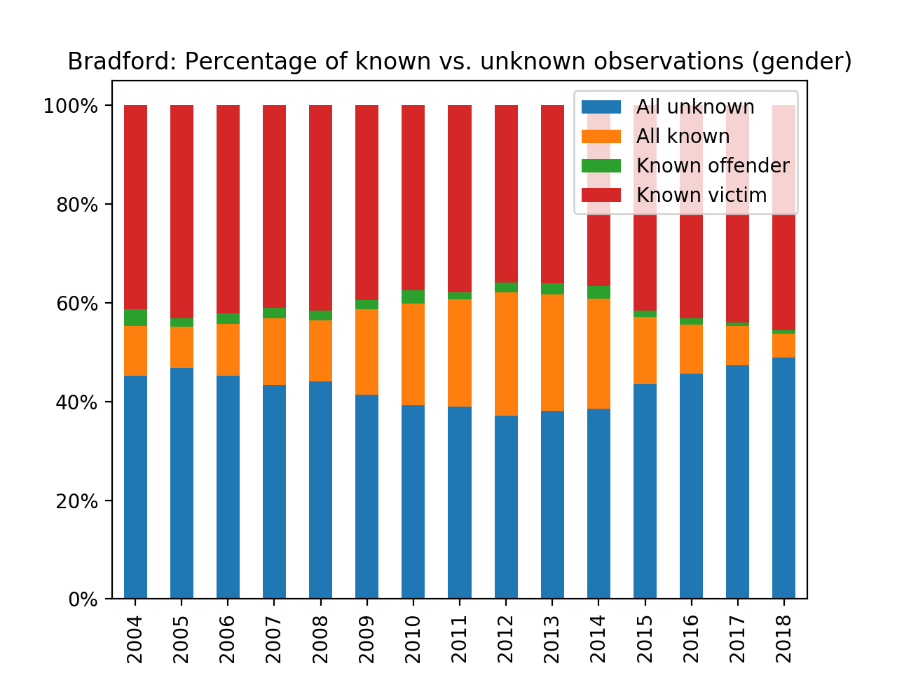

Slide 15
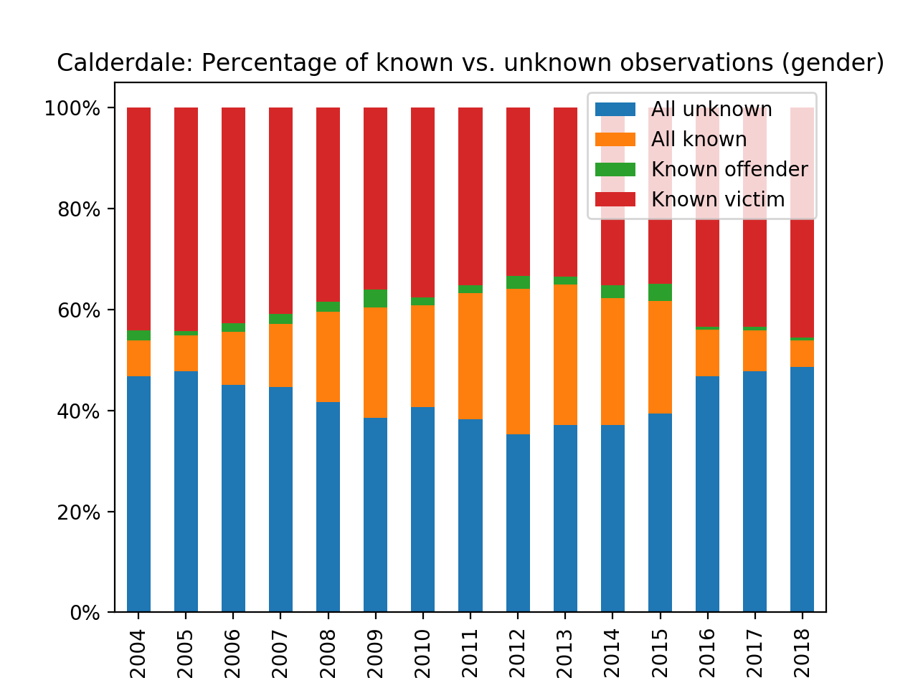

Slide 16
Headline findings
 | White | Muslim
Offender | 70% Bradford 84% Calderdale | 19% Bradford 12% Calderdale
Victim | 30% Bradford 30% Calderdale | 38% Bradford 40% Calderdale
Far more white than Muslim (together ca. 90%)
White/Muslim rather close (together ca. 70%)
Percentage of hate crimes where BOTH victim AND offender are known:
  White-on-Muslim. Bradford: 36%; Calderdale 38%
  Muslim-on-White. Bradford: 14%; Calderdale 10%

Slide 17
Muslim population density
In wards with less than 40% Muslims, there are more Muslim victims than demographic share.
  But in wards with more than 40% Muslims, there are fewer Muslim victims than demographic share.
    Does that indicate that Muslims are “safer” in Muslim-dominated wards than elsewhere?
In wards with more than 20% Muslims, there are fewer Muslim offenders than demographic share.
  But in many wards with less than 20% Muslims, there are more Muslim offenders than demographic share.
    Why on earth would Muslims be over-represented as offenders in white-dominated wards?
Notes:
I took out the sub-bullet indicating that the last bullet might be due to low crime rates because the sample size was large enough to be robust

Slide 18
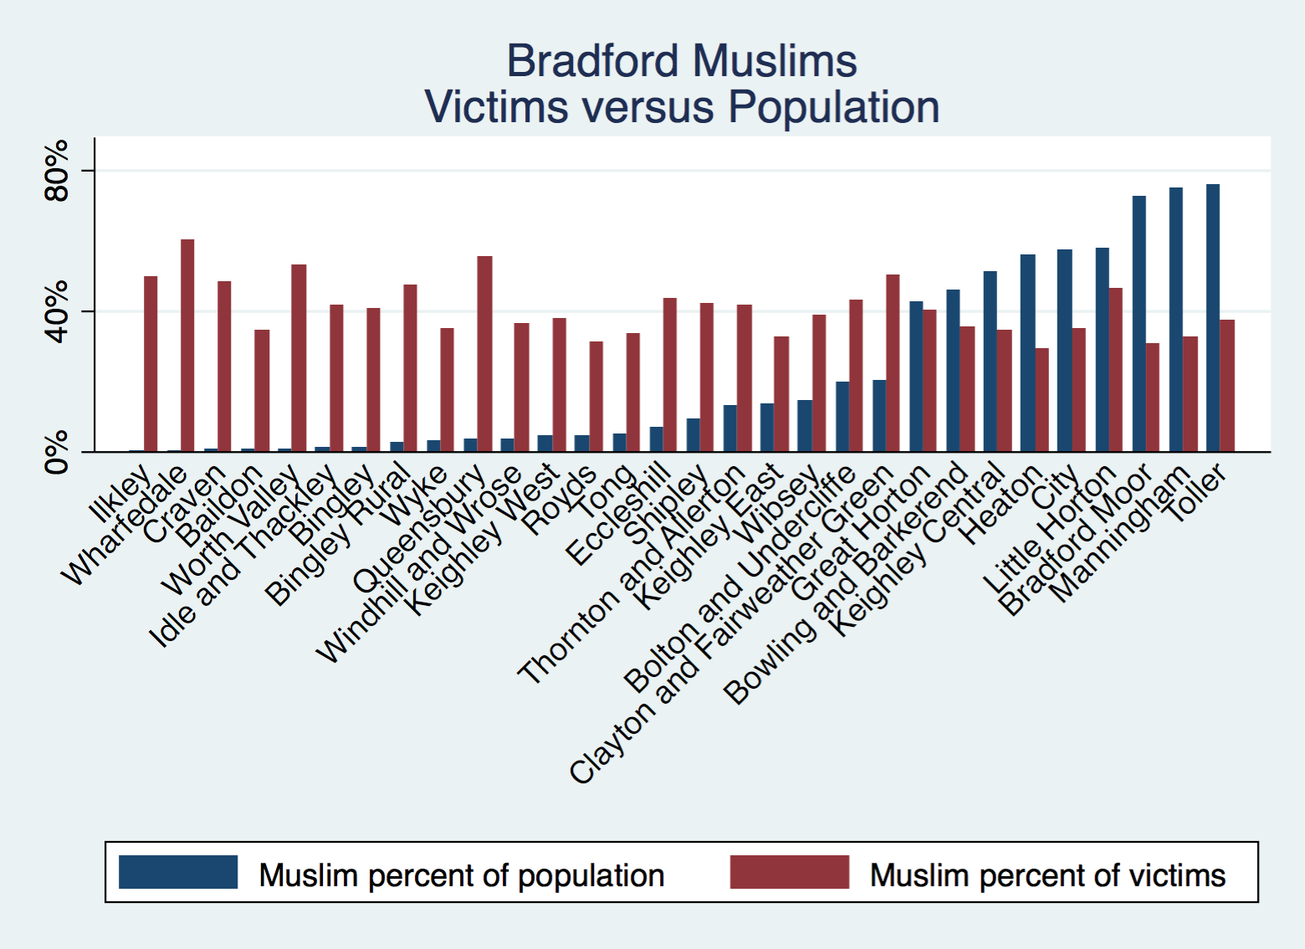

Slide 19
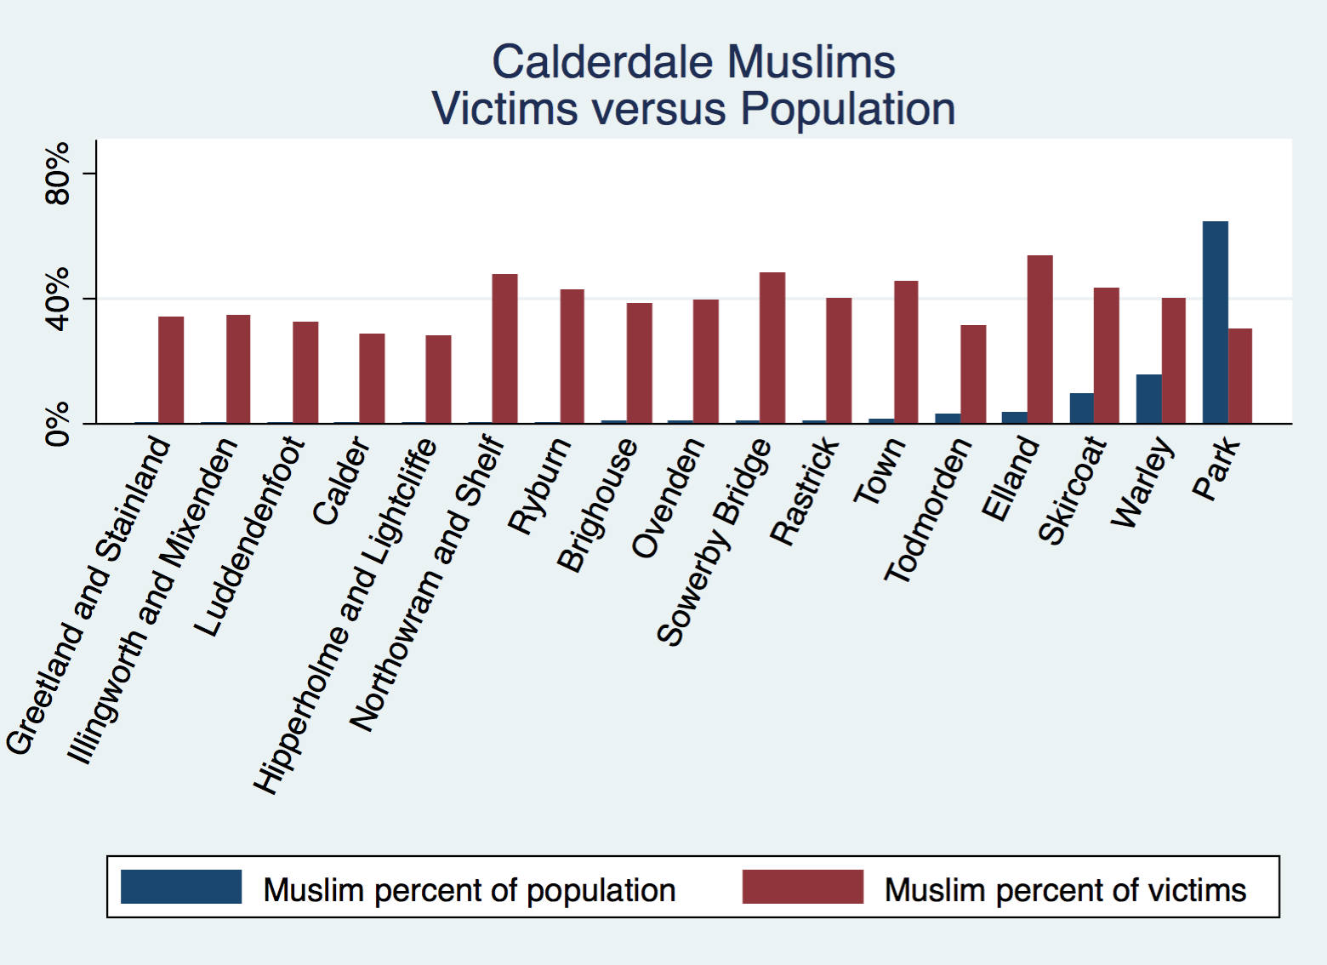
Notes:
The greater than 40% category includes only Park

Slide 20
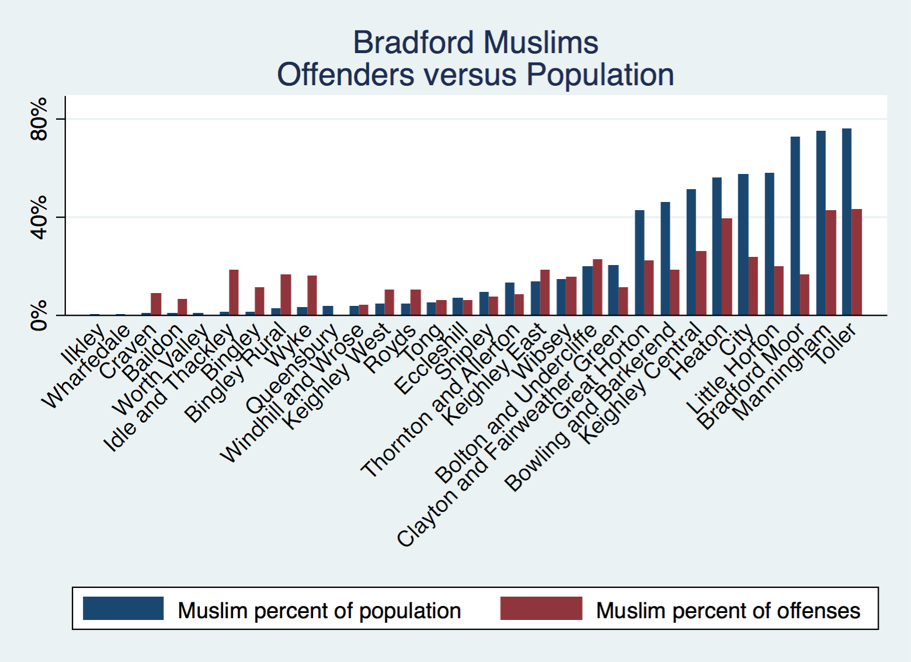

Slide 21
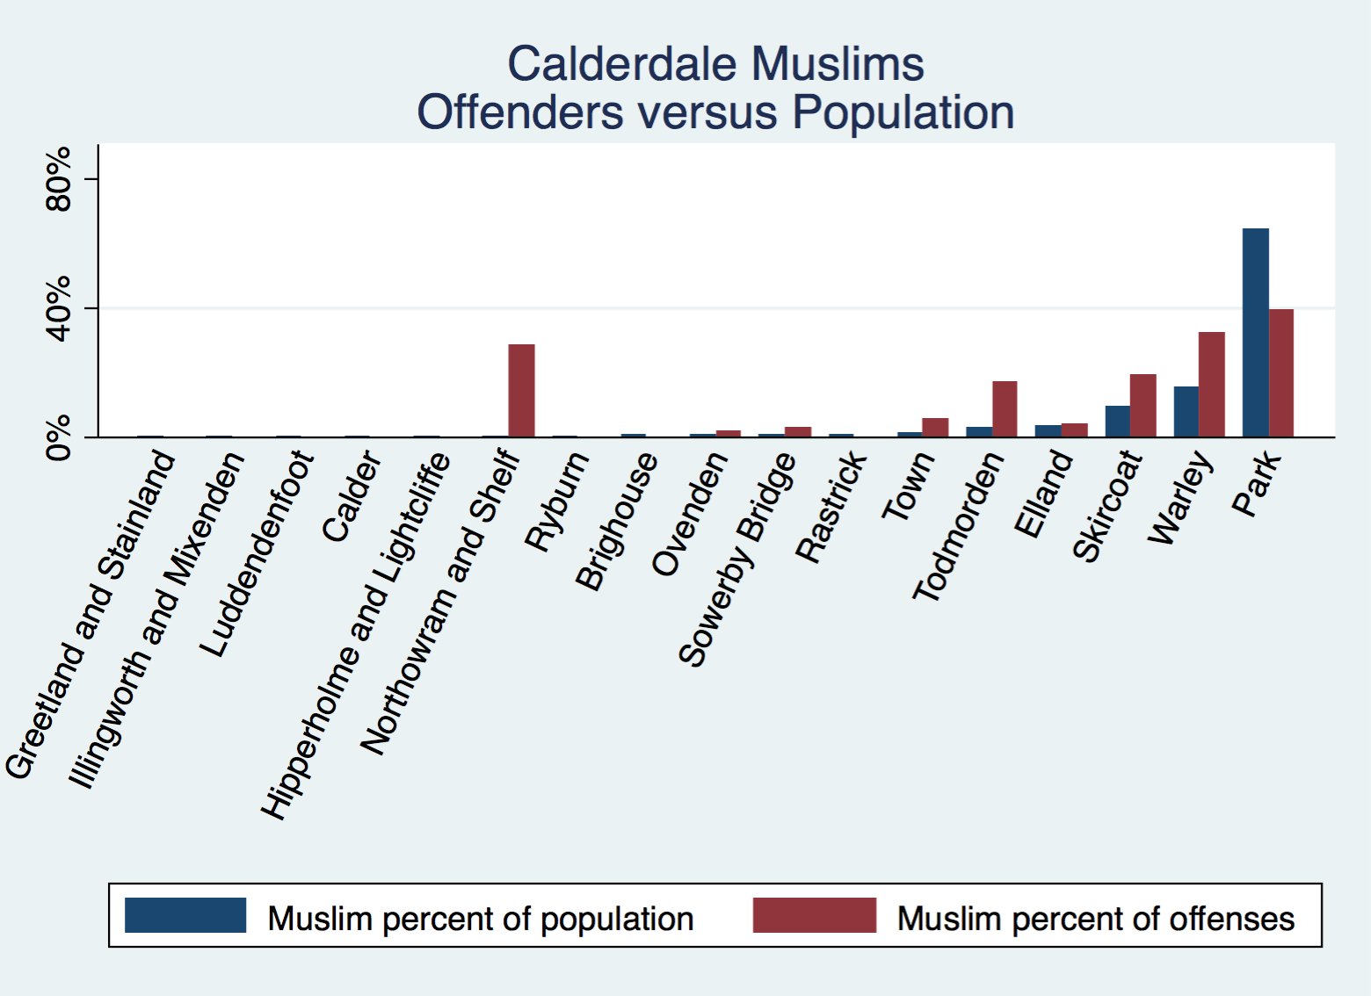
Notes:
The greater than 40% category includes only Park

Slide 22
White population density
In wards with less than 25% whites, there are more white victims than demographic share.
  In wards with more than 50% whites, there are fewer white victims than demographic share.
    Does that indicate that whites are at greater risk in “diverse” wards than elsewhere?
In wards with more than 60% whites, there are slightly fewer white offenders than demographic share.
  But in wards with less than 60% whites, there are more white offenders than demographic share.
    Why on earth would whites be over-represented as offenders in more “diverse” wards?

Slide 23
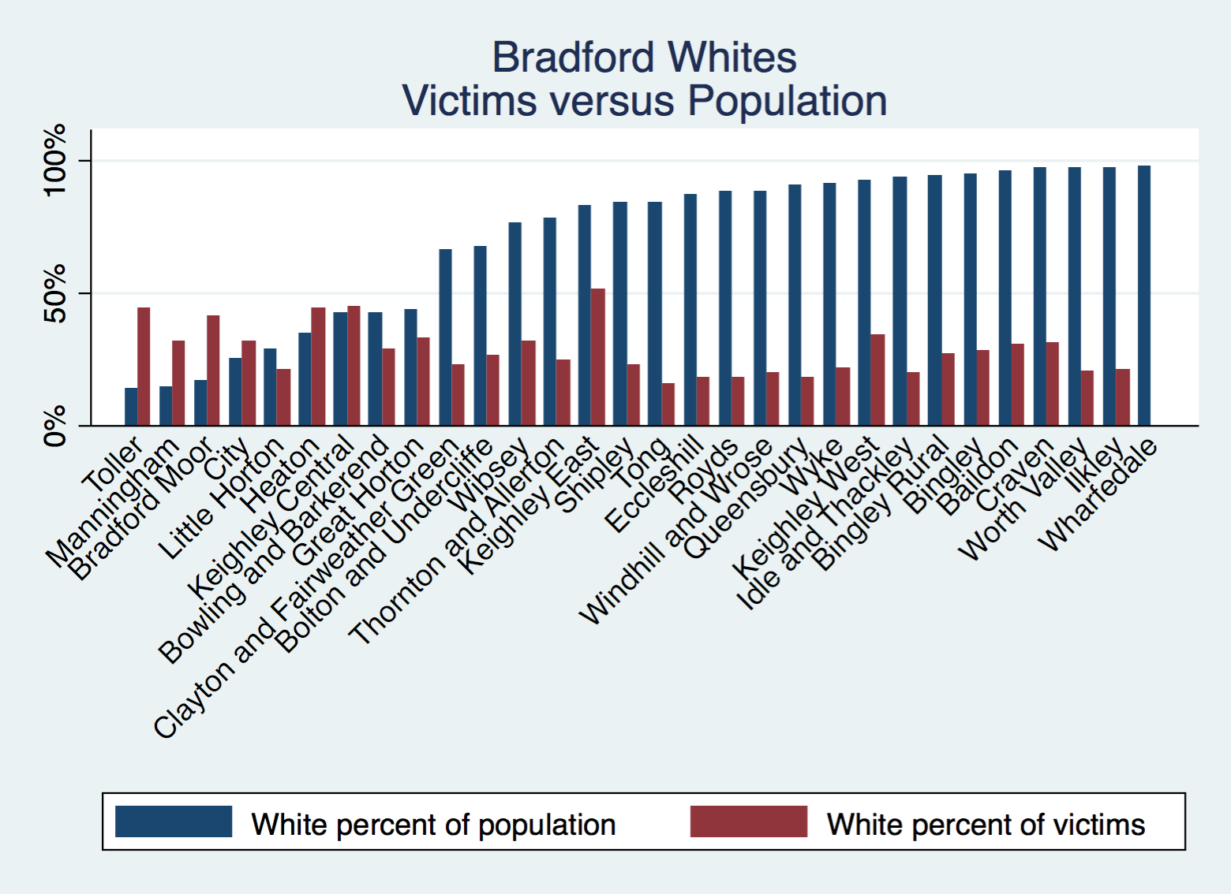

Slide 24
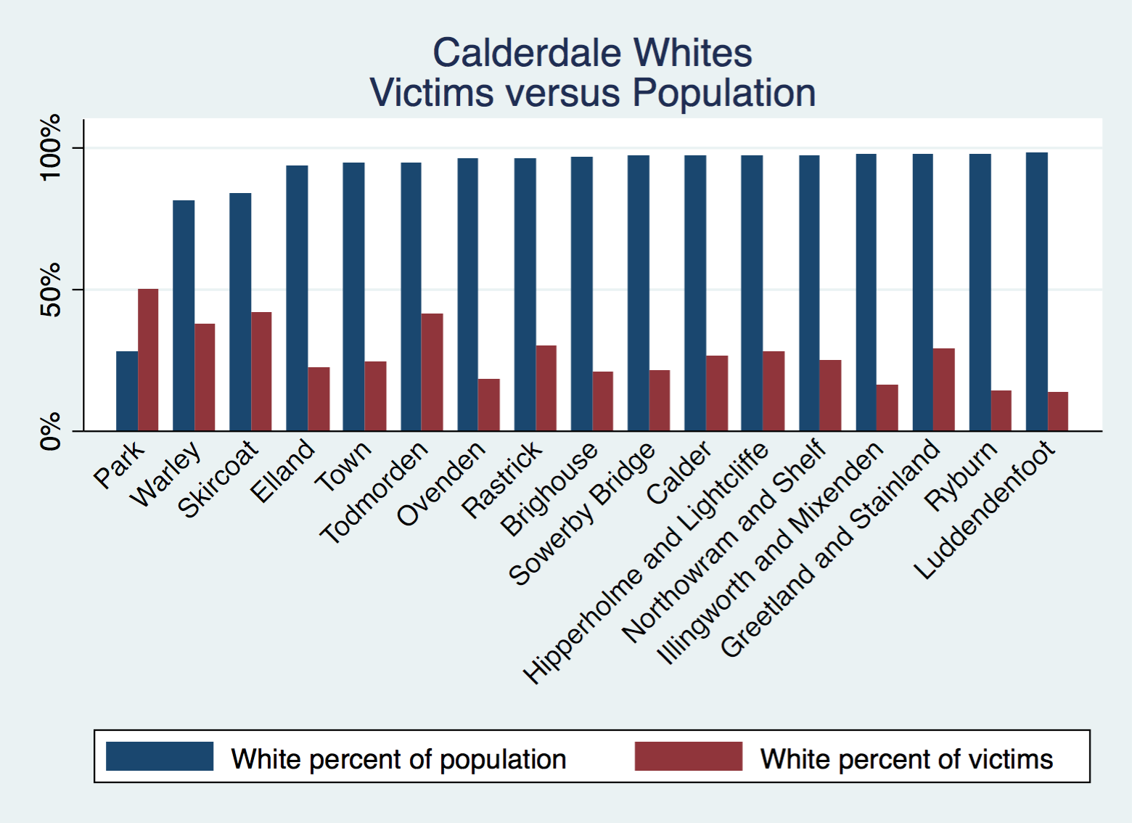
Notes:
The less than 40% category includes only Park

Slide 25
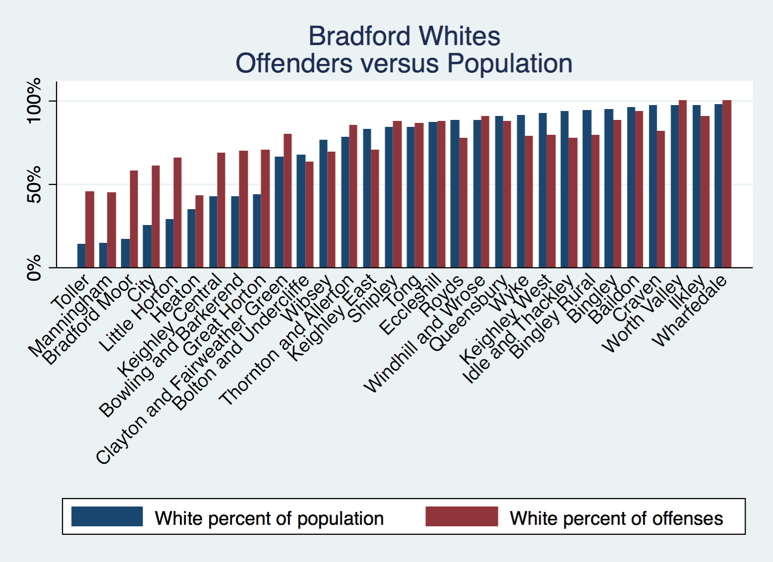

Slide 26
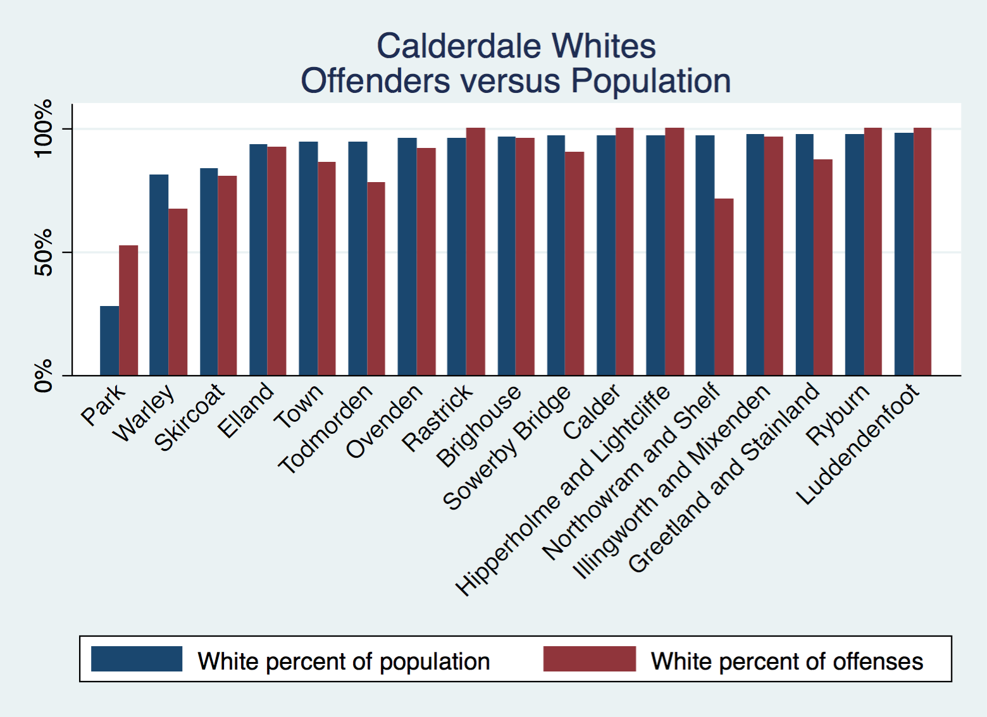
Notes:
The less than 40% category includes only Park

Slide 27
Muslim victims
Hate crimes where victims are recorded as Muslim
Absolute numbers track general trend.
  Fall between 2007 and 2014, then sharp rise from 2015.
  If anything, rise less sharp than in general dataset.
    Comments?
Percentage seems stationary
  Hovers around 40% of known victims (above population percentage).
  Moderate rise in first few years, moderate decline in recent years.
    Comments?

Slide 28
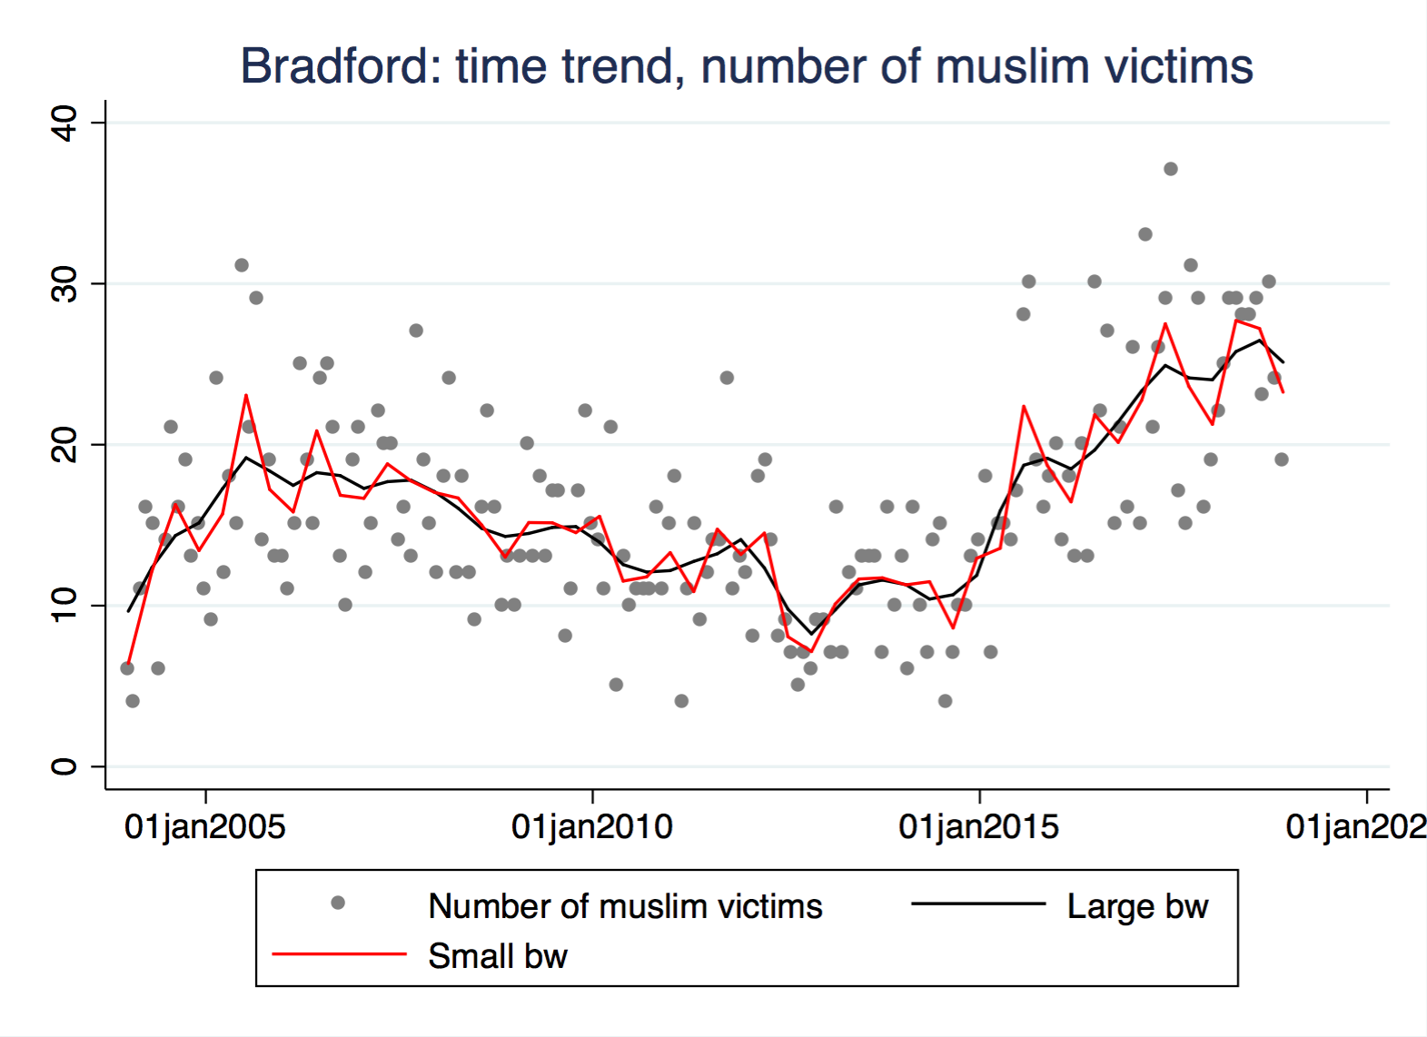

Slide 29
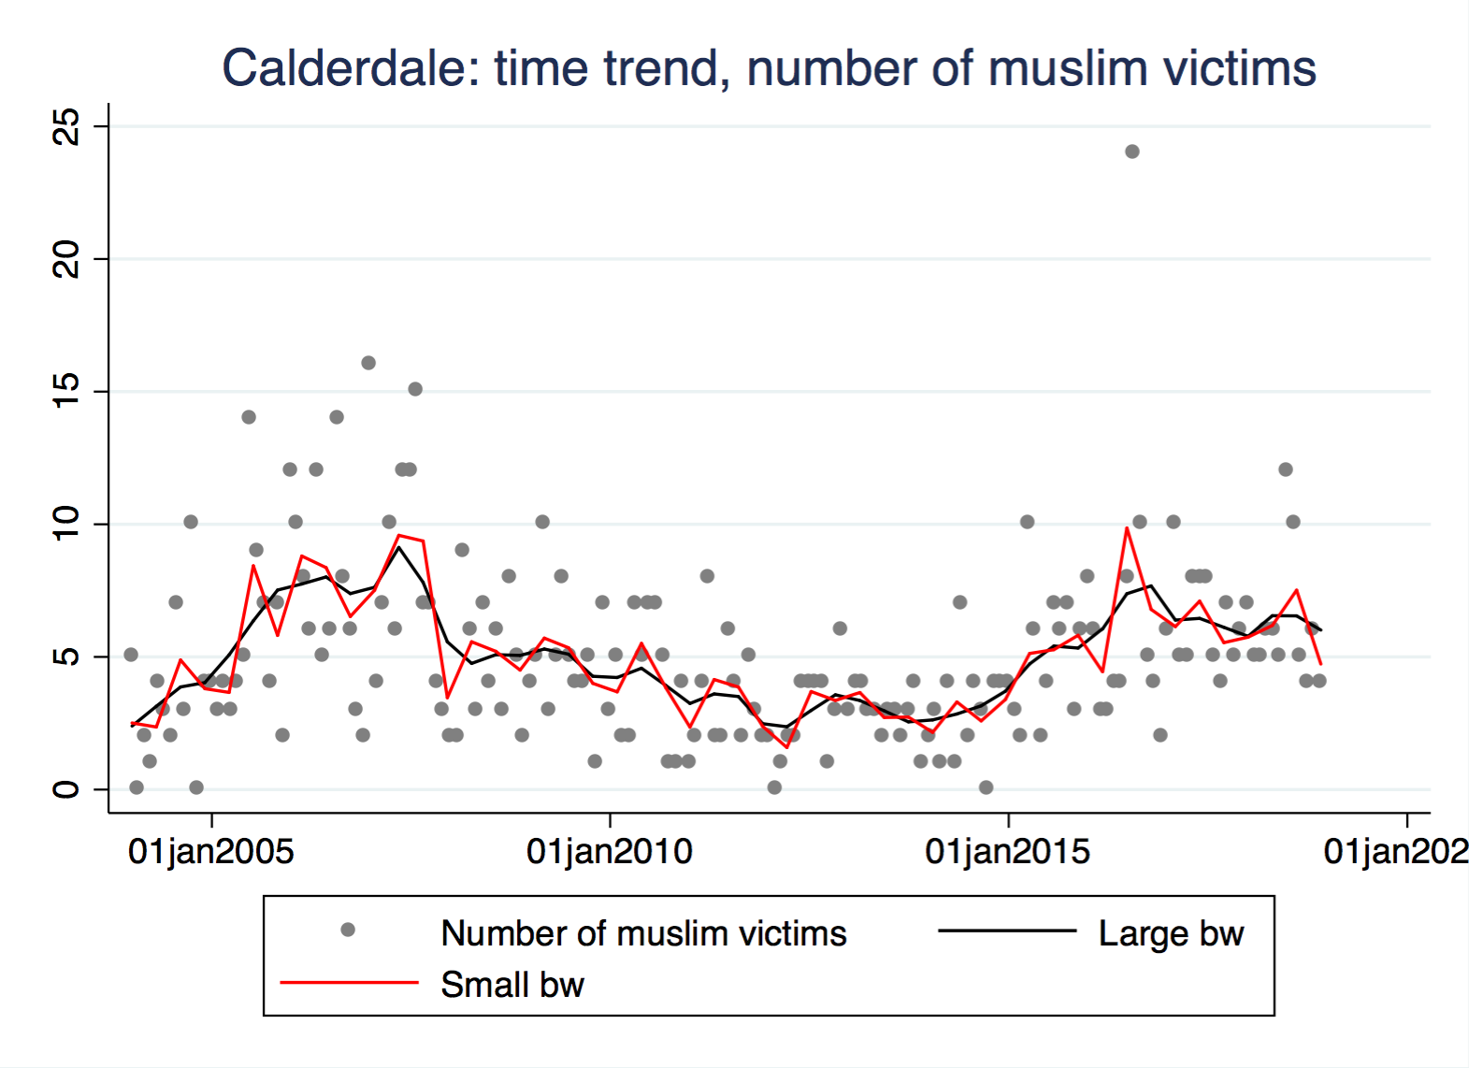

Slide 30
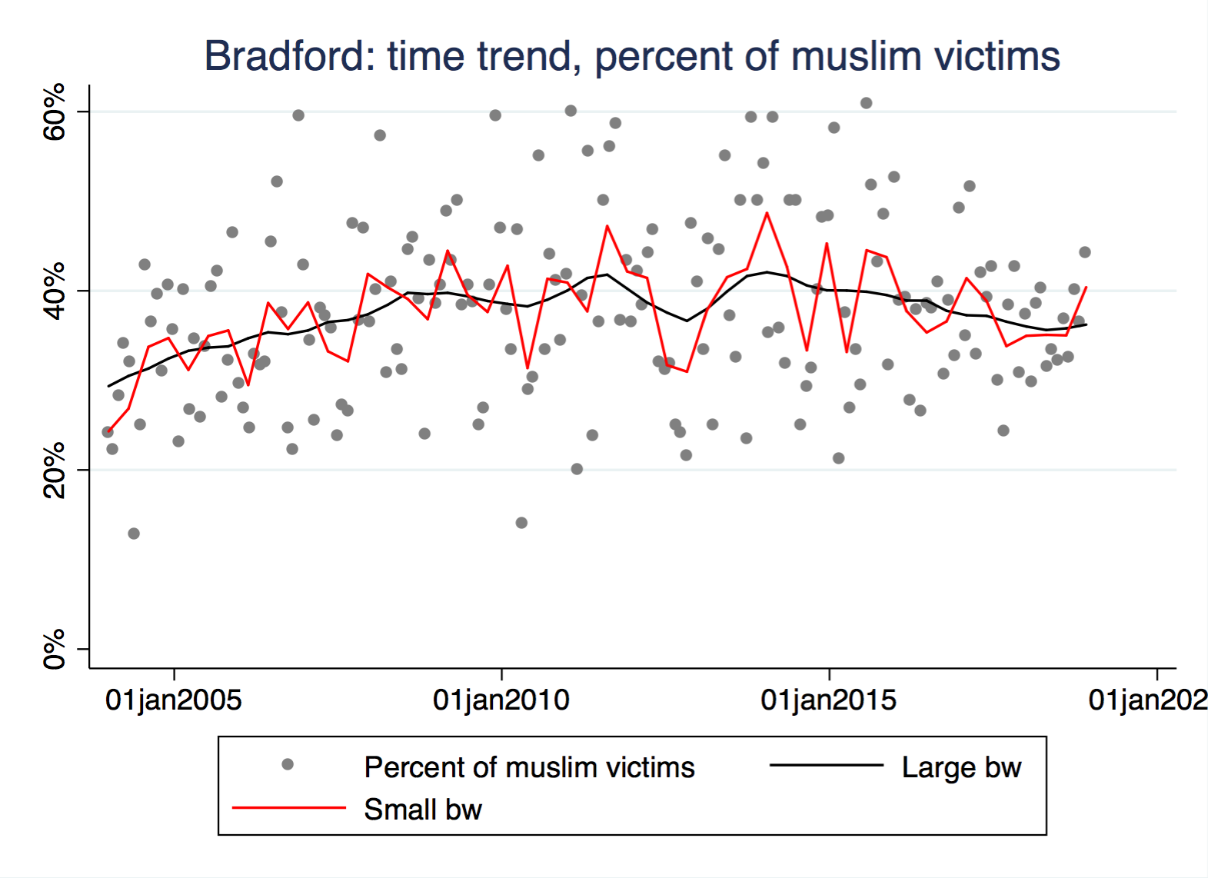

Slide 31
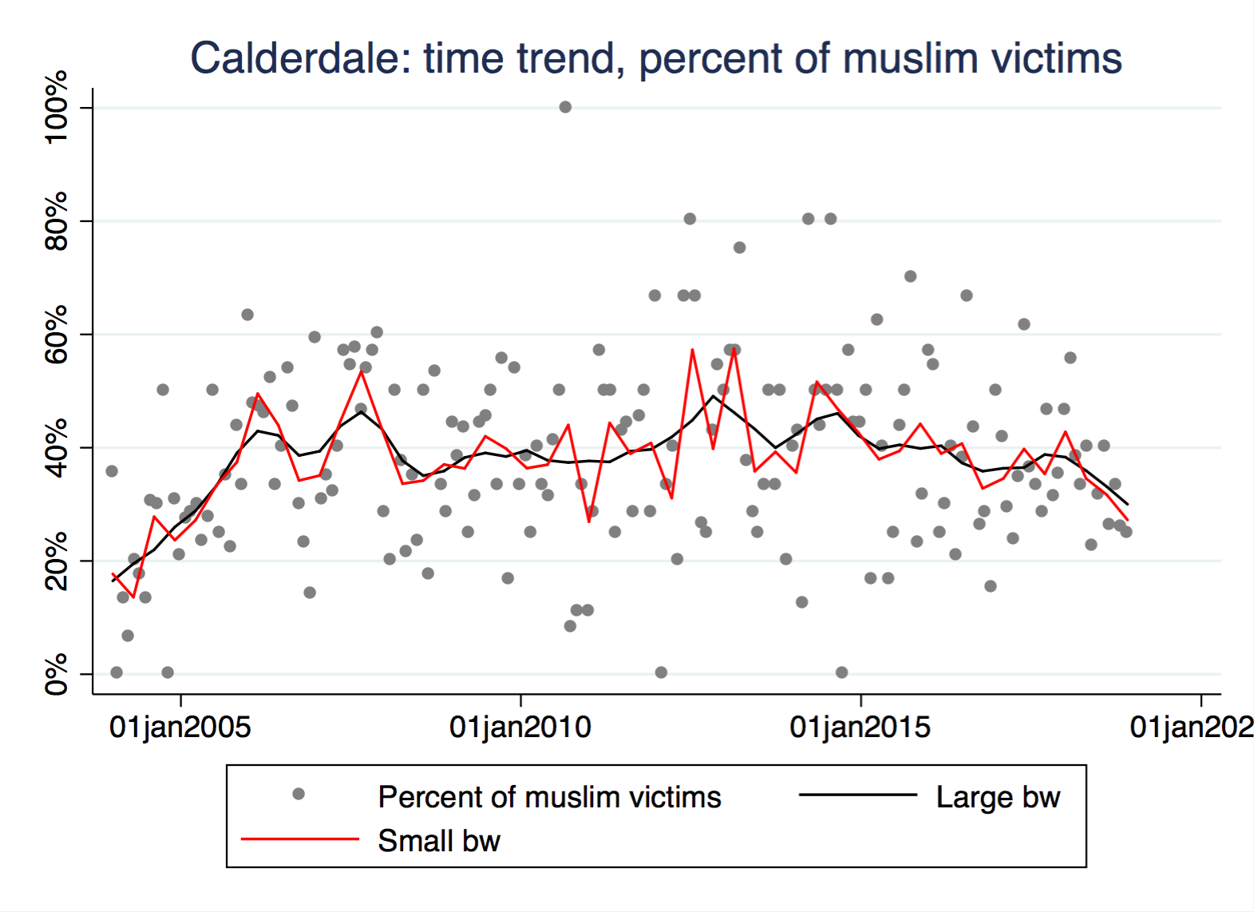

Slide 32
White victims
Hate crimes where victims are recorded as White British
  Other white ethnicities not included.
Absolute numbers track general trend.
  Fall between 2007 and 2014, then rise from 2015
Percentage seems rather stationary
  Hovers around 30% (far below population percentage).
  Decline in first few years, moderate rise in recent years.
  We see the reverse pattern for Muslim victims (p. 17).
    Comments?

Slide 33
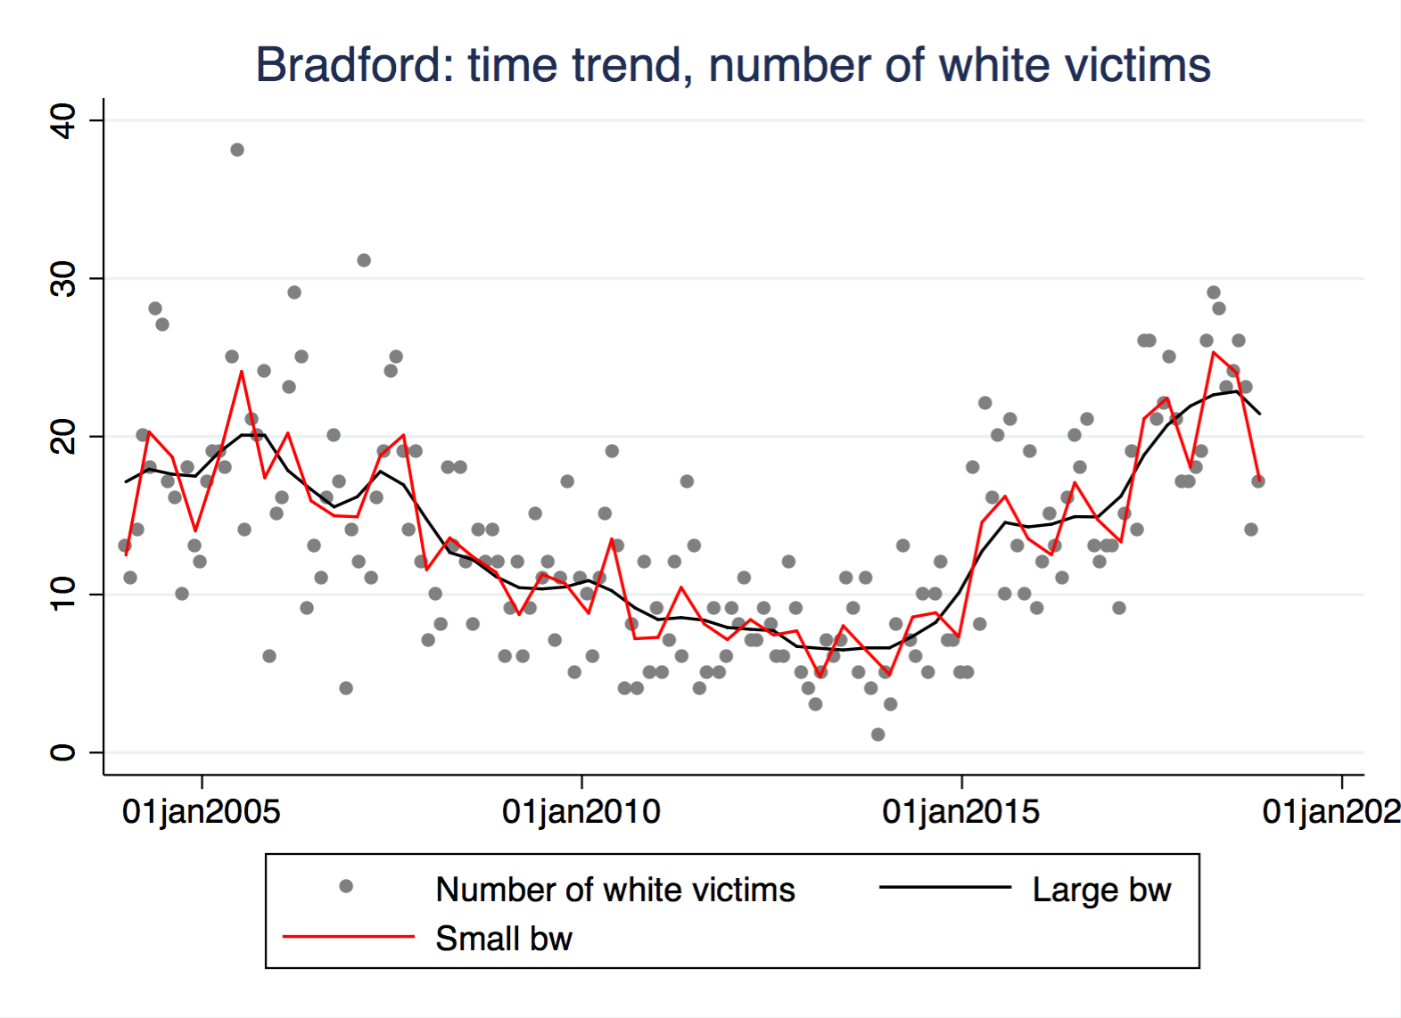

Slide 34
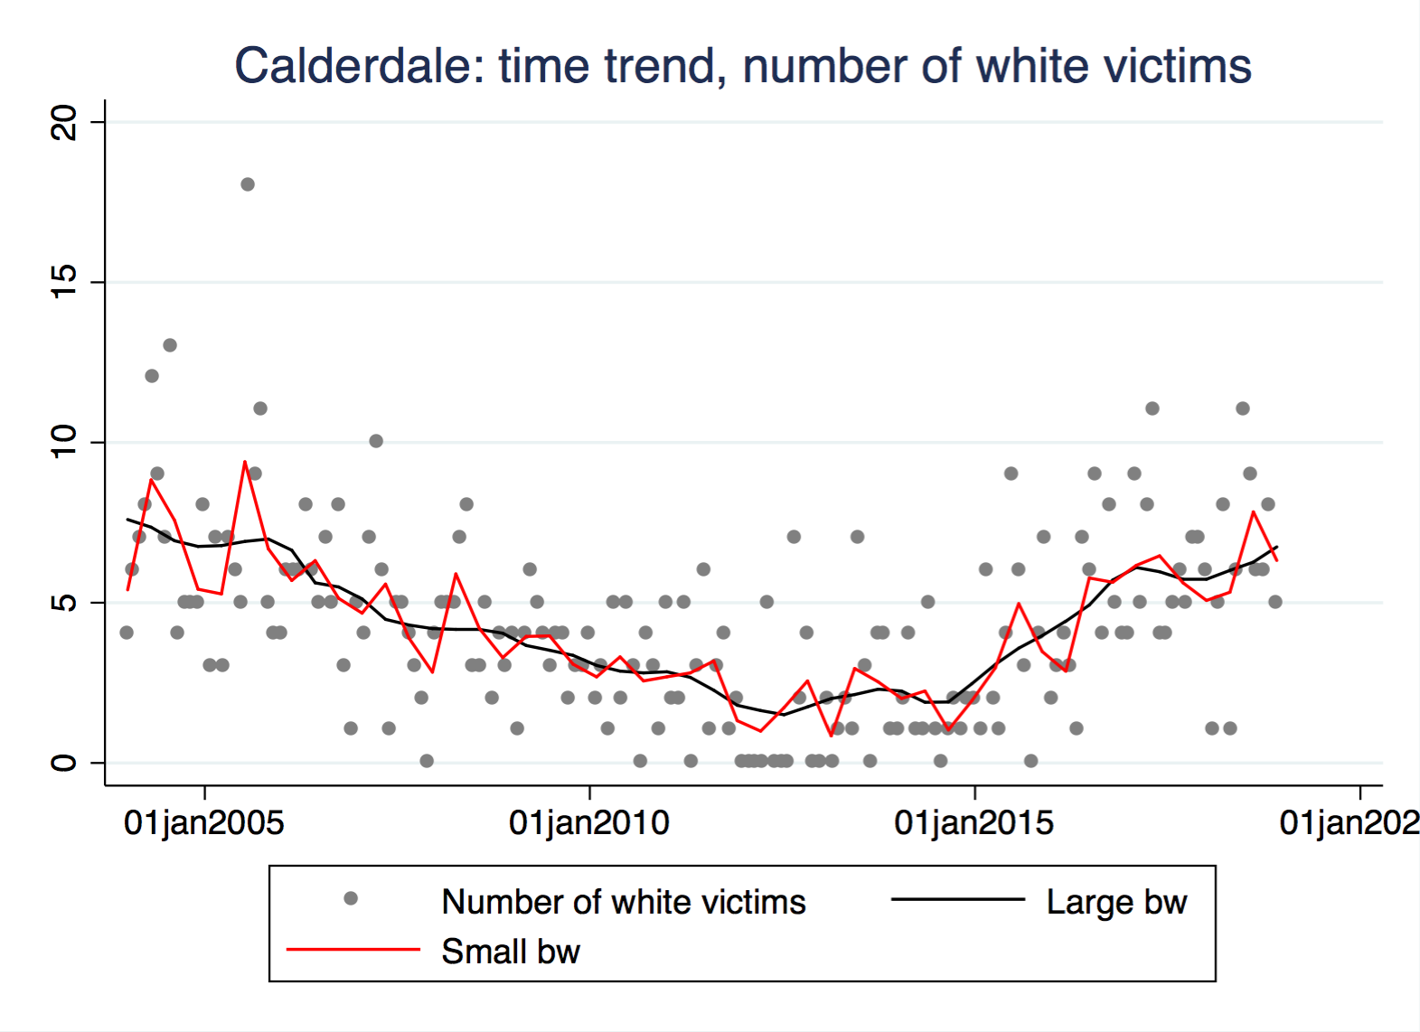

Slide 35
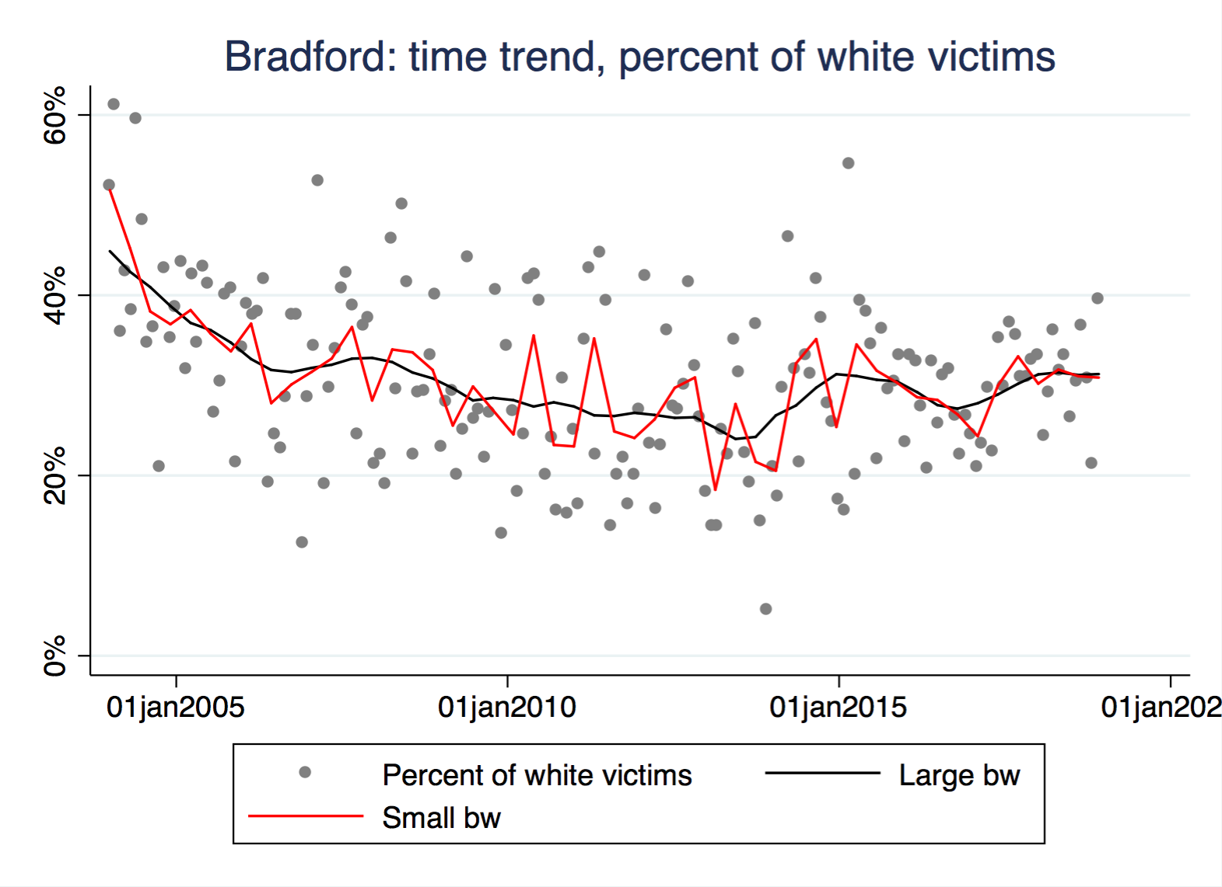

Slide 36
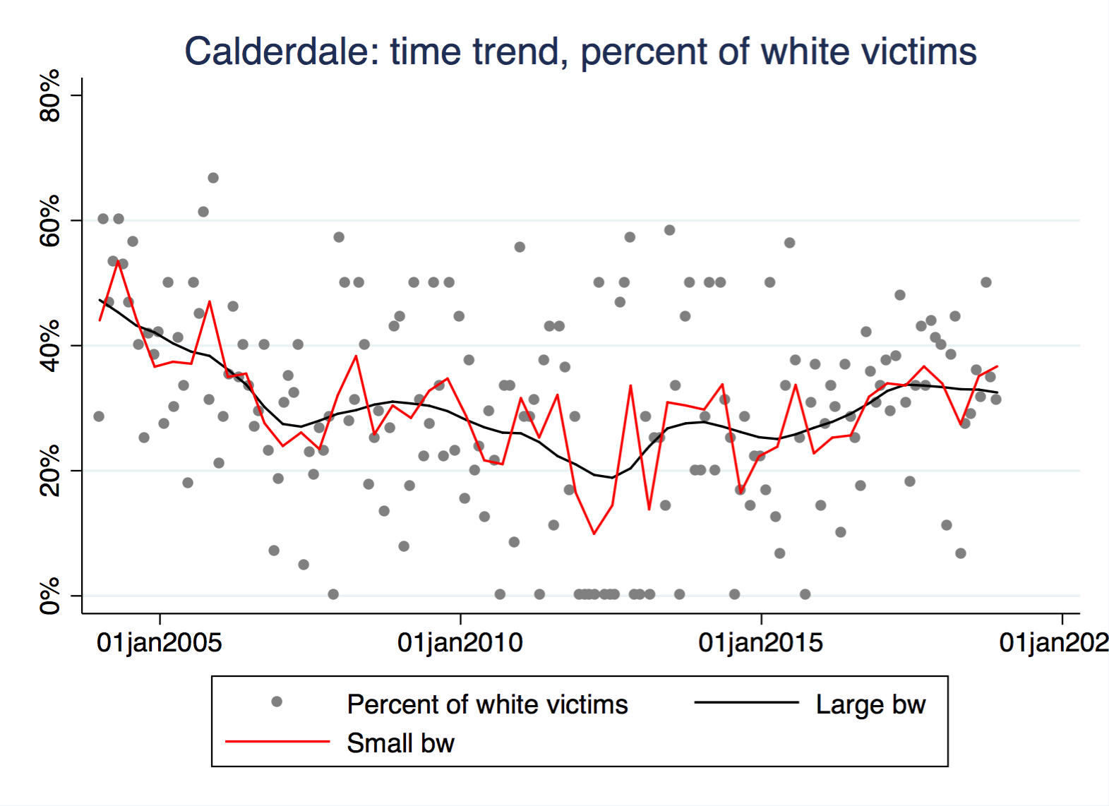

Slide 37
White offenders
The numbers recorded are low.
  1-22 per month in Bradford
  0-12 per month in Calderdale
The average numbers are relatively stationary.
The percentages are both high and stationary.
  Ca. 70% of known offenders in Bradford
  Ca. 80% of known offenders in Calderdale

Slide 38
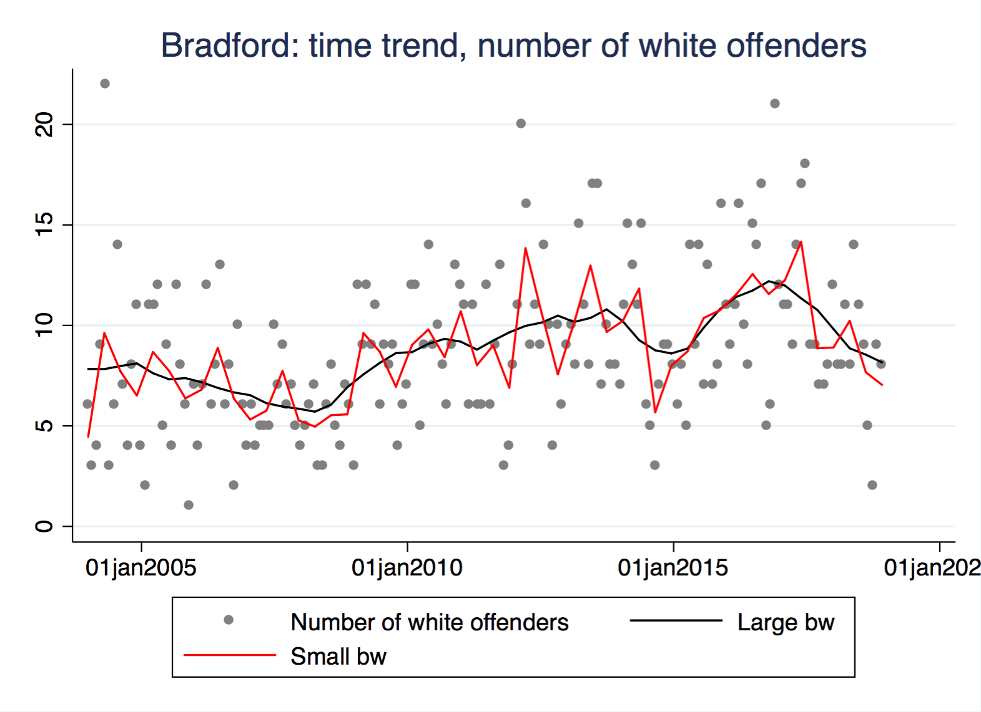

Slide 39
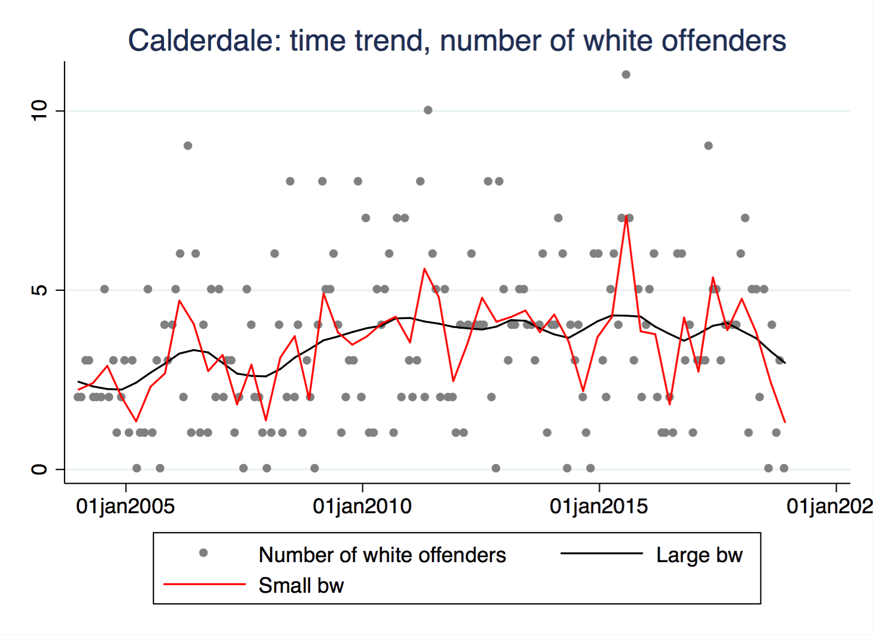

Slide 40
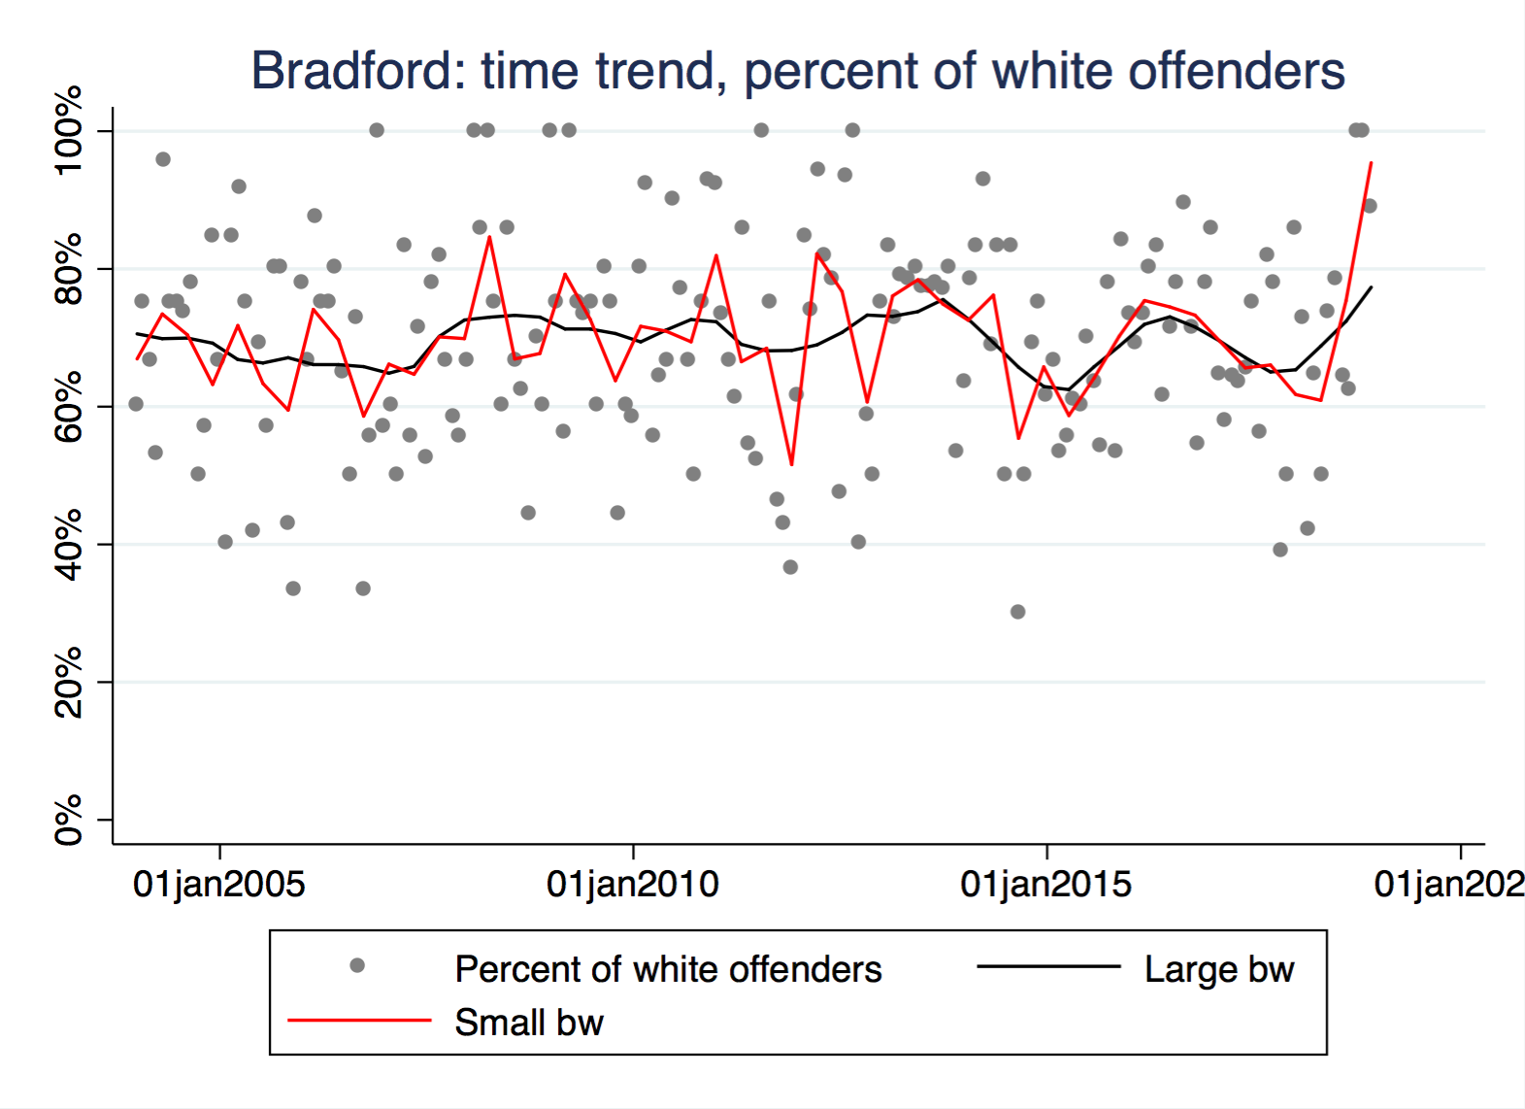

Slide 41
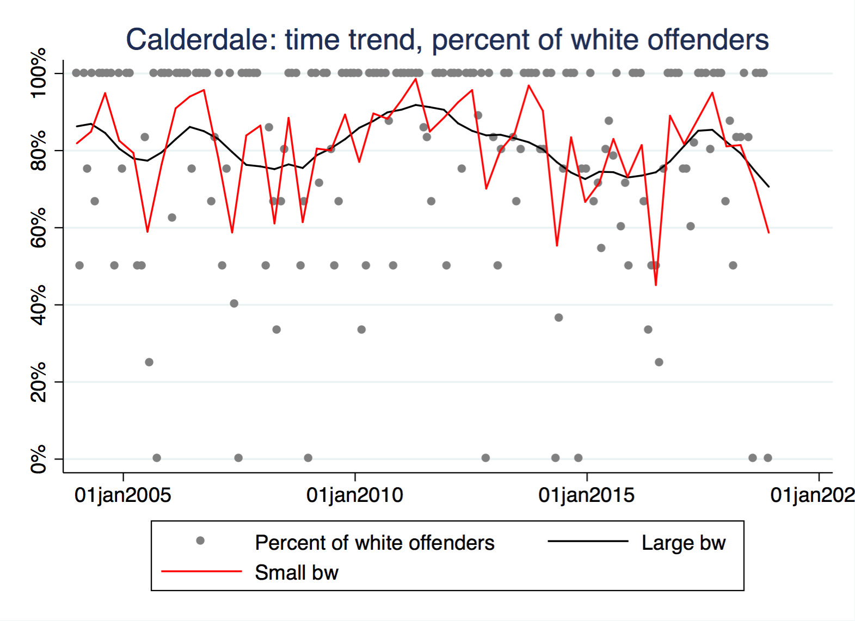

Slide 42
Muslim offenders
Numbers recorded even lower
  0-10 per month in Bradford
  0-6 per month in Calderdale
The average numbers relatively stationary.
The percentages are also quite stationary.
  Ca. 20% of known offenders in Bradford
  Ca. 10% of known offenders in Calderdale
That’s (slightly) below population percentage in Bradford, but above in Calderdale.
  Comments?

Slide 43
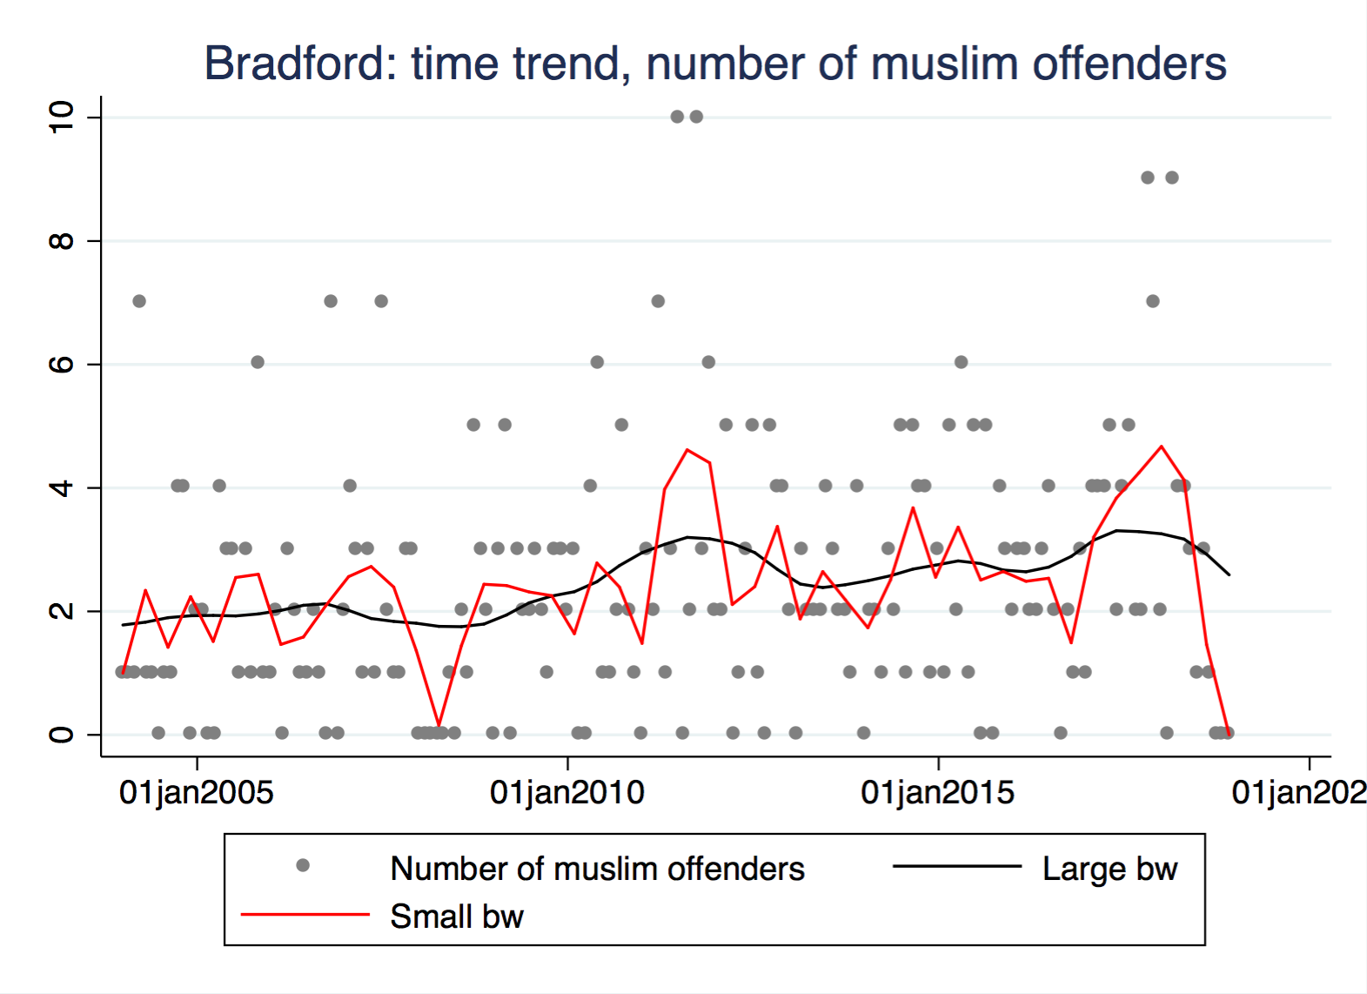

Slide 44
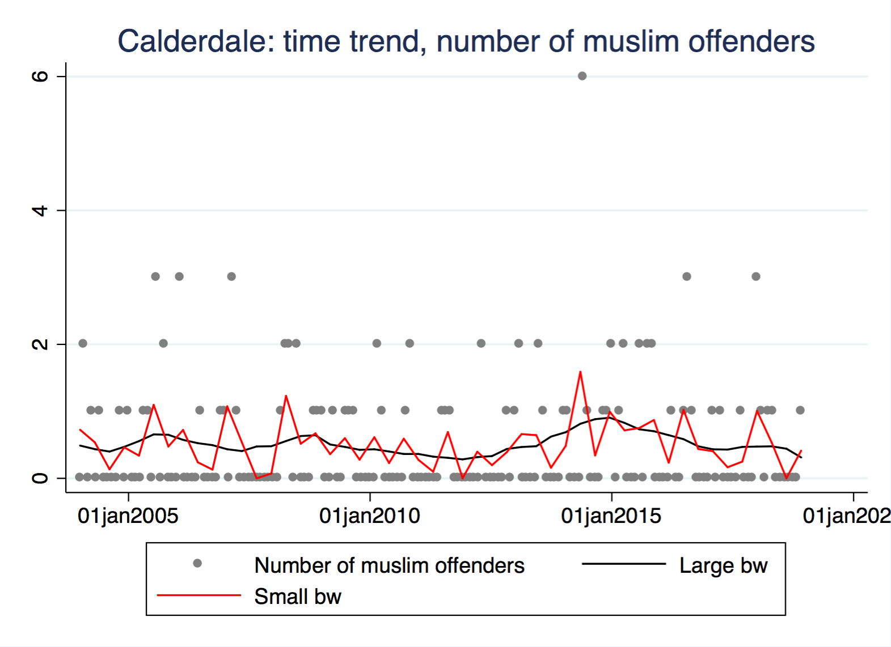

Slide 45
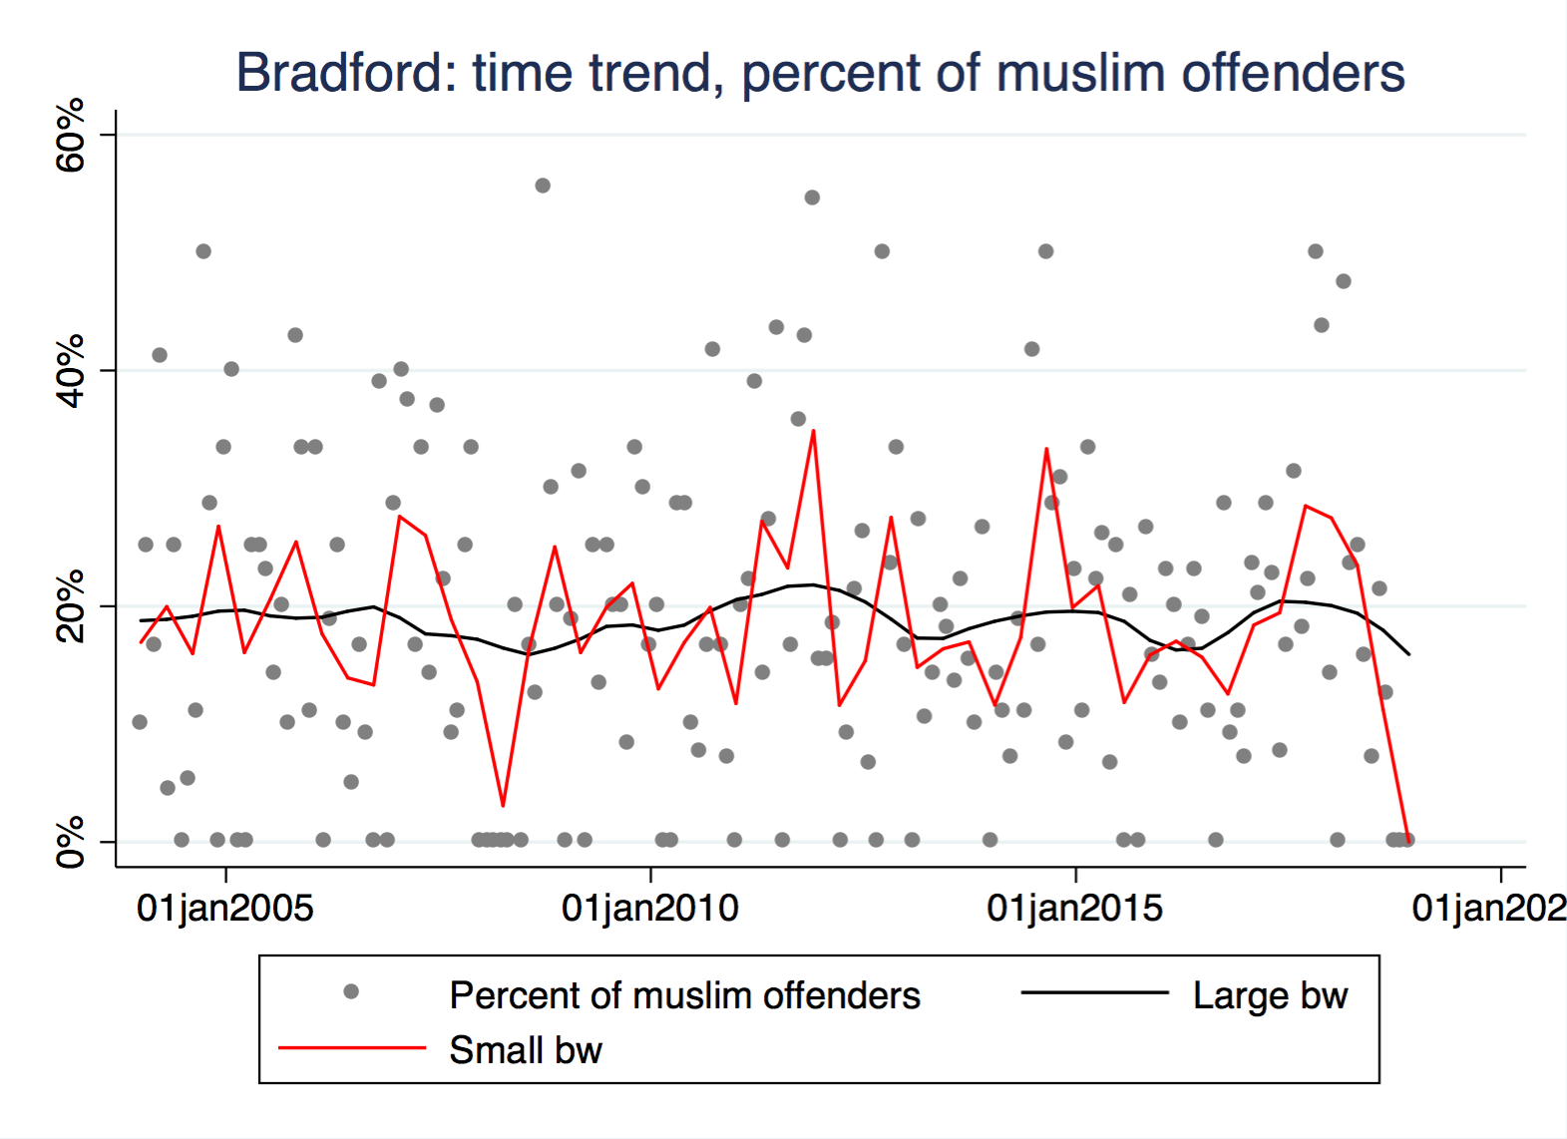

Slide 46
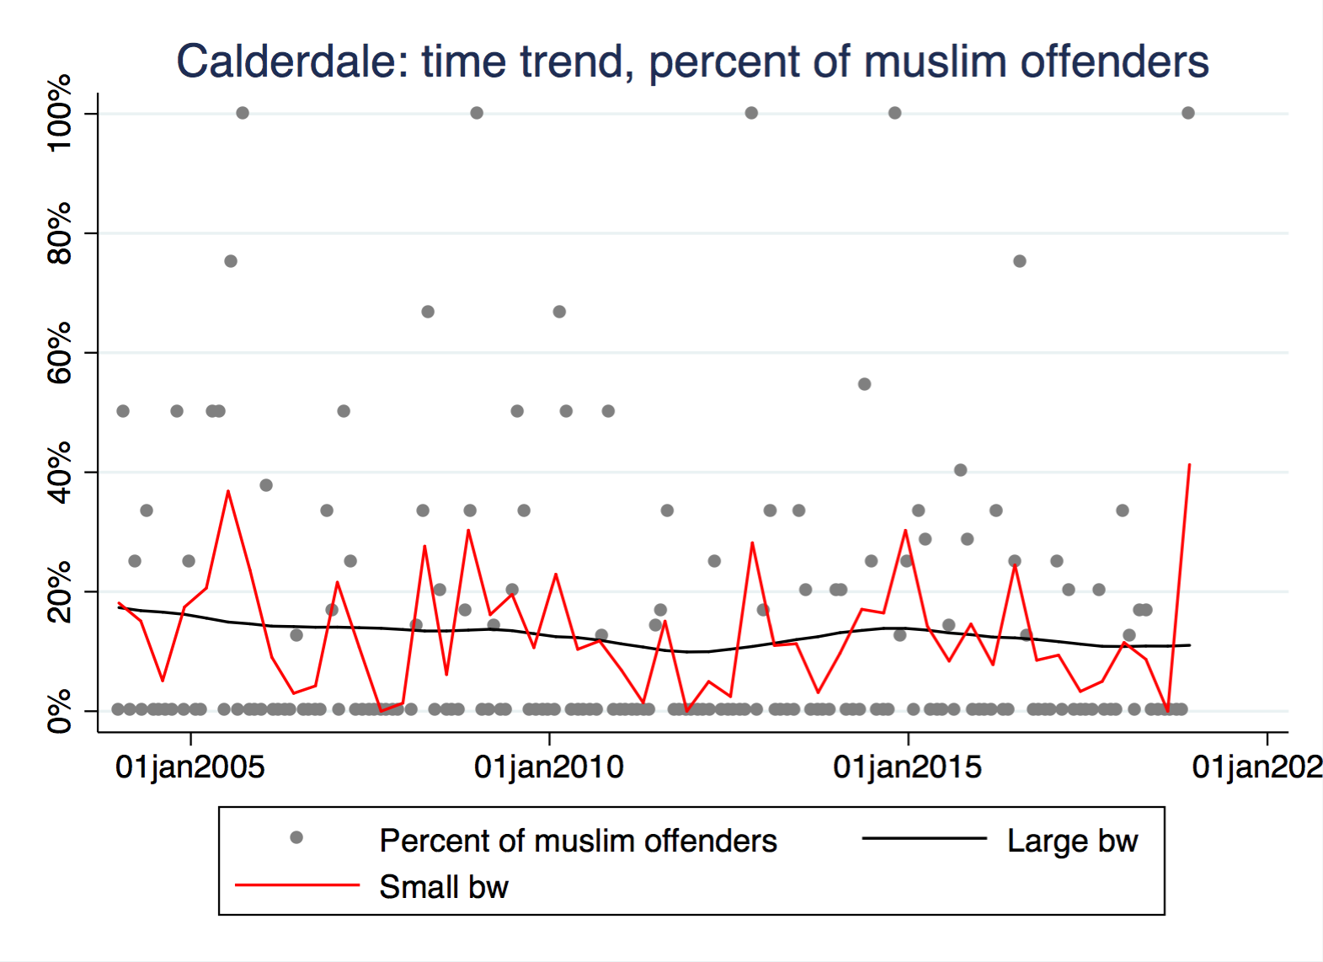

Slide 47
Muslim population density
In wards with less than 40% Muslims, there are more Muslim victims than demographic share.
  But in wards with more than 40% Muslims, there are fewer Muslim victims than demographic share.
    Does that indicate that Muslims are “safer” in Muslim-dominated wards than elsewhere?
In wards with more than 20% Muslims, there are fewer Muslim offenders than demographic share.
  But in many wards with less than 20% Muslims, there are more Muslim offenders than demographic share.
    Why on earth would Muslims be over-represented as offenders in white-dominated wards?
Notes:
I took out the sub-bullet indicating that the last bullet might be due to low crime rates because the sample size was large enough to be robust

Slide 49
Notes:
The greater than 40% category includes only Park

Slide 51
Notes:
The greater than 40% category includes only Park

Slide 52
White population density
In wards with less than 25% whites, there are more white victims than demographic share.
  In wards with more than 50% whites, there are fewer white victims than demographic share.
    Does that indicate that whites are at greater risk in “diverse” wards than elsewhere?
In wards with more than 60% whites, there are slightly fewer white offenders than demographic share.
  But in wards with less than 60% whites, there are more white offenders than demographic share.
    Why on earth would whites be over-represented as offenders in more “diverse” wards?

Slide 54
Notes:
The less than 40% category includes only Park

Slide 56
Notes:
The less than 40% category includes only Park

Slide 57
Increased victimization after dramatic events?
Dramatic events seem to have little short-term effect on hate crime, contrary to what nation-level reports would seem to suggest.
Does that also correspond with your impression and experience,
or do you have systematic or anecdotal evidence to the contrary?
What about longer-term effects, e.g. since the Brexit campaign?

Slide 58
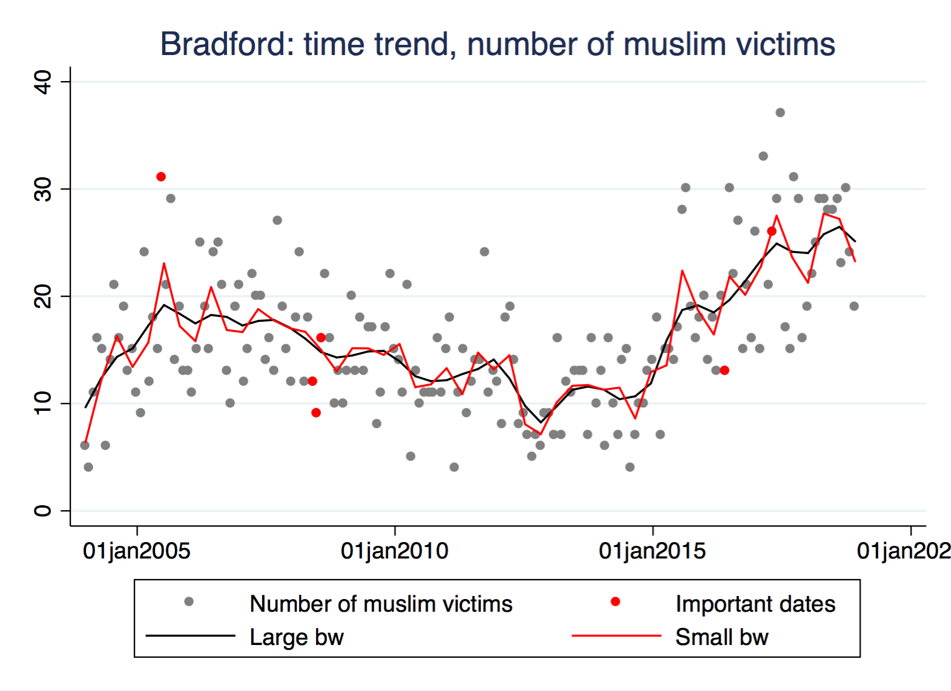
Central London Bombings
Manchester Arena Bombing
Jo Cox/Brexit Referendum
Child Grooming Scandal

Slide 59
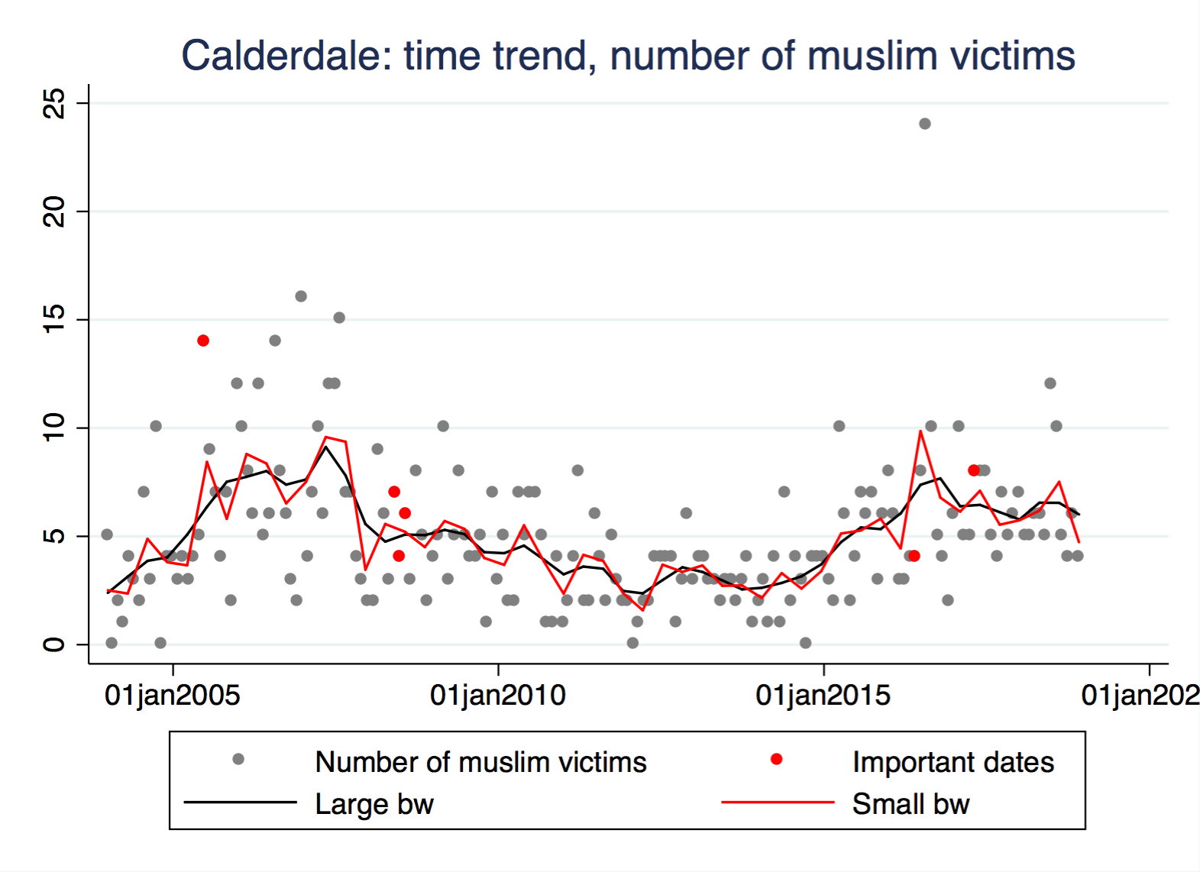
Central London Bombings
Manchester Arena Bombing
Child Grooming Scandal
Jo Cox/Brexit Referendum

Slide 60
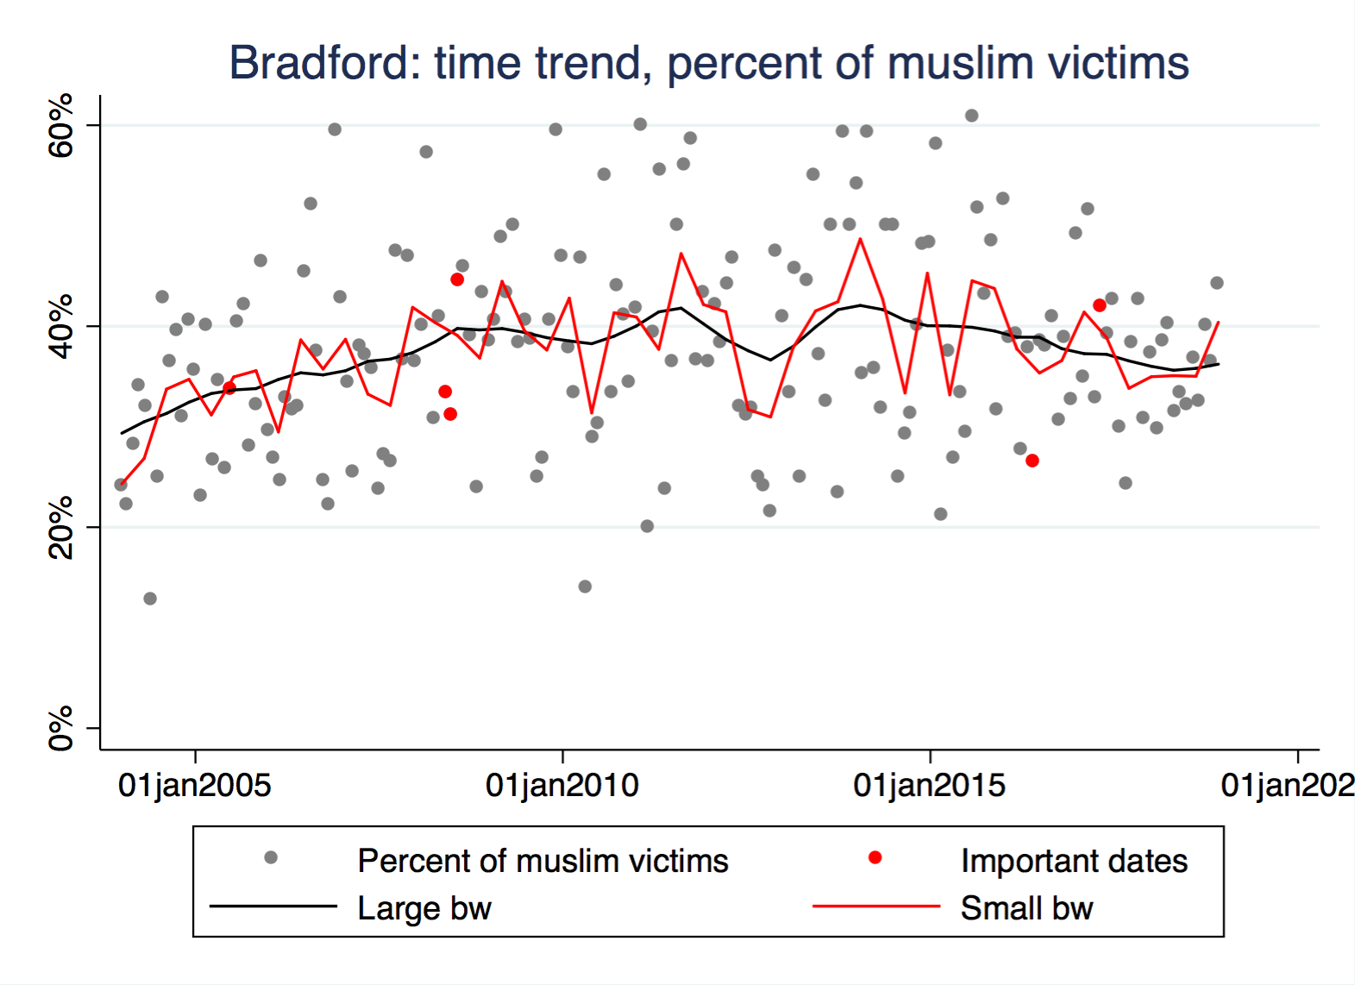
Central London Bombings
Manchester Arena Bombing
Child Grooming Scandal
Jo Cox/Brexit Referendum

Slide 61
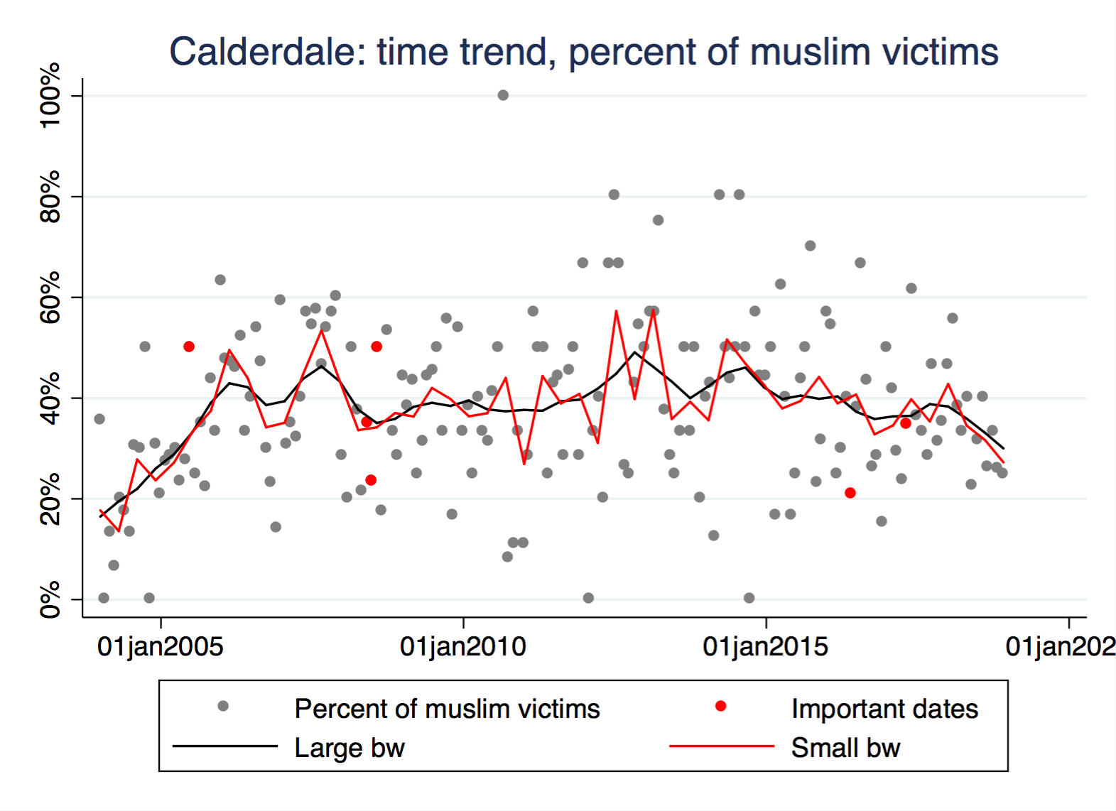
Central London Bombings
Manchester Arena Bombing
Child Grooming Scandal
Jo Cox/Brexit Referendum

Slide 62
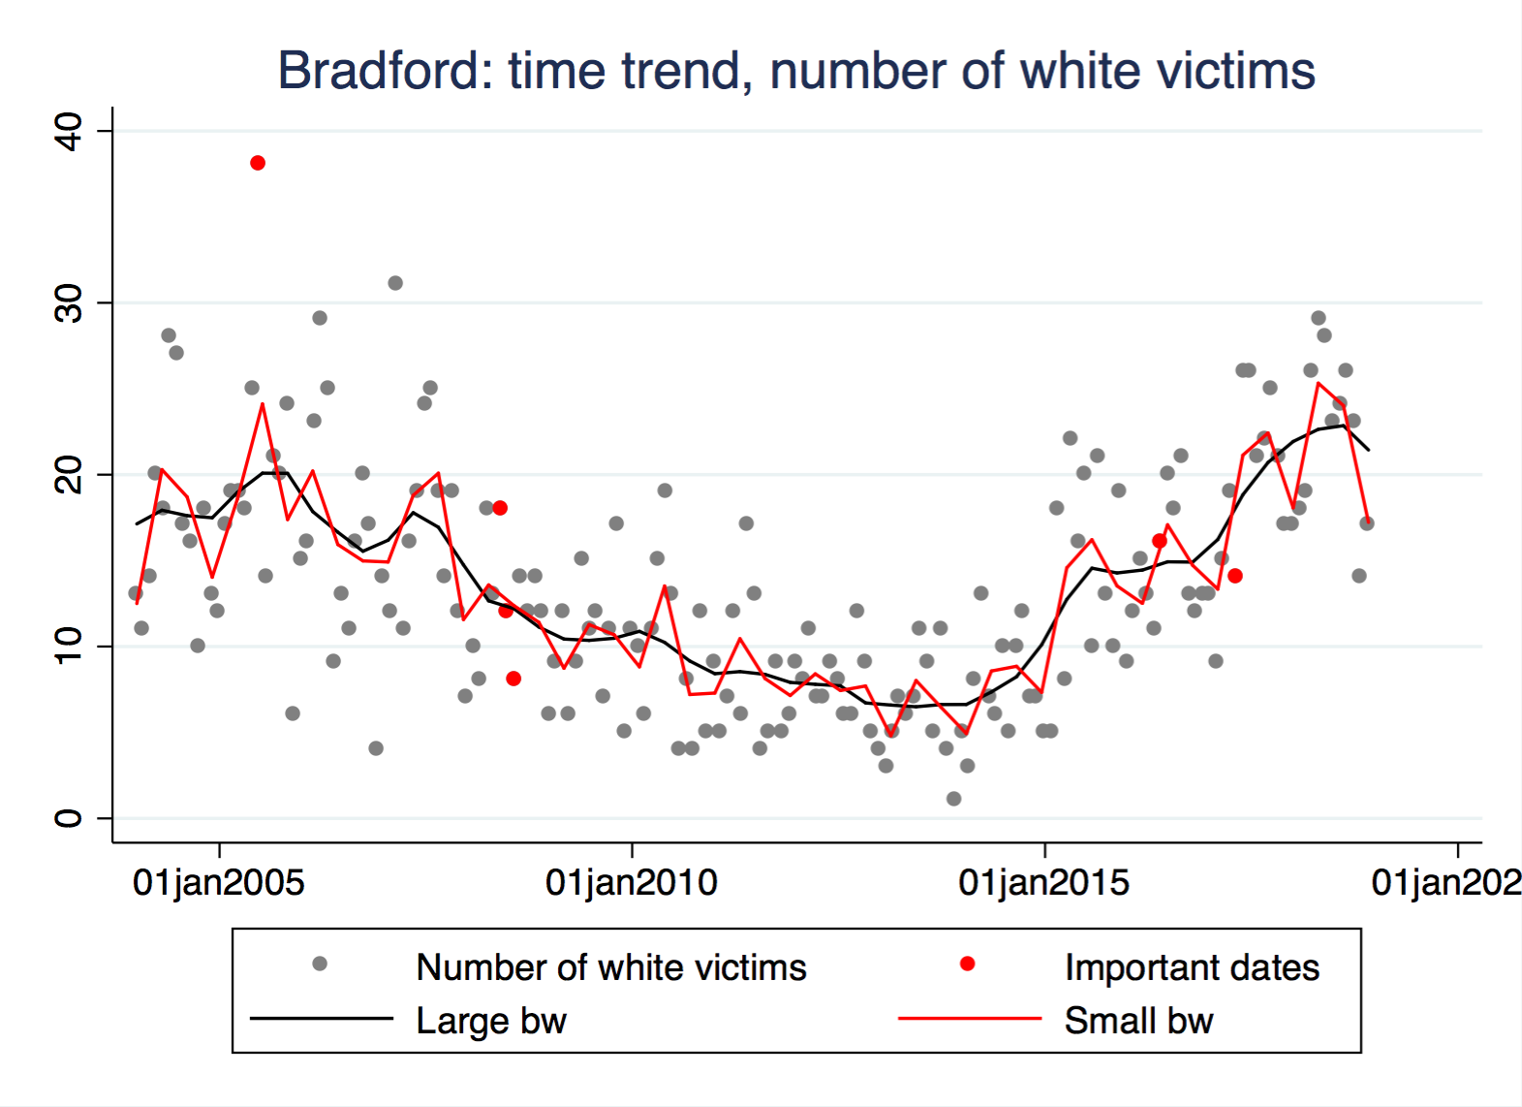
Central London Bombings
Manchester Arena Bombing
Jo Cox/Brexit Referendum
Child Grooming Scandal

Slide 63
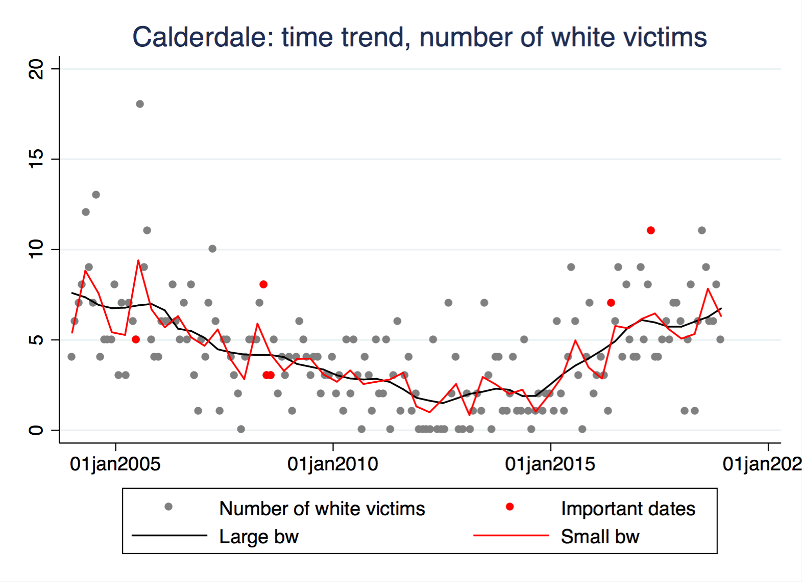
Central London Bombings
Manchester Arena Bombing
Child Grooming Scandal
Jo Cox/Brexit Referendum

Slide 64
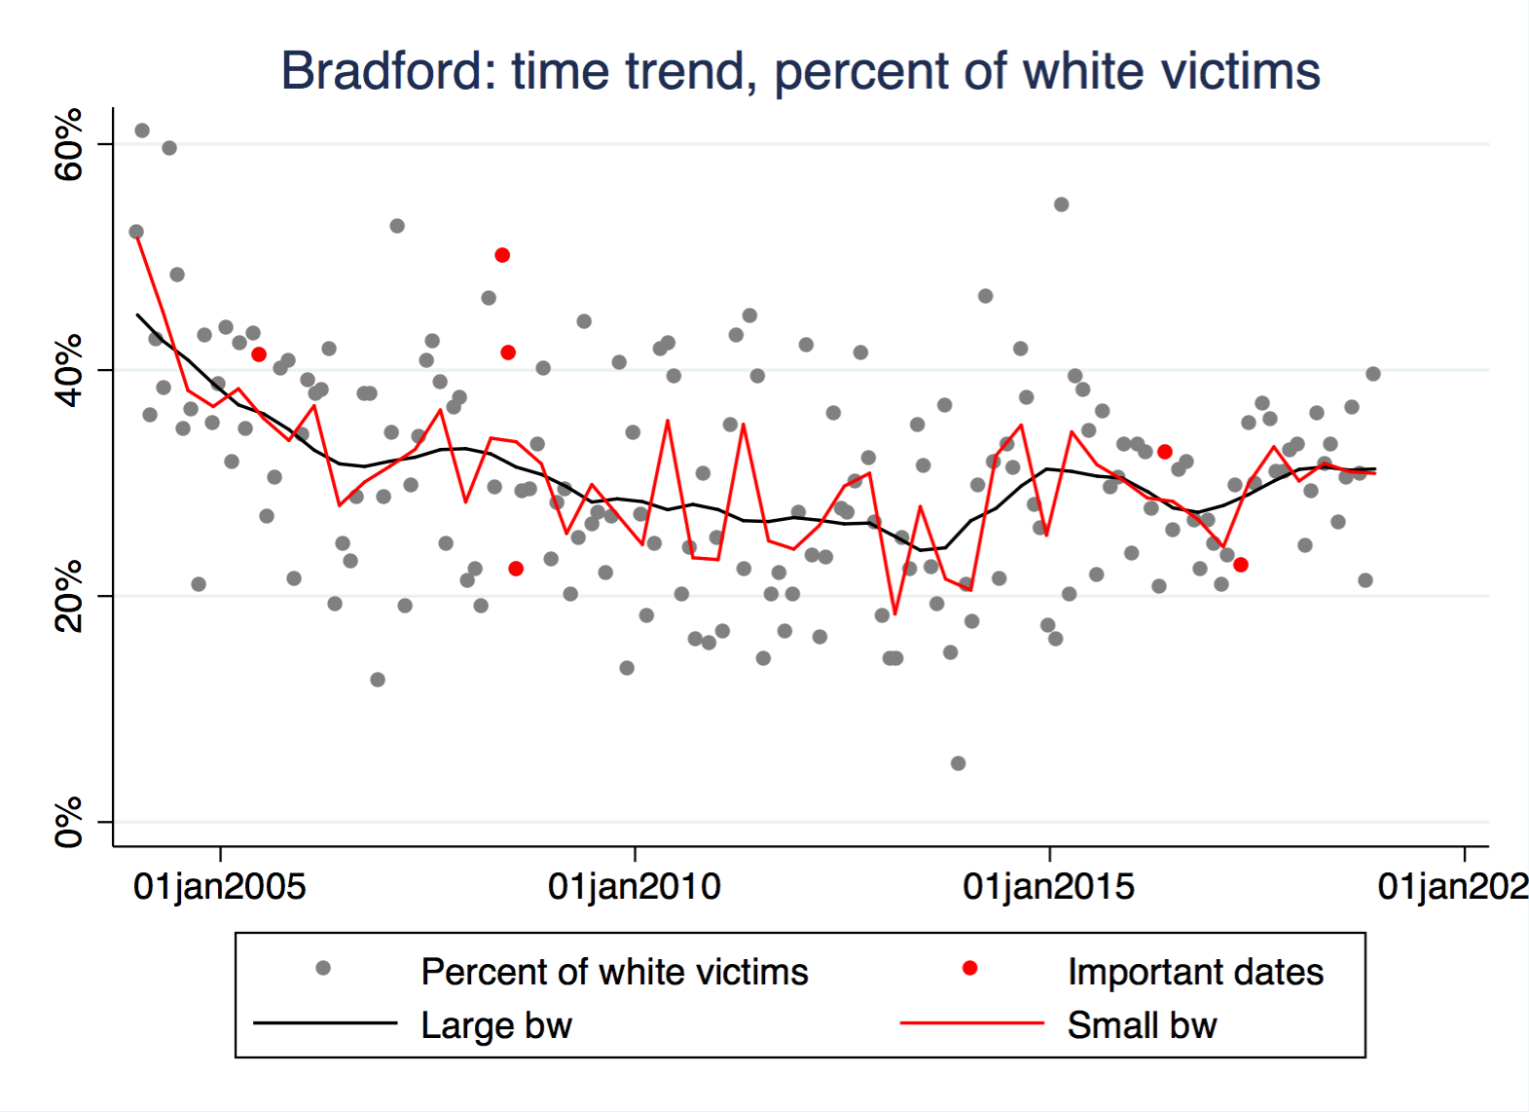
Central London Bombings
Child Grooming Scandal
Jo Cox/Brexit Referendum
Manchester Arena Bombing

Slide 65
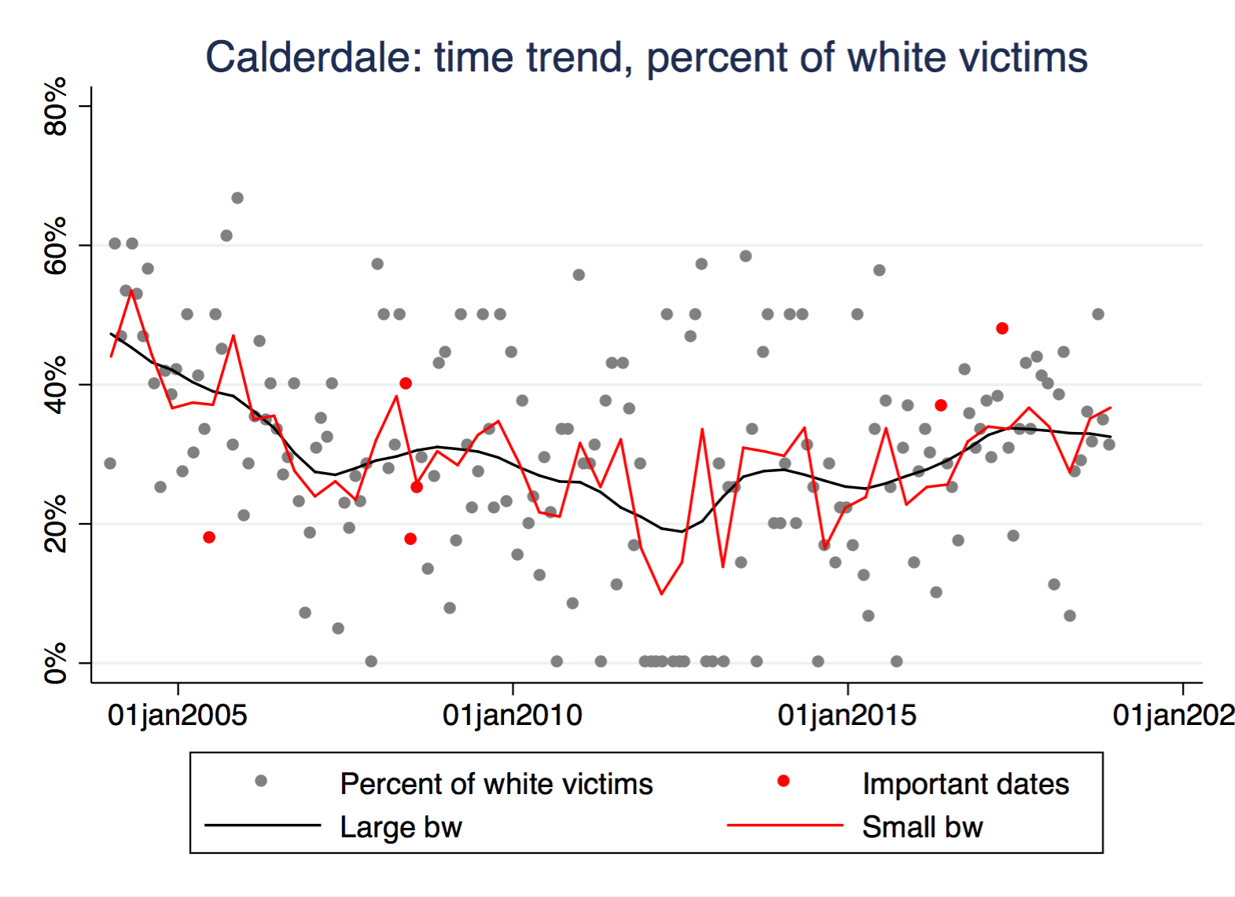
Manchester Arena Bombing
Central London Bombings
Jo Cox/Brexit Referendum
Child Grooming Scandal

Slide 66
Offence types and outcomes
White-White and White-Muslim hate crimes are more likely to be arson than Muslim-White hate crimes (Muslim-Muslim is never arson).
Muslim-Muslim hate crimes are the most likely to be violent, although this might be attributable to small sample size (12 cases only).
Hate crimes with Muslim offenders are slightly more likely to result in a charge/summons than hate crimes with white offenders.

Slide 67
Offense
Offense | Muslim-white | White-muslim | White-white | Muslim-muslim
Arson and criminal damage | 3 | 39 | 14 | 0
Miscellaneous crimes against society | 2 | 0 | 1 | 0
Public order offences | 106 | 291 | 72 | 11
Robbery | 0 | 4 | 0 | 0
Sexual offences | 1 | 0 | 0 | 0
Theft | 0 | 2 | 1 | 0
Violence against the person | 65 | 173 | 51 | 12
Grand Total | 177 | 509 | 139 | 23
Offense | Muslim-white | White-muslim | White-white | Muslim-muslim
Arson and criminal damage | 1.7% | 7.7% | 10.1% | 0.0%
Miscellaneous crimes against society | 1.1% | 0.0% | 0.7% | 0.0%
Public order offences | 59.9% | 57.2% | 51.8% | 47.8%
Robbery | 0.0% | 0.8% | 0.0% | 0.0%
Sexual offences | 0.6% | 0.0% | 0.0% | 0.0%
Theft | 0.0% | 0.4% | 0.7% | 0.0%
Violence against the person | 36.7% | 34.0% | 36.7% | 52.2%
Grand Total | 100.0% | 100.0% | 100.0% | 100.0%

Slide 68
Outcome
Outcome | Muslim-White | White-Muslim | White-White | Muslim-Muslim
Charge/Summons | 155 | 422 | 118 | 21
Evidential difficulties: Suspect ID | 0 | 3 | 0 | 0
Youth Caution | 10 | 25 | 3 | 2
Adult Caution | 3 | 24 | 6 | 0
Penalty Notice for Disorder | 2 | 7 | 2 | 0
Community Resolution | 1 | 16 | 5 | 0
Undetected | 6 | 12 | 3 | 0
Total | 177 | 509 | 137 | 23
Outcome | Muslim-White | White-Muslim | White-White | Muslim-Muslim
Charge/Summons | 87.6% | 82.9% | 86.1% | 91.3%
Evidential difficulties: Suspect ID | 0.0% | 0.6% | 0.0% | 0.0%
Youth Caution | 5.6% | 4.9% | 2.2% | 8.7%
Adult Caution | 1.7% | 4.7% | 4.4% | 0.0%
Penalty Notice for Disorder | 1.1% | 1.4% | 1.5% | 0.0%
Community Resolution | 0.6% | 3.1% | 3.6% | 0.0%
Undetected | 3.4% | 2.4% | 2.2% | 0.0%
Total | 100.0% | 100.0% | 100.0% | 100.0%

Slide 69
Days of the week
Whites offend most on Saturday, followed by Sunday.
Muslims are most heavily victimized on weekends.
Muslims offend more on weekdays, especially Wednesday.
Highest percentage of white victims is also on weekdays.
What drives these patterns?

Slide 70
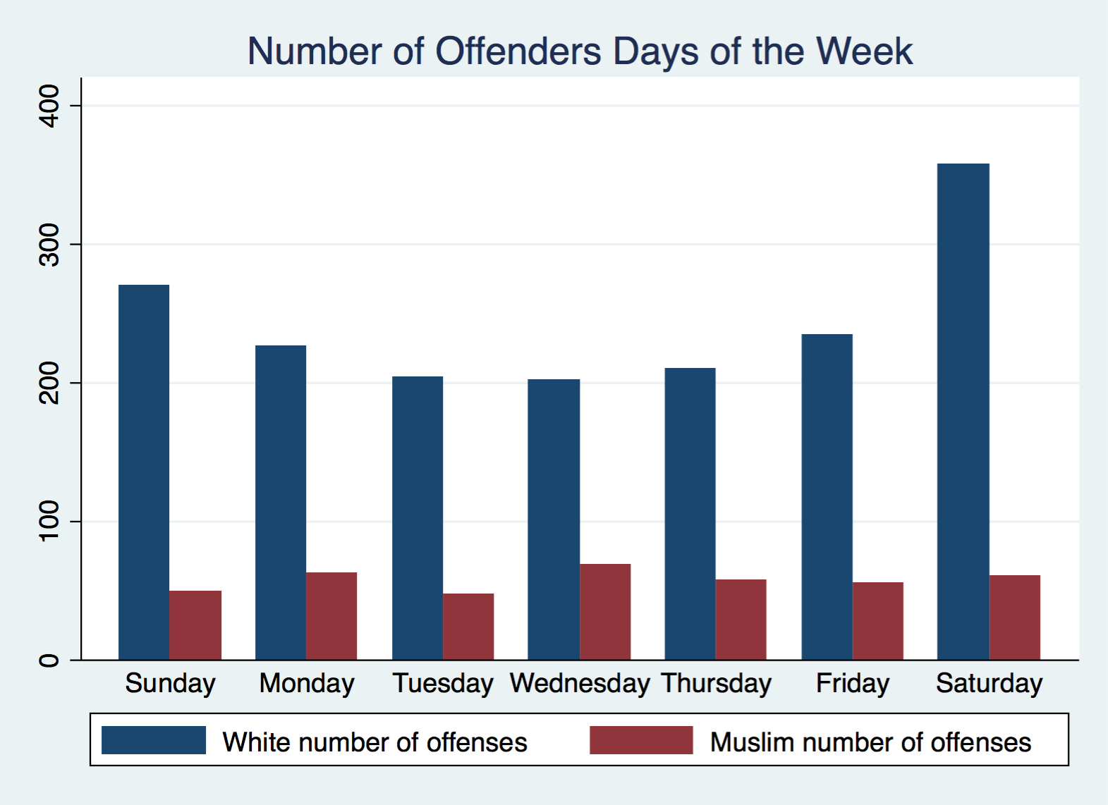

Slide 71
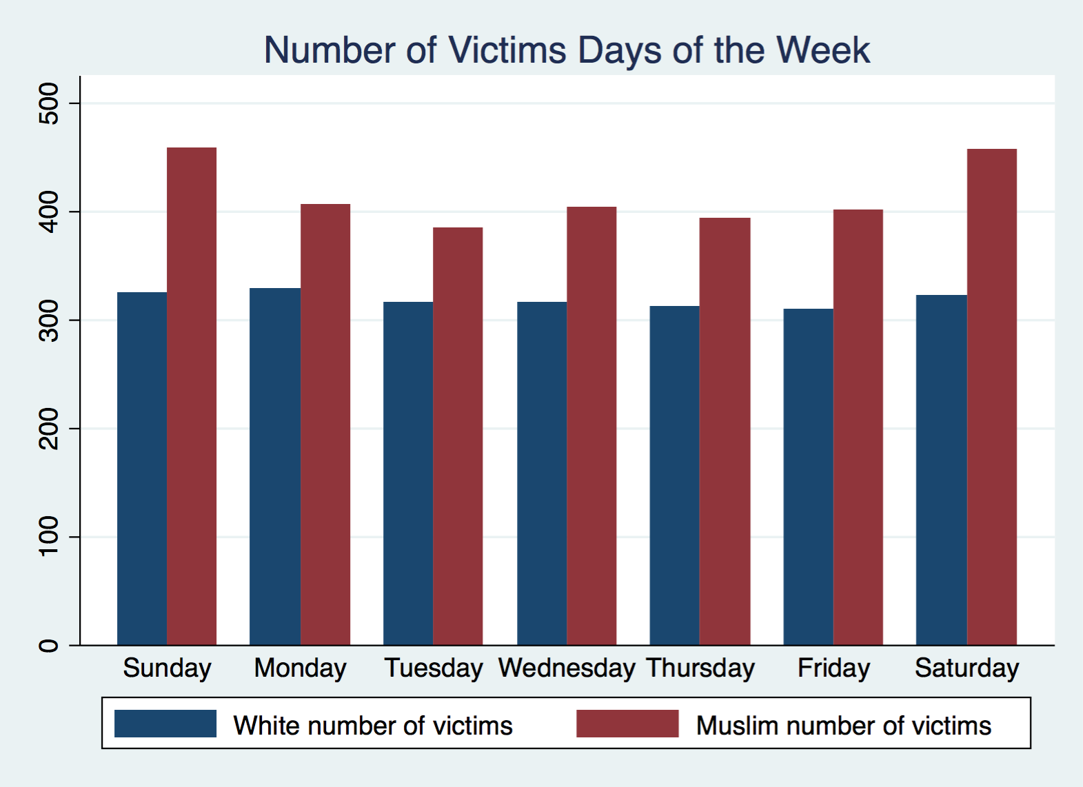

Slide 72
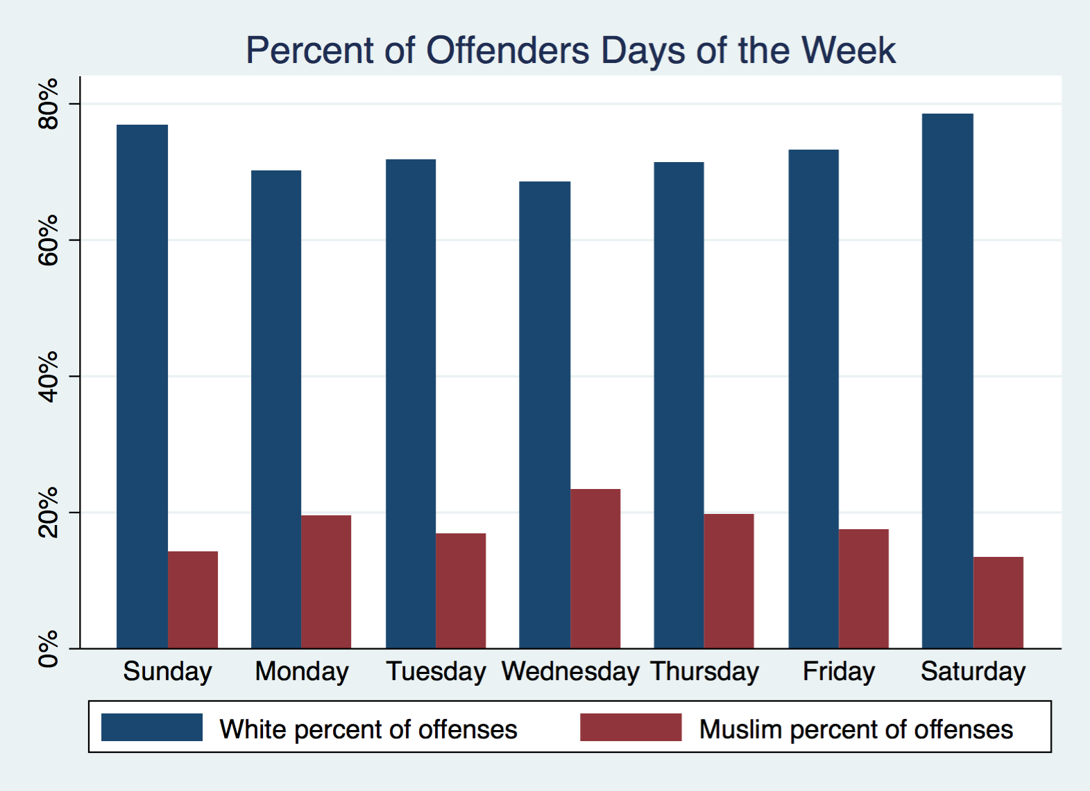

Slide 73
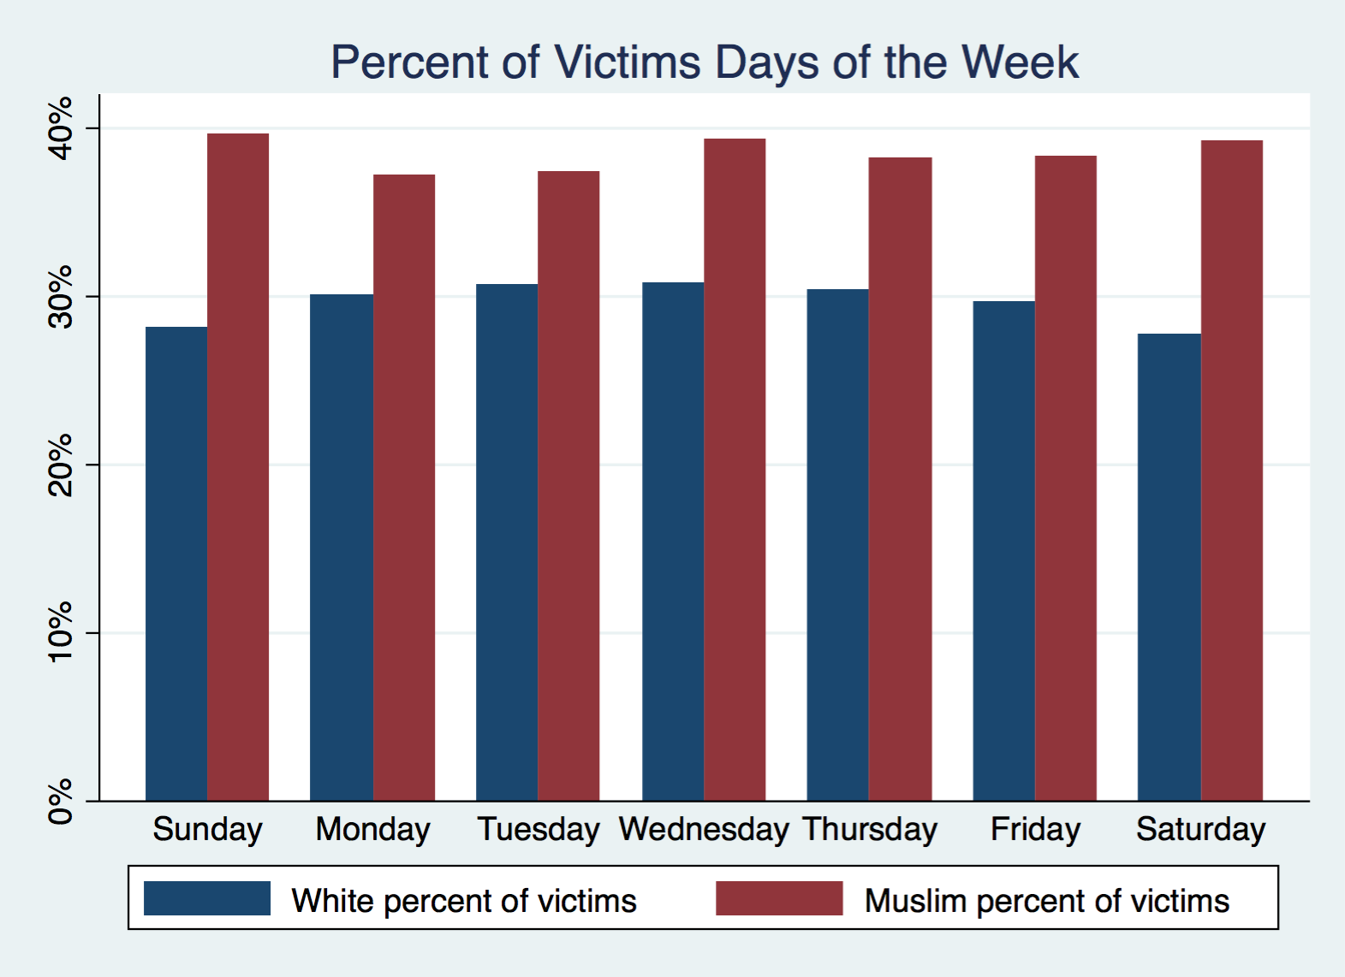

Slide 74
Hours of the day
A daily climax
  Over the afternoon, both victimization and offending start increasing.
  After 10pm, victimization and offending increase to the highest levels.
  There is a surprising drop immediately after midnight.
  What drives these patterns?
After 10pm
  Victimization spikes for Muslims but increases less dramatically for whites.
  Victimization spikes for men but increases less dramatically for women.
  Offending spikes for whites, but increases only modestly for Muslims.
  Offending spikes for men, but increases only modestly for women.
  What drives these patterns?

Slide 75
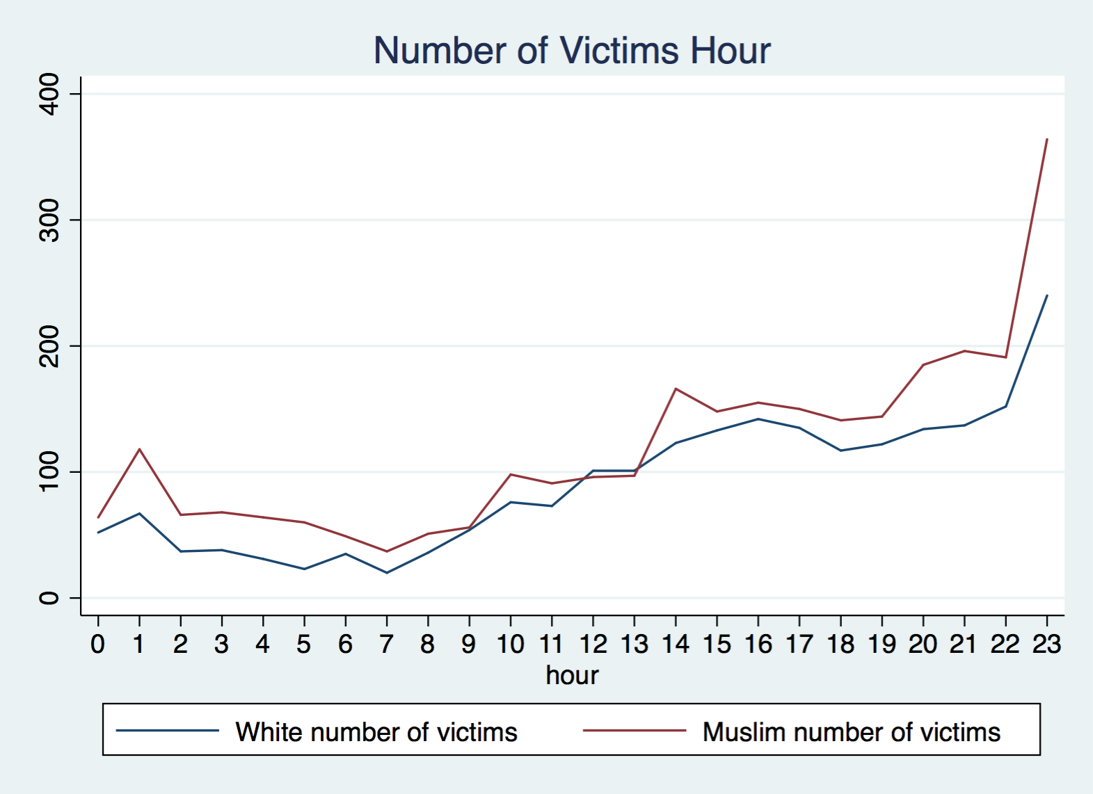

Slide 76
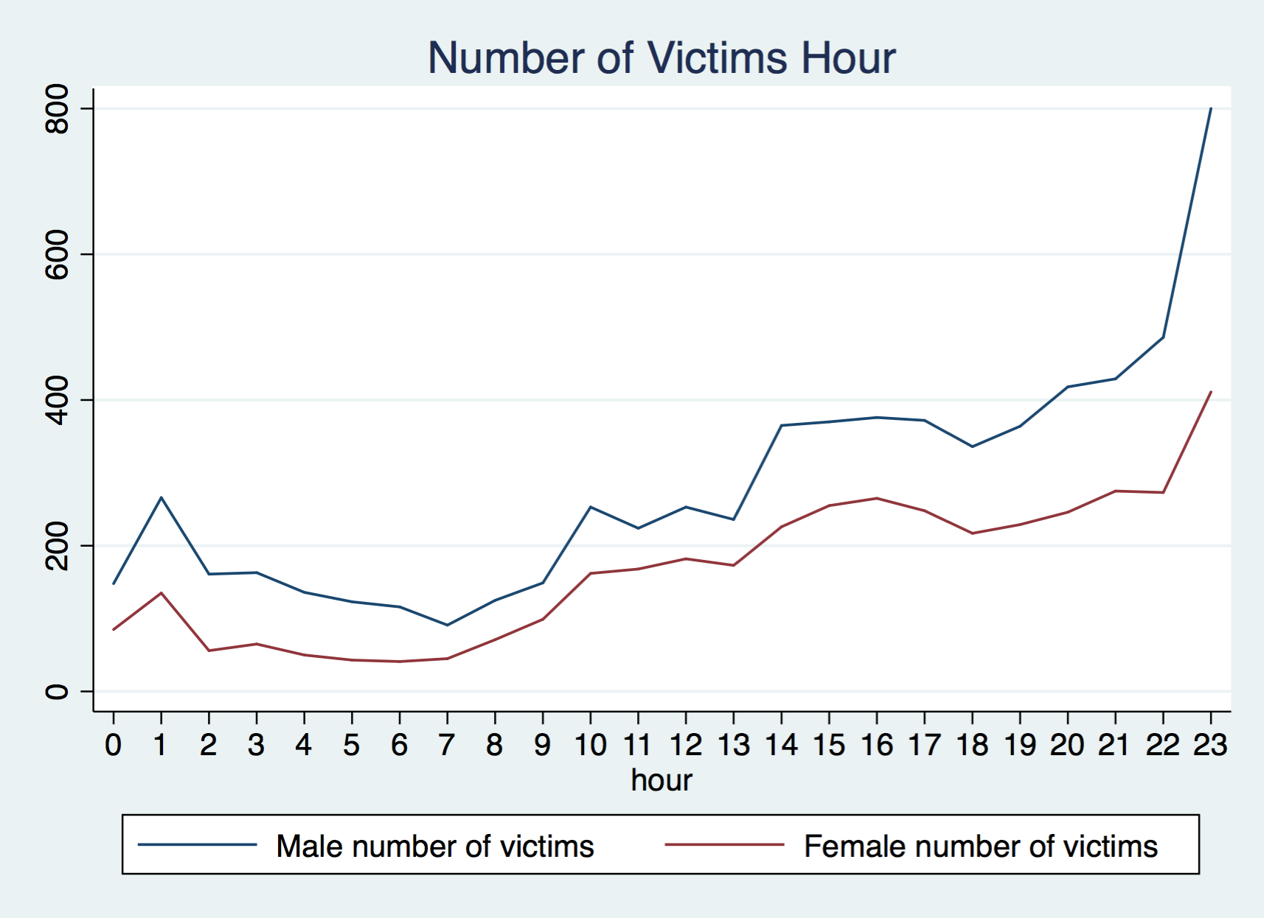

Slide 77
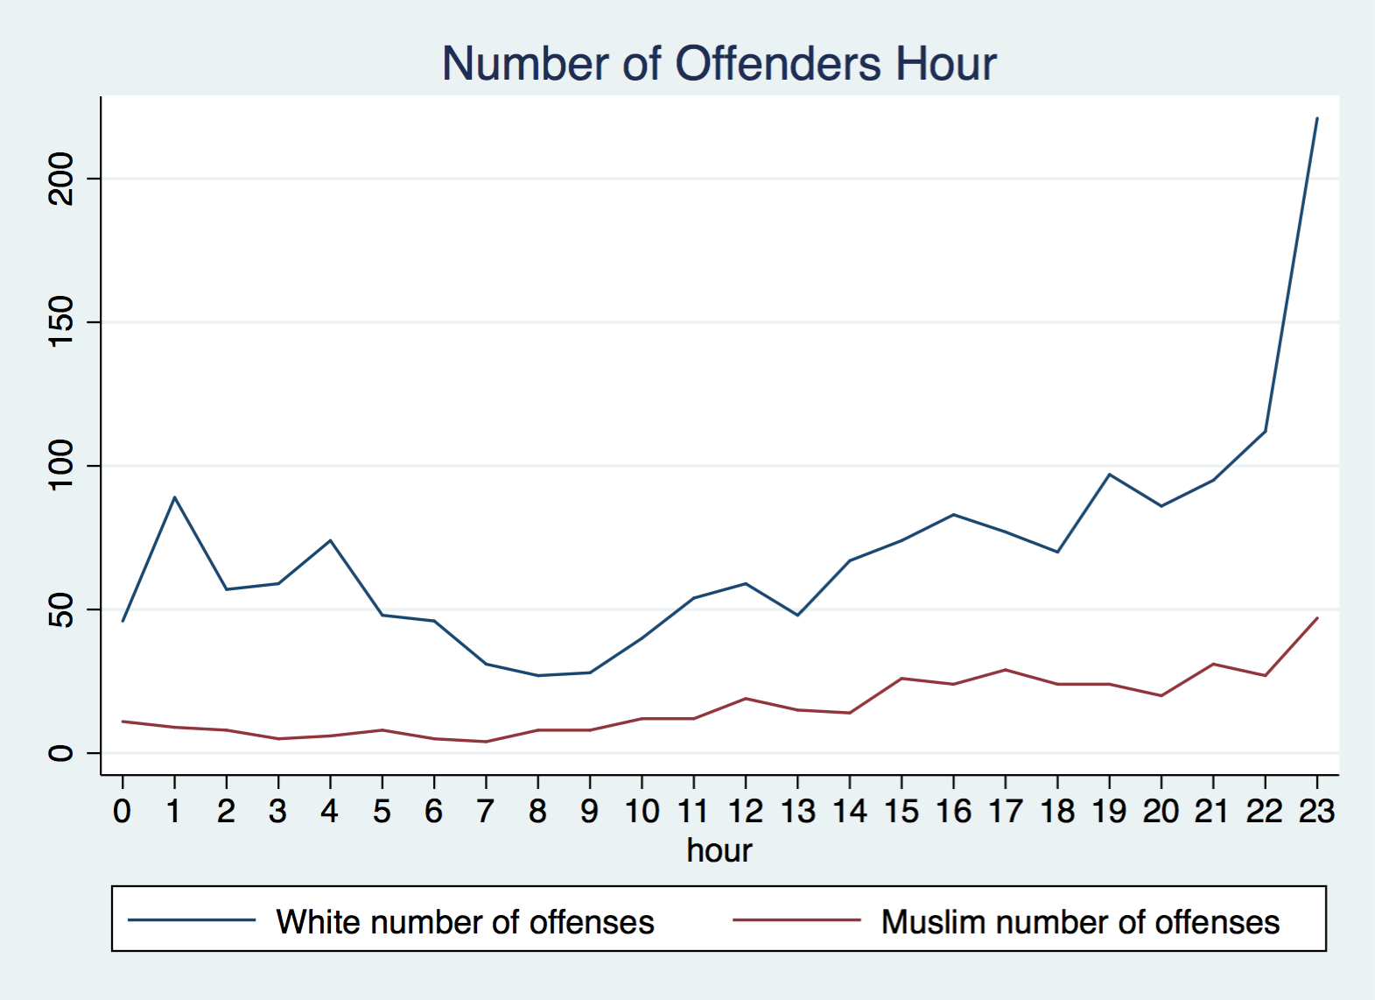

Slide 78
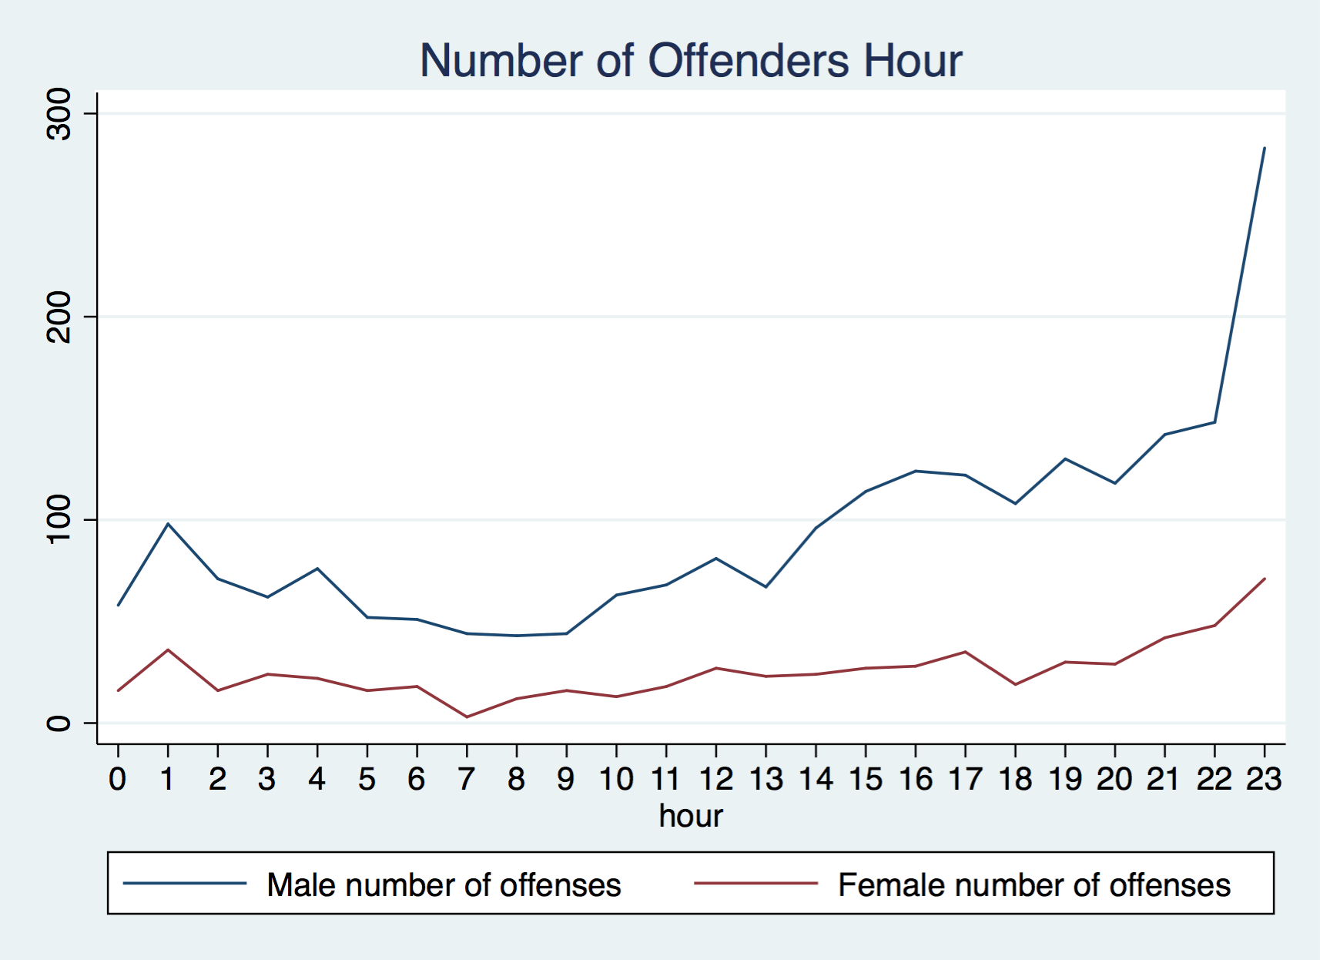

Slide 79
Hours of the day – percentages
From midnight to 8am, there are far more Muslim than white victims.
  There is an extreme hike between around 4am and 5am.
During most of the day, the numbers Muslim/white victims converge.
  Note the different share of Muslims and whites of the general population.
From 8pm to midnight, there are again more Muslim than white victims.
There are far more white than Muslim offenders at any time of the day.

Slide 80
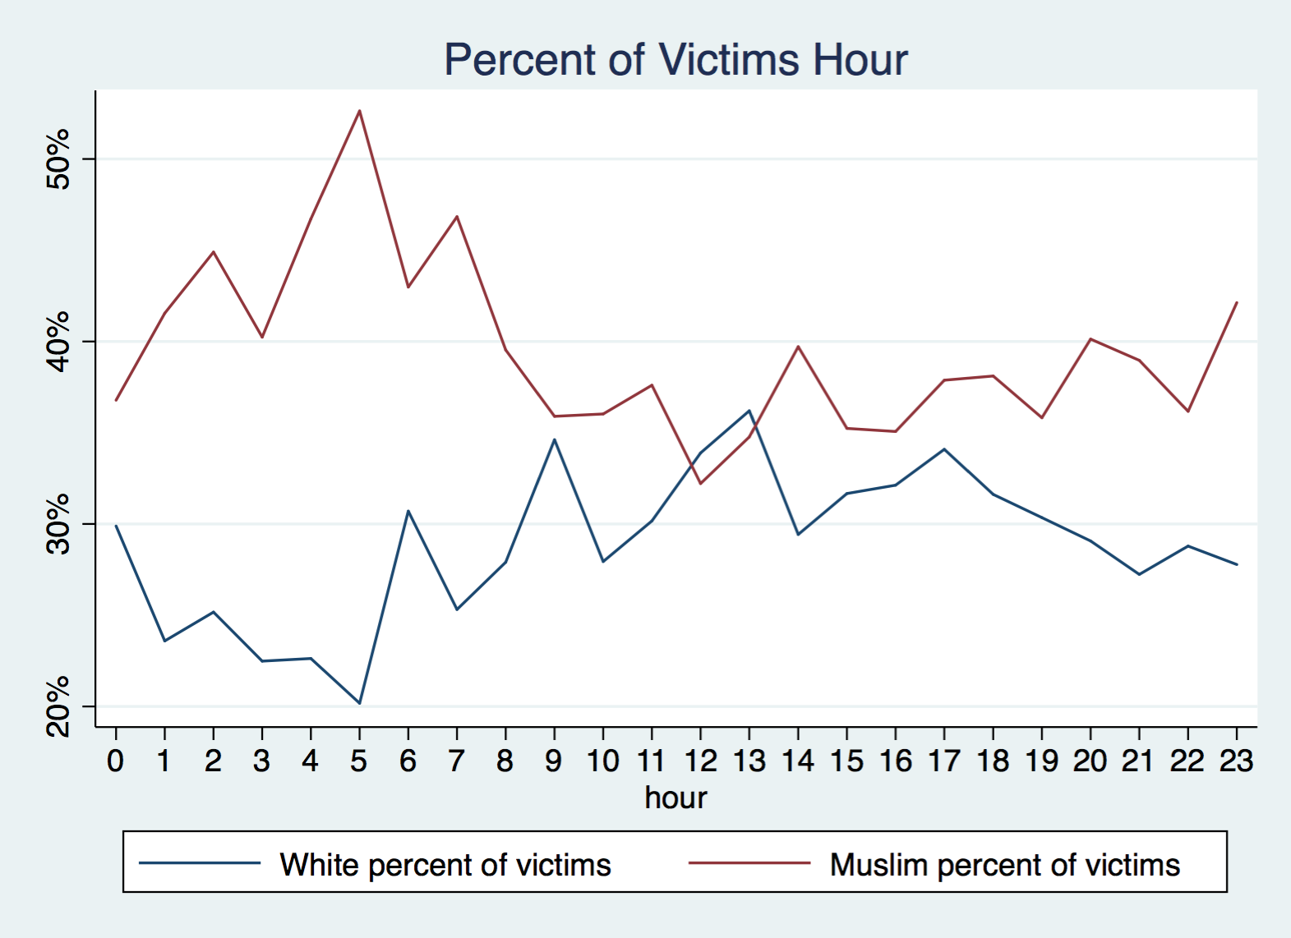

Slide 81
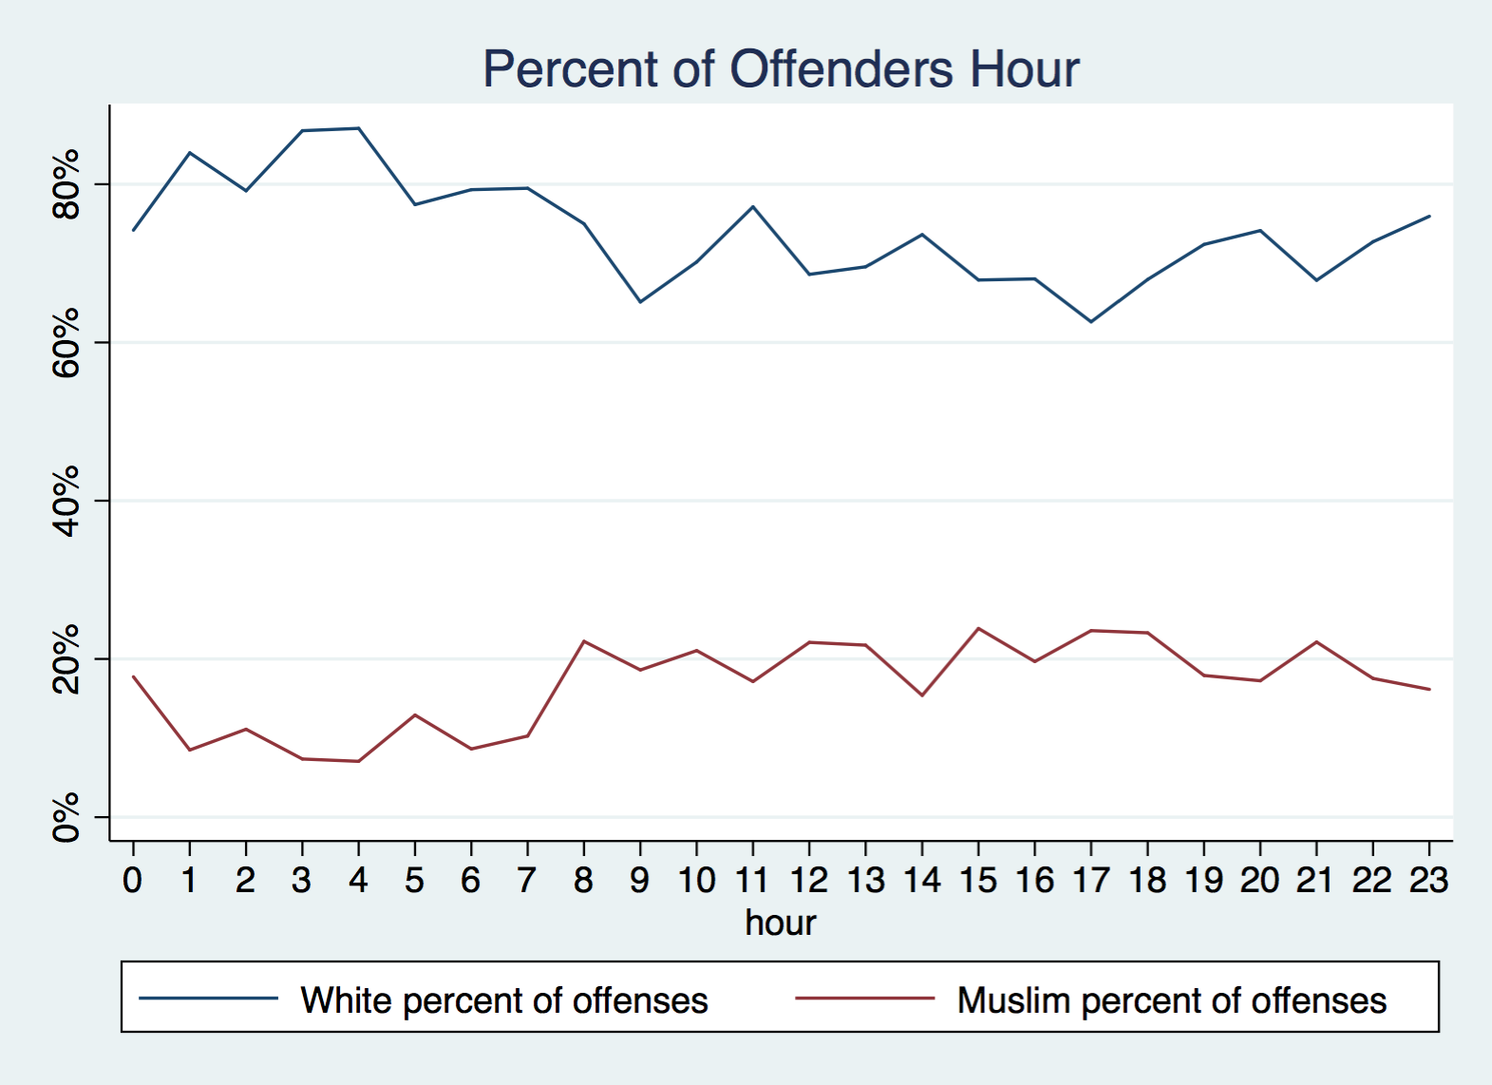

Slide 82
There are more male than female victims.
  Ca. 60/40 during most of the day.
  Ca. 70/30 during the early morning.
    Why?
There are far more male than female offenders.
  Ca. 80/20 all over the day.
  Stark outlier (ca. 95/5) around 7am.
    Why?

Slide 83


Slide 84


Slide 85
There are more white male than Muslim male offenders.
  The pattern (ca. 40/10) is consistent for any time of the day.
Muslim women hardly offend.
White women do offend, but much less then white men
  The highest incidence is in the early morning.
  There is another (moderate) peak around noon.

Slide 86


Slide 87


Slide 88
There are more male Muslim than male white victims.
  Especially during the late night and early morning.
    Why?
There are more female white than female Muslim victims.
  The pattern is consistent for any time of the day.
    Why?

Slide 89


Slide 90


Slide 91
How do these findings sit with the narrative of
“gendered Islamophobia”?
Prof. Peter Hopkins, Newcastle University, 2018:
“Most victims of anti-Muslim hatred are women.”
Source: Tell MAMA (2018) Beyond the Incident: Annual Report 2017, p. 4.

