Slide 1

Original Article
20-Year Risks of Breast-Cancer Recurrence after Stopping Endocrine Therapy at 5 Years
Hongchao Pan, Ph.D., Richard Gray, M.Sc., Jeremy Braybrooke, B.M., Ph.D., Christina Davies, B.M., B.Ch., Carolyn Taylor, B.M., B.Ch., Ph.D., Paul McGale, Ph.D., Richard Peto, F.R.S., Kathleen I. Pritchard, M.D., Jonas Bergh, M.D., Ph.D., Mitch Dowsett, Ph.D., Daniel F. Hayes, M.D., for the EBCTCG
N Engl J Med
Volume 377(19):1836-1846
November 9, 2017

Slide 2
Study Overview
In a meta-analysis of 88 trials involving nearly 63,000 women with breast cancer who were disease-free after 5 years of endocrine therapy, the risk of recurrence ranged from 10 to 41% between years 5 and 20, depending on nodal status and tumor grade.

Slide 3
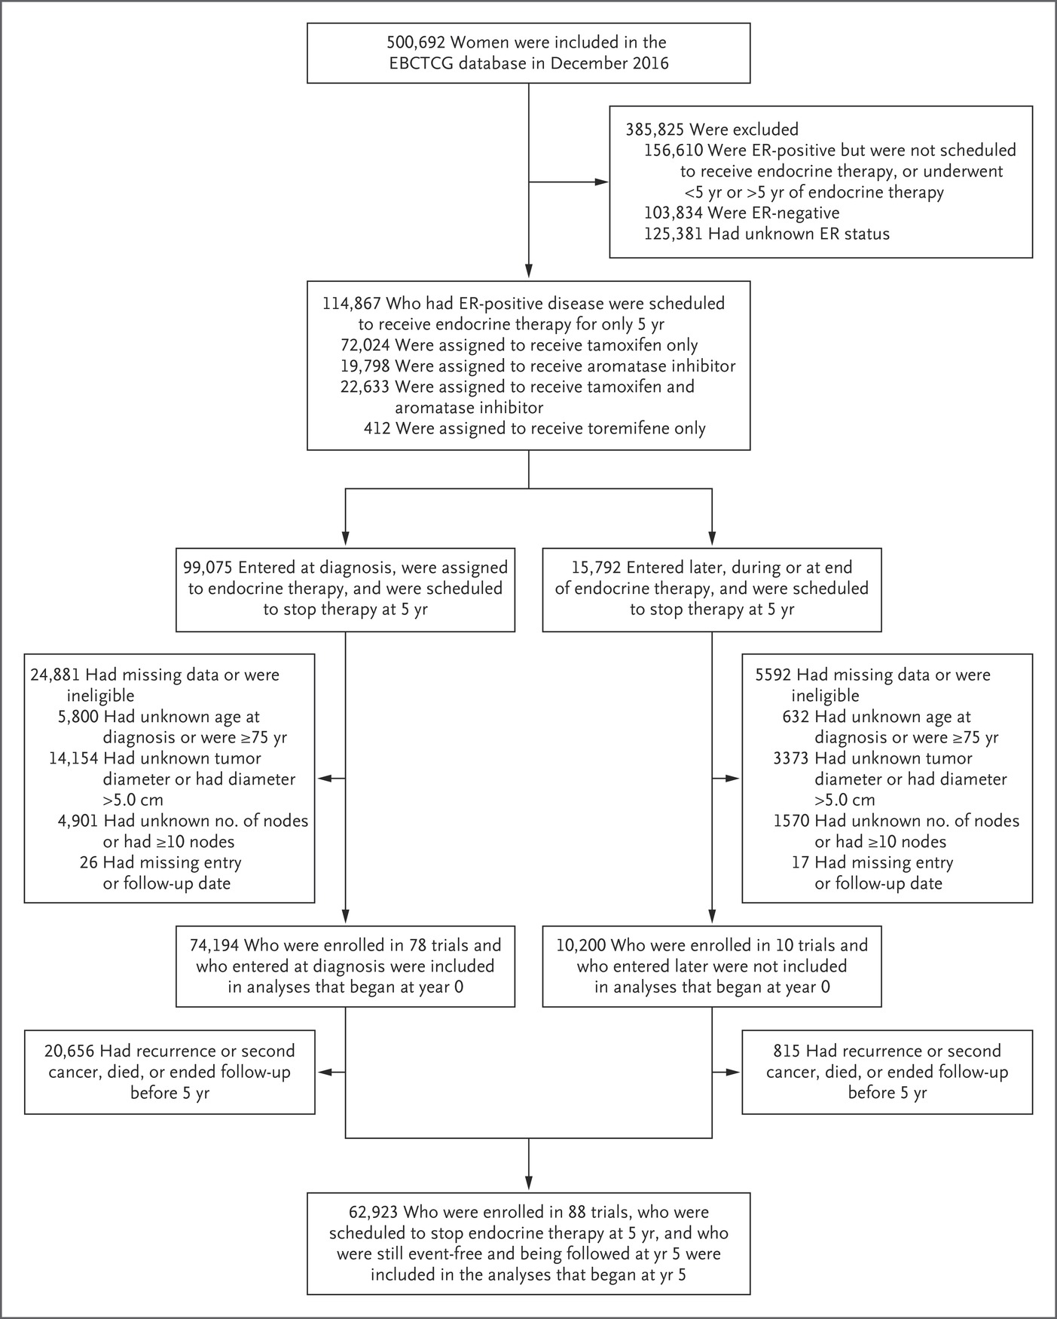
Selection of Women with Breast Cancer from 88 Trials of Adjuvant Breast-Cancer Therapy.
Pan H et al. N Engl J Med ;377:1836-1846
Notes:
Figure 1 Selection of Women with Breast Cancer from 88 Trials of Adjuvant Breast-Cancer Therapy. The analyses combine individual patient data from 88 trials in the Early Breast Cancer Trialists’ Collaborative Group (EBCTCG) database of randomized trials. All the women who were included in the study were scheduled to receive adjuvant endocrine therapy for only 5 years, regardless of actual adherence, after a diagnosis of estrogen-receptor (ER)–positive breast cancer before the age of 75 years. A total of 74,194 women who were enrolled in 78 trials at the time of diagnosis were included in the analyses that began at year 0. A total of 62,923 women who were enrolled in 88 trials either at the time of diagnosis or later (having already received 2 to 5 years of endocrine therapy) were scheduled to stop therapy at 5 years and were included in the analyses that began at year 5.

Slide 4
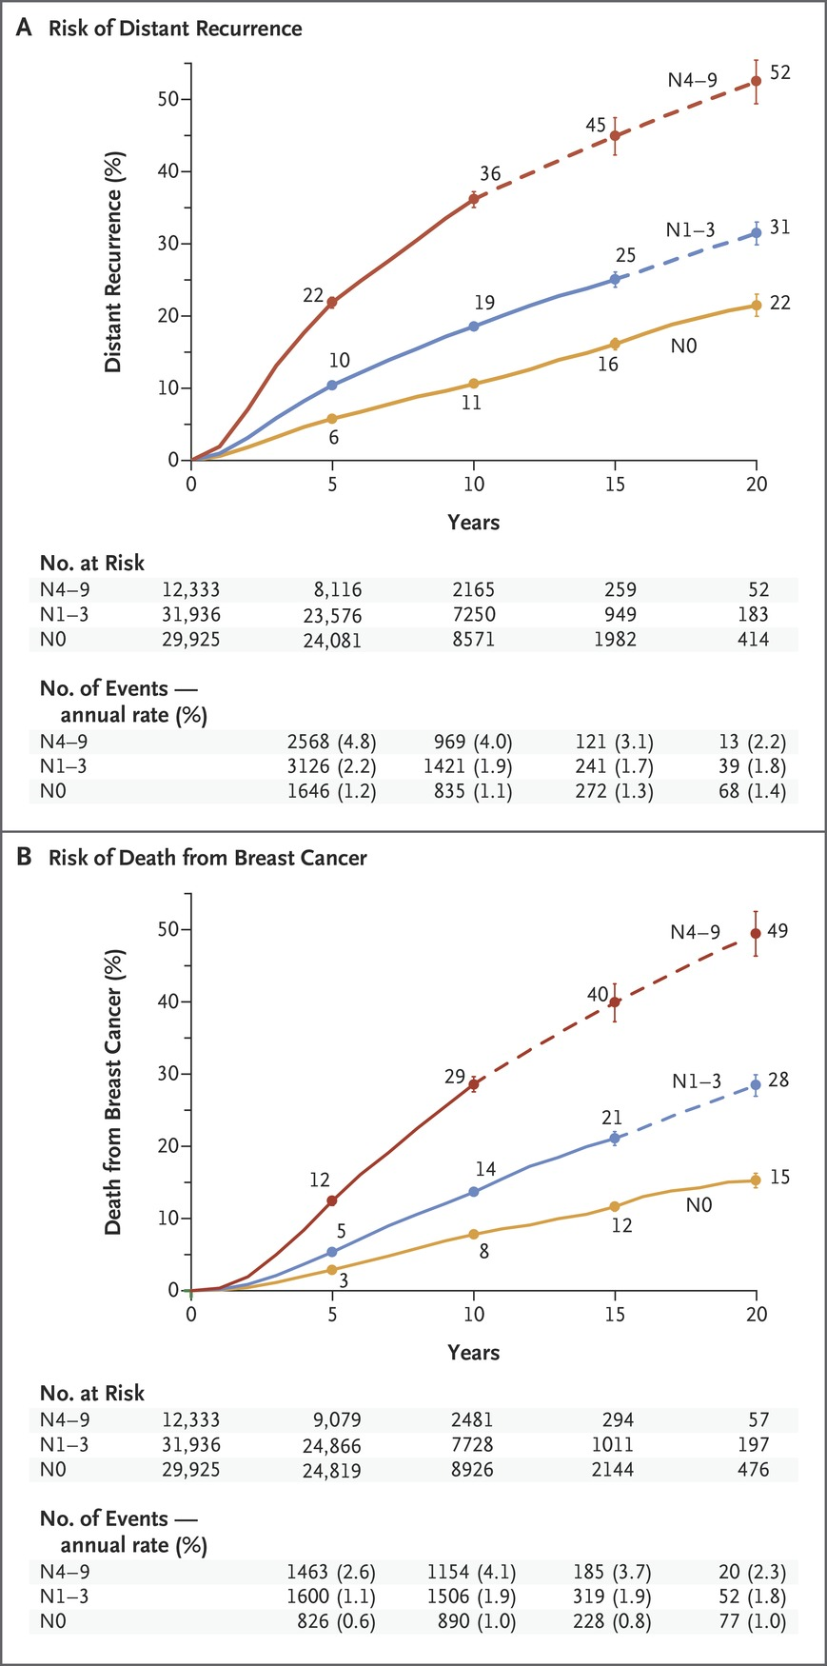
Association between Pathological Nodal Status and the Risk of Distant Recurrence or Death from Breast Cancer during the 20-Year Study Period.
Pan H et al. N Engl J Med ;377:1836-1846
Notes:
Figure 2 Association between Pathological Nodal Status and the Risk of Distant Recurrence or Death from Breast Cancer during the 20-Year Study Period. Shown are data regarding the risk of distant recurrence (Panel A) and death from breast cancer (Panel B) among 74,194 women with ER-positive T1 or T2 disease who were enrolled in 78 trials at year 0 and were scheduled to receive 5 years of endocrine therapy. (Data for another 10,200 women who enrolled in 10 trials after year 0 are not shown here.) The risk was calculated according to the patients’ pathological nodal status at the time of diagnosis: N0, N1–3, or N4–9. The number of events and annual rate are shown for the preceding period (e.g., data for years 0 to 4 are shown at 5 years). The I bars indicate 95% confidence intervals. The dashed lines indicate that the event rate is for the whole 5-year period, rather than for individual years, as is otherwise shown. The annual rate of death from breast cancer was estimated by subtracting the death rate in women without recurrence from the rate in all women.

Slide 5
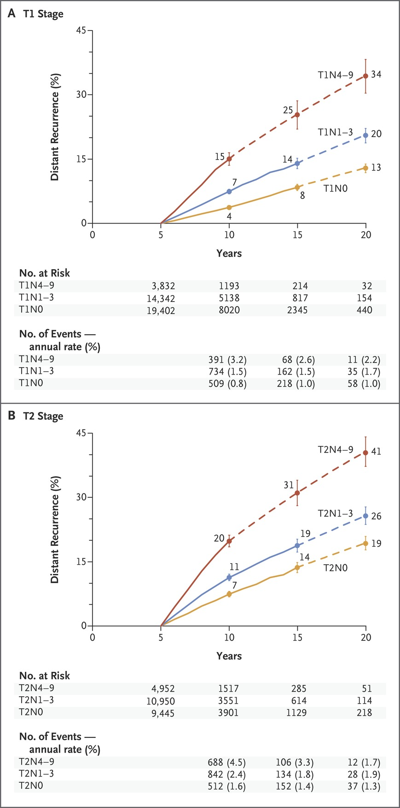
Association between Pathological Nodal Status and the Risk of Distant Recurrence during Years 5 to 20 of the Study, According to Tumor Stage.
Pan H et al. N Engl J Med ;377:1836-1846
Notes:
Figure 3 Association between Pathological Nodal Status and the Risk of Distant Recurrence during Years 5 to 20 of the Study, According to Tumor Stage. Shown are the data for 62,923 women with ER-positive disease who were enrolled in 88 trials of breast-cancer therapy and who initiated therapy either at year 0 or within the first 5 years, according to whether they had T1 disease (Panel A) or T2 disease (Panel B). All the women were scheduled to receive 5 years of endocrine therapy and were event-free and still being followed at year 5. The I bars indicate 95% confidence intervals. The dashed lines indicate that the event rate is for the whole 5-year period, rather than for individual years, as is otherwise shown. Data for the number of events and annual rate begin at 5 years, since the analysis of the risk of distant recurrence starts at year 5.

Slide 6
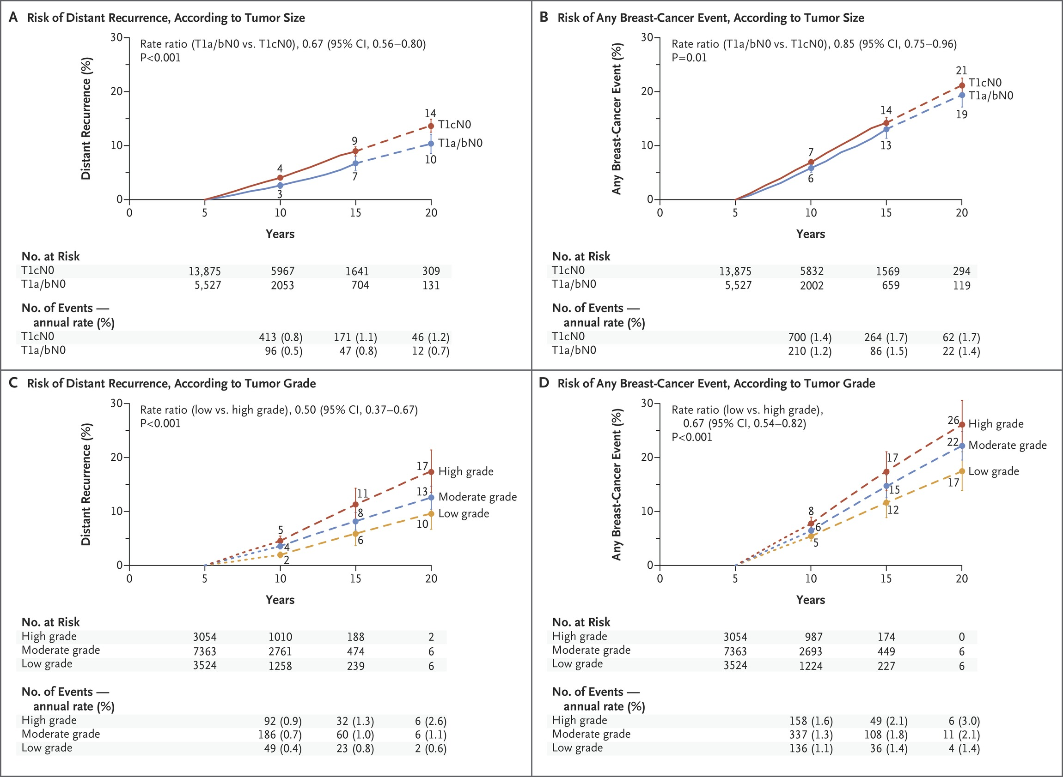
Association of Tumor Diameter and Tumor Grade with the Risk of Distant Recurrence or Any Breast-Cancer Event during Years 5 to 20 of the Study.
Pan H et al. N Engl J Med ;377:1836-1846
Notes:
Figure 4 Association of Tumor Diameter and Tumor Grade with the Risk of Distant Recurrence or Any Breast-Cancer Event during Years 5 to 20 of the Study. Shown are data for 19,402 women (13,941 of whom had a known tumor grade) with ER-positive breast cancer with a tumor size of 2 cm or less with no spread to lymph nodes (T1N0). All the women were scheduled to receive 5 years of adjuvant endocrine therapy and then discontinue therapy and were event-free and being followed at year 5. The findings were categorized according to tumor diameter (T1a or T1b [≤1.0 cm] vs. T1c [greater than 1.0–2.0 cm]) and tumor grade. Panels A and C show the risk of distance recurrence during years 5 to 20 according to tumor diameter and tumor grade, respectively; Panels B and D show the risk of any breast-cancer event (distant or local recurrence or contralateral onset) during years 5 to 20 according to tumor diameter and tumor grade, respectively. The I bars indicate 95% confidence intervals. The dashed lines indicate that the event rate is for the whole 5-year period, rather than for individual years, as is otherwise shown.

Slide 7
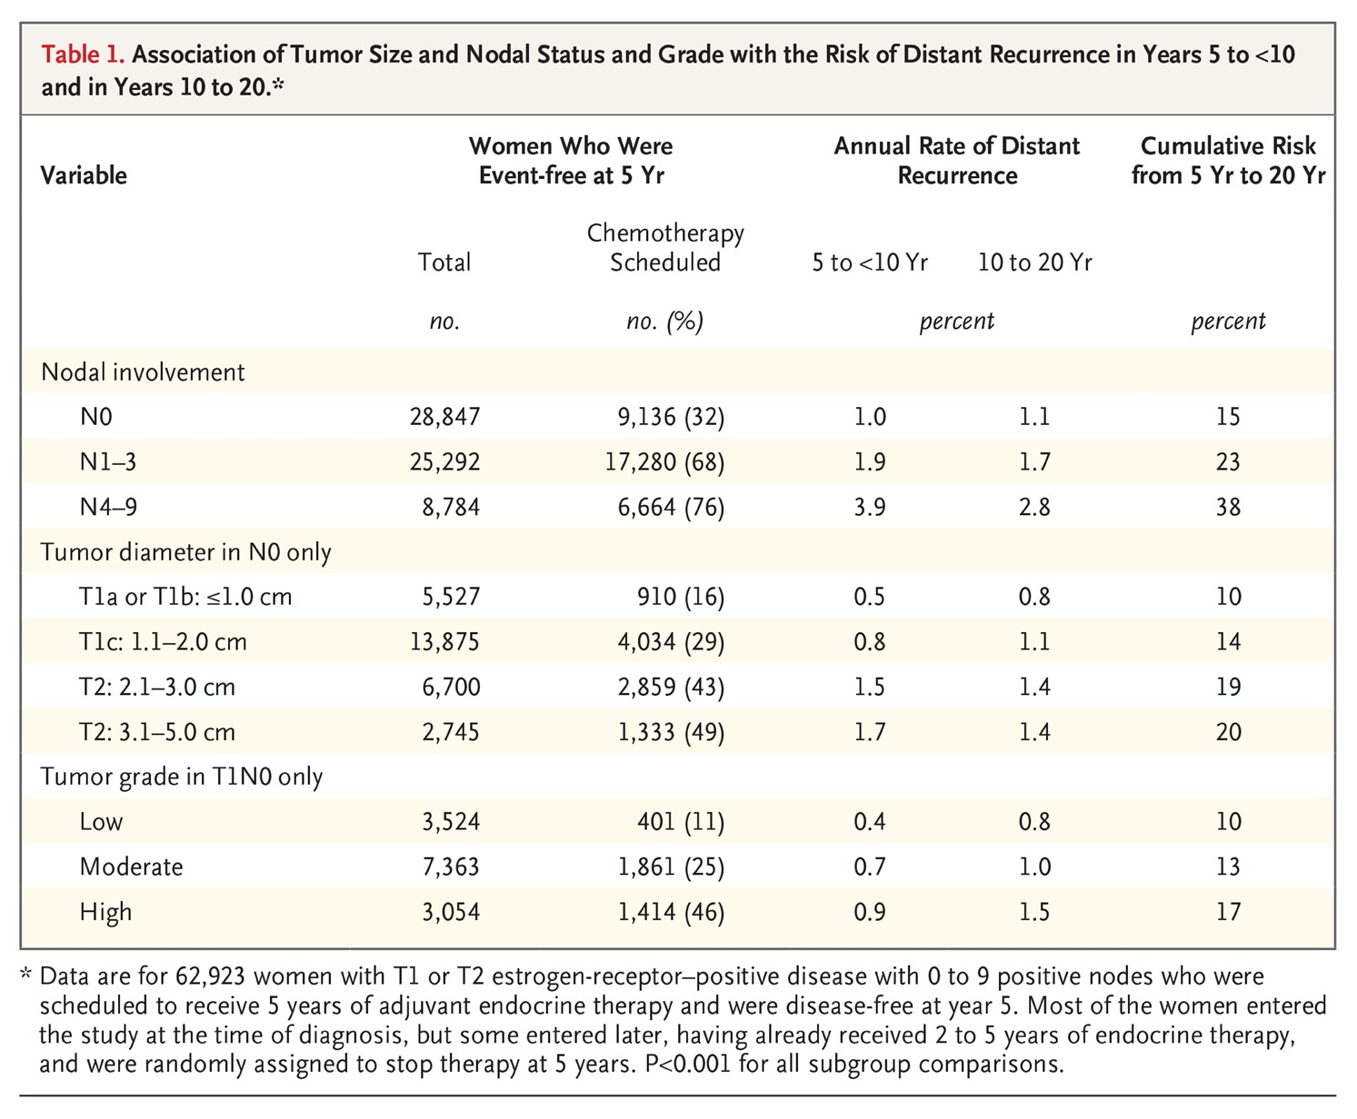
Association of Tumor Size and Nodal Status and Grade with the Risk of Distant Recurrence in Years 5 to Less Than 10 and in Years 10 to 20.
Pan H et al. N Engl J Med ;377:1836-1846
Notes:
Table 1 Association of Tumor Size and Nodal Status and Grade with the Risk of Distant Recurrence in Years 5 to Less Than 10 and in Years 10 to 20.

Slide 8
Conclusions
After 5 years of adjuvant endocrine therapy, breast-cancer recurrences continued to occur steadily throughout the study period from 5 to 20 years.
The risk of distant recurrence was strongly correlated with the original TN status, with risks ranging from 10 to 41%, depending on TN status and tumor grade.

