Slide 1
Supplementary Figures
Programmable polyproteams built using twin peptide superglues
Gianluca Veggiani¹, Tomohiko Nakamura^{1,2}, Michael D. Brenner¹, Raphaël V. Gayet^{1,3}, Jun Yan⁴, Carol V. Robinson⁴ & Mark Howarth^{1*}
¹Department of Biochemistry, University of Oxford, South Parks Road, Oxford, OX1 3QU, UK. ²LOC Development Department, R&D Division, Medical Business Unit, Sony Corporation, 1-5-45 Yushima, Bunkyo-ku, Tokyo 113-8510, Japan. ³Ecole Normale Supérieure de Lyon, 46 Allée d'Italie, 69364 Lyon Cedex 07, France. ⁴Department of Chemistry, Physical and Theoretical Chemistry Laboratory, University of Oxford, South Parks Road, Oxford, OX1 3QZ, UK.
*Corresponding author. E-mail: mark.howarth@bioch.ox.ac.uk (M.H.).

Slide 2
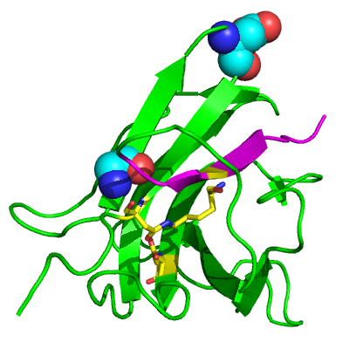
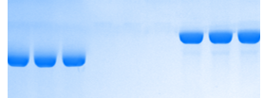
a
Residues mutated to make
SnoopCatcher
b
D848
Tag and
Catcher
(1:2)
SnoopTag
Tag
Catcher
G842
0
0
32 min
SnoopTag-MBP:
SnoopCatcher
Reactive
triad
SnoopTag-MBP
c
Tag
Catcher
Tag and Catcher (4:1)
Time (min)
0
0
32
64
128
SnoopTag-MBP:
SnoopCatcher
SnoopTag-MBP
SnoopCatcher
Supplementary Figure 1. SnoopTag and SnoopCatcher reacted to completion. (a) Point mutations to make SnoopCatcher. From the C-terminal domain of RrgA in cartoon format (based on PDB 2WW8), residues mutated are shown in space-fill with carbons in cyan (G842 was changed to T and D848 to G). The Lys, Asn and Glu involved in isopeptide bond formation are shown in stick-format in yellow and the rest of SnoopTag colored magenta. (b) Sample gel to test for quantitative reaction of SnoopTag. 10 µM SnoopTag-MBP and 20 µM SnoopCatcher are shown alone or mixed for 32 min (triplicate samples), before SDS-PAGE with Coomassie staining. (c) Sample gel to test for quantitative reaction of SnoopCatcher. 10 µM SnoopCatcher and 40 µM SnoopTag-MBP are shown alone or mixed for the indicated times (triplicate samples), before SDS-PAGE with Coomassie staining.

Slide 3
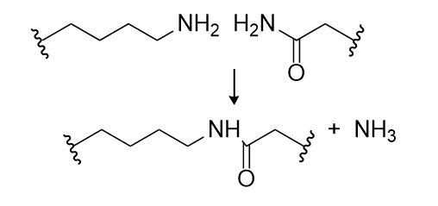
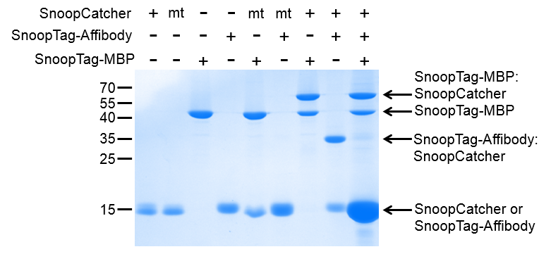
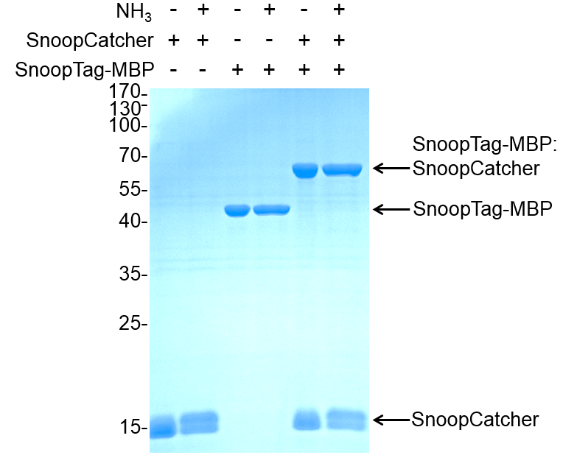
a
?
1. Let SnoopCatcher react
with SnoopTag-MBP
2. Add overnight competing
SnoopTag-Affibody
b
Supplementary Figure 2. SnoopCatcher reaction with SnoopTag was not reversible. (a) Reaction not reversed by competing SnoopTag. In lanes 1-8 SnoopCatcher, SnoopCatcher NA non-reactive control (mt), SnoopTag-MBP and SnoopTag-Affibody (SnoopTag-AffiHER2-SpyTag) are shown alone (each at 10 µM) or after mixing for 6 h. In lane 9, 10 µM SnoopCatcher was reacted with 15 µM SnoopTag-MBP for 6 h and then we added SnoopTag-AffiHER2-SpyTag to 130 µM for 16 h, to look for SnoopTag-AffiHER2-SpyTag:SnoopCatcher formation. (b) Reaction not reversed by competing ammonia. We incubated SnoopTag-MBP with SnoopCatcher for 2 h in TBS with TMAO. We then added NH4Cl pH 9.0 to 1 M final concentration to the indicated samples (+ NH₃) for 16 h (all at 25°C), before SDS-PAGE with Coomassie staining. (The ammonium ion’s pKa is 9.2.)

Slide 4
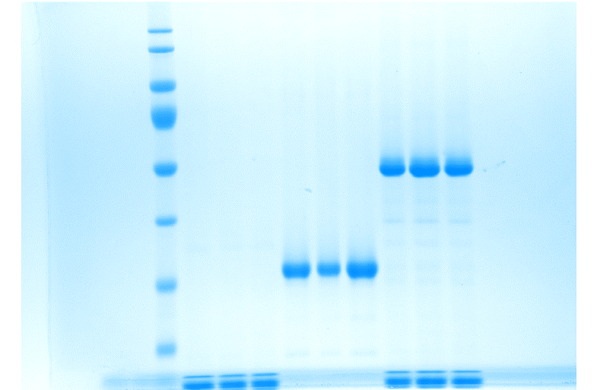
a
Catcher
Tag
Both
70
SpyCatcher:
SnoopTag-mEGFP-SpyTag
55
40
35
SnoopTag-mEGFP-SpyTag
b
Catcher
Tag
Both
100
SpyCatcher:
SpyTag-MBP
70
55
SpyTag-MBP
40
35
25
SpyCatcher
15
Supplementary Figure 3. SpyTag and SpyCatcher reacted to a high degree of completion. (a) SpyTag with excess SpyCatcher. 20 µM SnoopTag-mEGFP-SpyTag was incubated with 40 µM SpyCatcher for 120 min at 25°C, before SDS-PAGE with Coomassie staining showing triplicate samples. (b) SpyCatcher with excess SpyTag. 10 µM SpyCatcher was incubated with 20 µM SpyTag-MBP for 32 min at 25°C, before SDS-PAGE with Coomassie staining showing triplicate samples.
Notes:
24 April

Slide 5
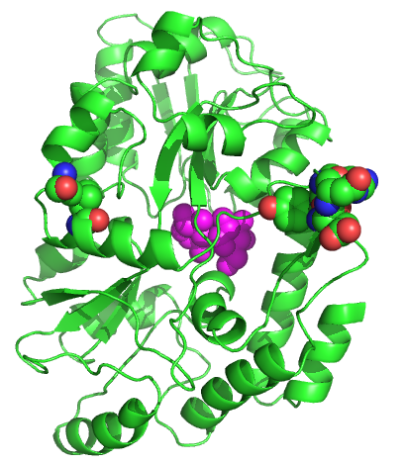
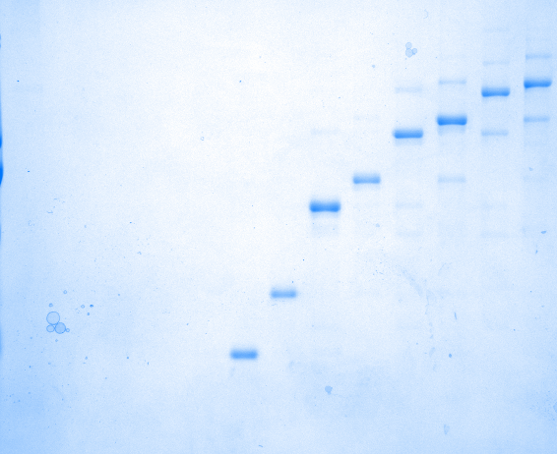
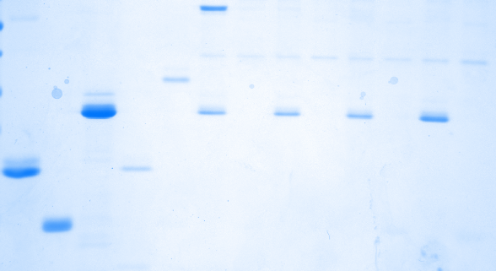
a
MBP
A312
I317
172-173
175-176
Bound sugar
b
-
-
+
-
-
1
1
2
2
3
3
4
4
SpyCatcher-SnoopCatcher
-
+
-
-
1
1
2
2
3
3
4
4
5
SnoopTag-AffiHER2-SpyTag
460
+
-
-
1
1
1
1
1
1
1
1
1
1
biotin-SpyCatcher
268
238
171
130
117
8% SDS-PAGE
72
72
55
43
34
26
16% SDS-PAGE
17
Supplementary Figure 4. Resin attachment for solid-phase polyprotein synthesis. (a) Location of MBP mutations, based on PDB 1ANF. A312 was changed to V, I317 to V, and 172-173 and 175-176 were deleted. Mutated residues are shown in space-fill. The bound sugar part is shown in space-fill and colored magenta. (b) Solid-phase polyprotein synthesis using avidin attachment. Lanes 1-3 show biotin-SpyCatcher, SnoopTag-AffiHER2-SpyTag and SpyCatcher-SnoopCatcher in isolation. For solid-phase synthesis, biotin-SpyCatcher was bound to monomeric avidin resin. Sequential addition of SnoopTag-AffiHER2-SpyTag and SpyCatcher-SnoopCatcher led to chain formation up to a decamer. After each stage, sample was eluted from one aliquot of resin with biotin (lanes 4-13). Samples, without any further purification, were analyzed by SDS-PAGE (both 8% and 16% gels) with Coomassie staining.
Notes:
B better data

Slide 6
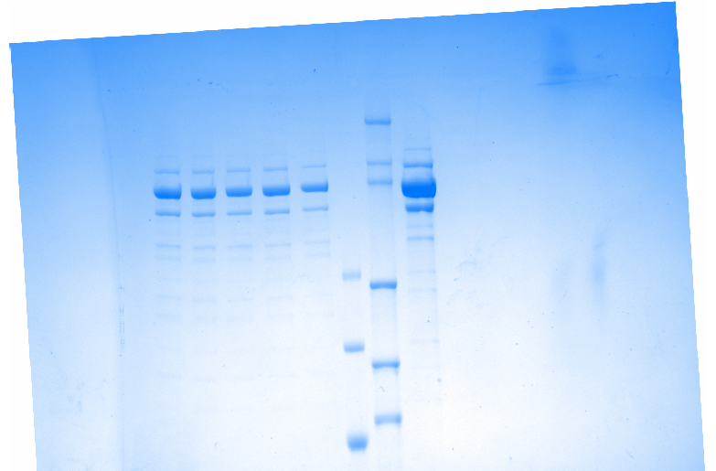
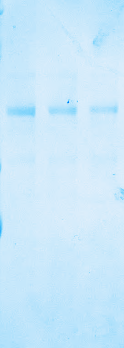
a
Temp (°C)
25
37
50
60
70
500
290
240
180
130
116
95
b
Time (h)
0
24
96
460
268
238
171
117
72
Supplementary Figure 5. Stability of polyproteins. (a) Decamer thermostability. MBPx-SpyCatcher:(SnoopTag-AffiHER2-SpyTag:SpyCatcher-SnoopCatcher)₄:SnoopTag-AffiHER2-SpyTag was incubated at the indicated temperature for 3 min, centrifuged to remove aggregates, and analyzed by SDS-PAGE with Coomassie staining. (b) Decamer time-dependent stability. Biotin-SpyCatcher:(SnoopTag-AffiHER2-SpyTag:SpyCatcher-SnoopCatcher)₄:SnoopTag-AffiHER2-SpyTag was incubated at 25°C for the indicated time, before boiling in SDS-loading buffer and analysis by SDS-PAGE with Coomassie staining.
Notes:
A better data

Slide 7
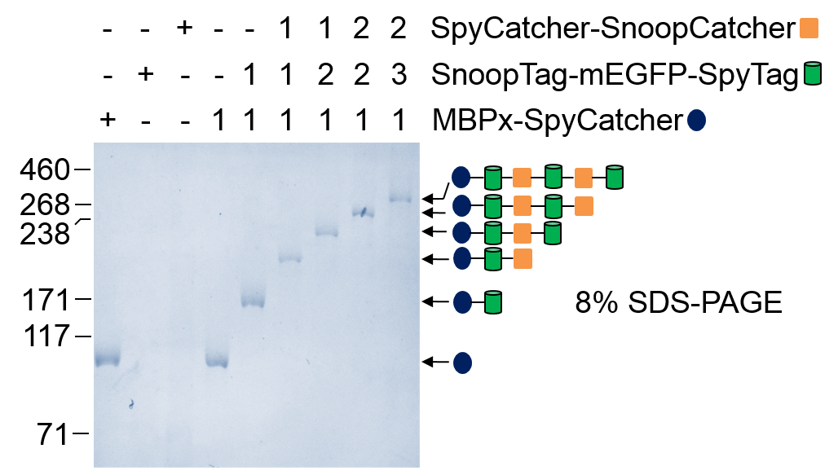
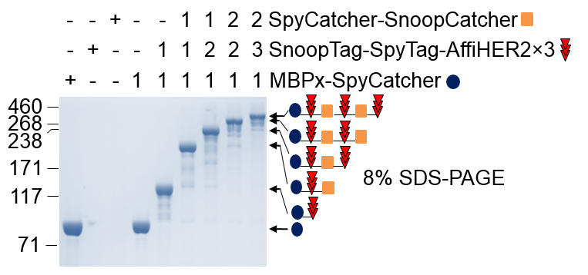
a
b
Supplementary Figure 6. Different building blocks incorporated in polyproteams. (a) Synthesis of fluorescent polyproteins. MBPx-SpyCatcher was bound by amylose resin and then extended iteratively with SnoopTag-mEGFP-SpyTag and SpyCatcher-SnoopCatcher. Samples were eluted at each stage with maltose and analyzed by SDS-PAGE with Coomassie staining. (b) Synthesis of branched polyproteins. As for (a), except using 3 tandemly-linked affibodies (SnoopTag-SpyTag-AffiHER2×3).
Notes:
A: show 16% gel
Fix blue colour like others

Slide 8
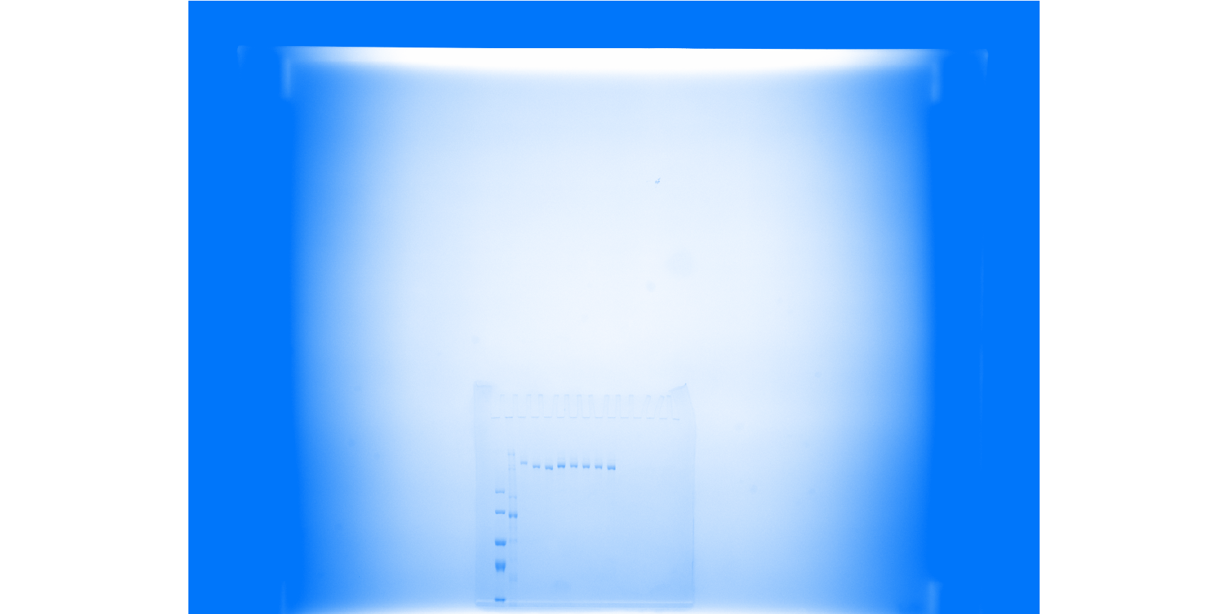

a
5
4
3
2
1
SnoopTag-SpyTag-AffiHER2×3
SnoopTag-AffiIGF1R-SpyTag
SnoopTag-AffiEGFR-SpyTag
SnoopTag-antiDR5-SpyTag
SnoopTag-AffiTaq-SpyTag
460
SpyCatcher-SnoopCatcher
268
MBPx-SpyCatcher
238
180
b
Supplementary Figure 7. Effect of valency on polyproteam activation of cell death. (a) Synthesis of polyproteam homomultimers and polyproteams with varying numbers of nanobodies and affibodies to either EGFR or Taq polymerase. Synthesis was analyzed by SDS-PAGE with Coomassie staining. (b) Polyproteam effect on viability of MDA-MB-231 after 40 h with each chain, analyzed by a resazurin assay with untreated cells set at 100% (mean ± 1 s.d., n = 3). Affibody to EGFR (E), triple affibody to HER2 (H), affibody to IGF1R (I), nanobody to DR5 (N), affibody to Taq polymerase (T).
Notes:
A better data

