Slide 1
Core 2
GlcNAcT
T-synthase
S/T
(C1galt1)
S/T
S/T
Core 1
Core 2
GalNAc
Gal
GlcNAc
1 column
Fig. 1

Slide 2
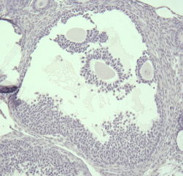
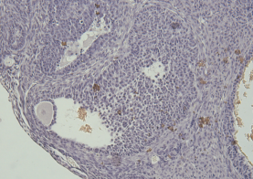
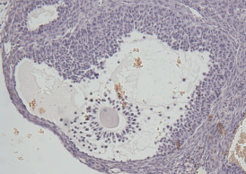





Control
Mutant
A
B
GC
C
A1
A2
#
#
A3
*
B1
C1
1 column
*
#
Fig. 2

Slide 3
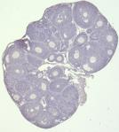
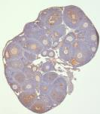
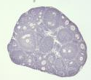
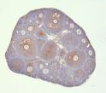
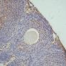
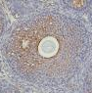
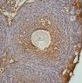
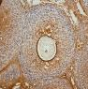
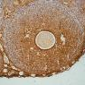
A
Control
Mutant
No Ab
IgG
No Ab
IgG
B
Low
High
No brown stain
*
**
C
100
% of follicles
80
60
40
20
28
19
31
28
50
71
21
57
0
Control
Mutant
Control
Mutant
Control
Mutant
Control
Mutant
Primary
Secondary
Preantral
Antral
Fig. 3
Low
High
1.5 or 2 column

Slide 4
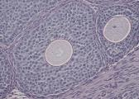
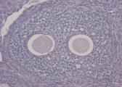
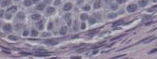
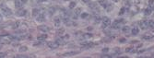
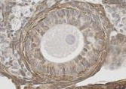
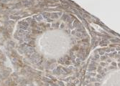
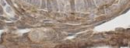
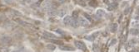
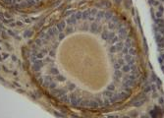
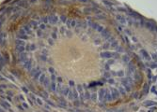

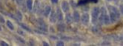
Distinct
Indistinct
*
A
B
C
*
PAS
A’
B’
11
14
34
61
56
60
23
39
D
E
F
#
*
Laminin
D’
E’
8
11
11
20
7
34
18
35
G
H
I
*
Collagen IV
G’
H’
10
3
27
13
30
42
11
17
Fig. 4
1.5 or 2 column

Slide 5
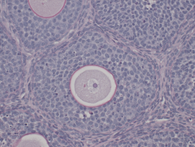
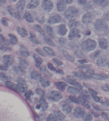
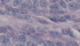
A
4
1
12
11
26
19
13
19
3
11
2
5
1
1
B
6
C
1
*
2
5
3
4
Distinct
Intermingled
57
66
Control
Mutant
Fig. 5
1.5 column

Slide 6
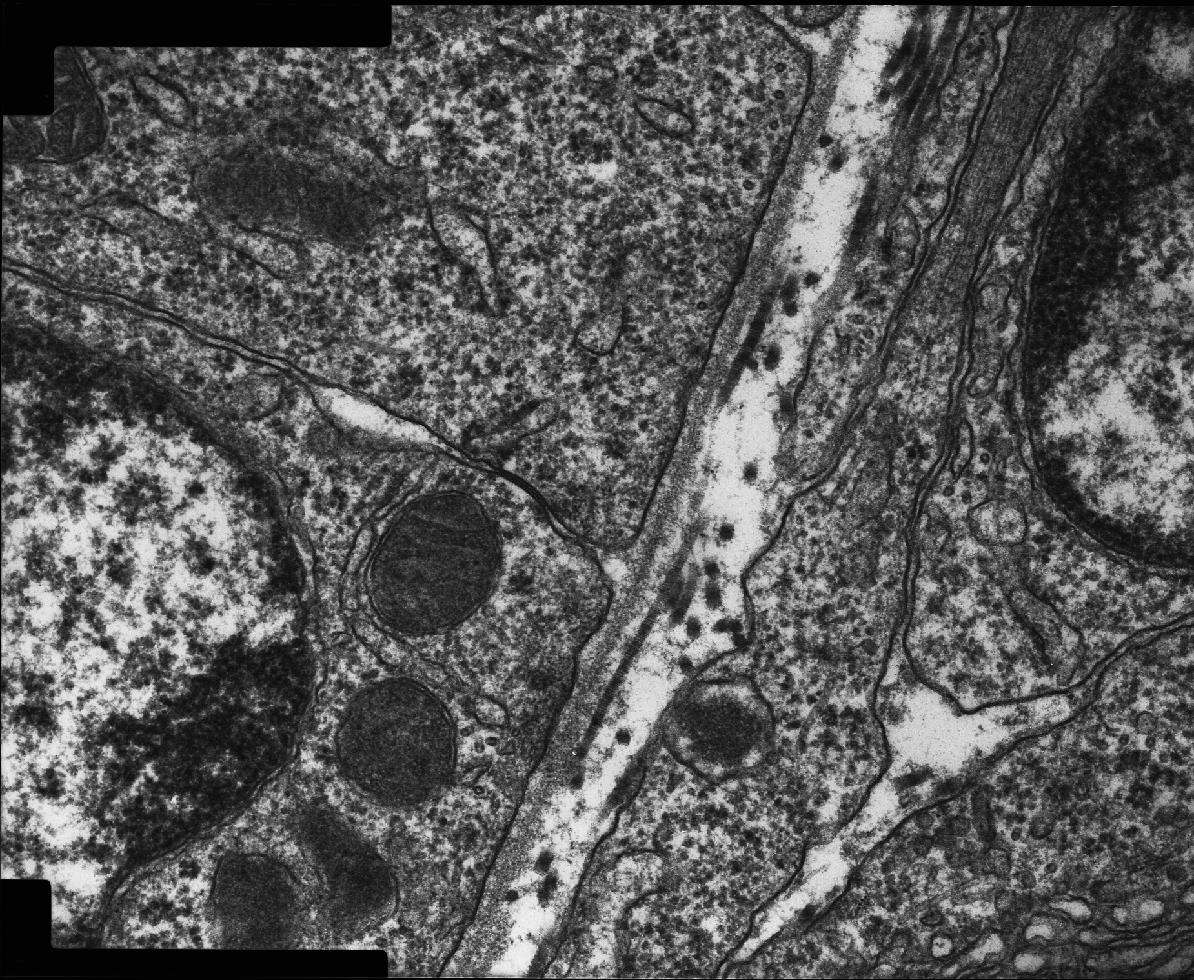
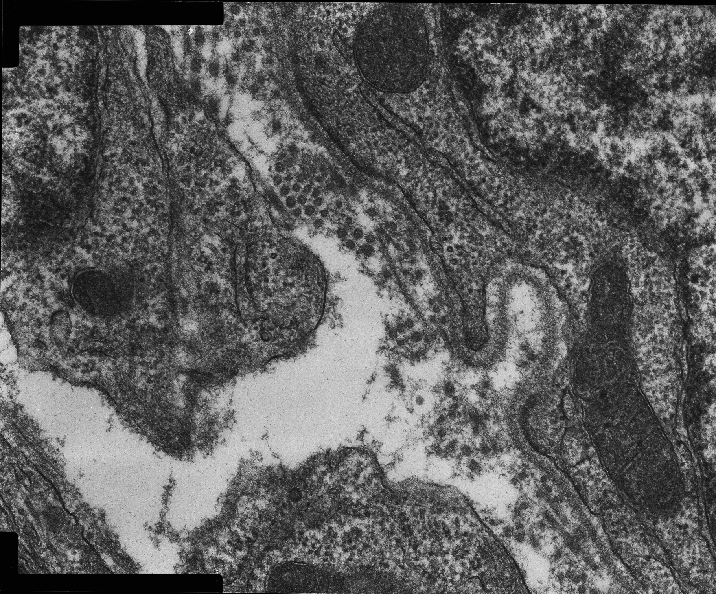
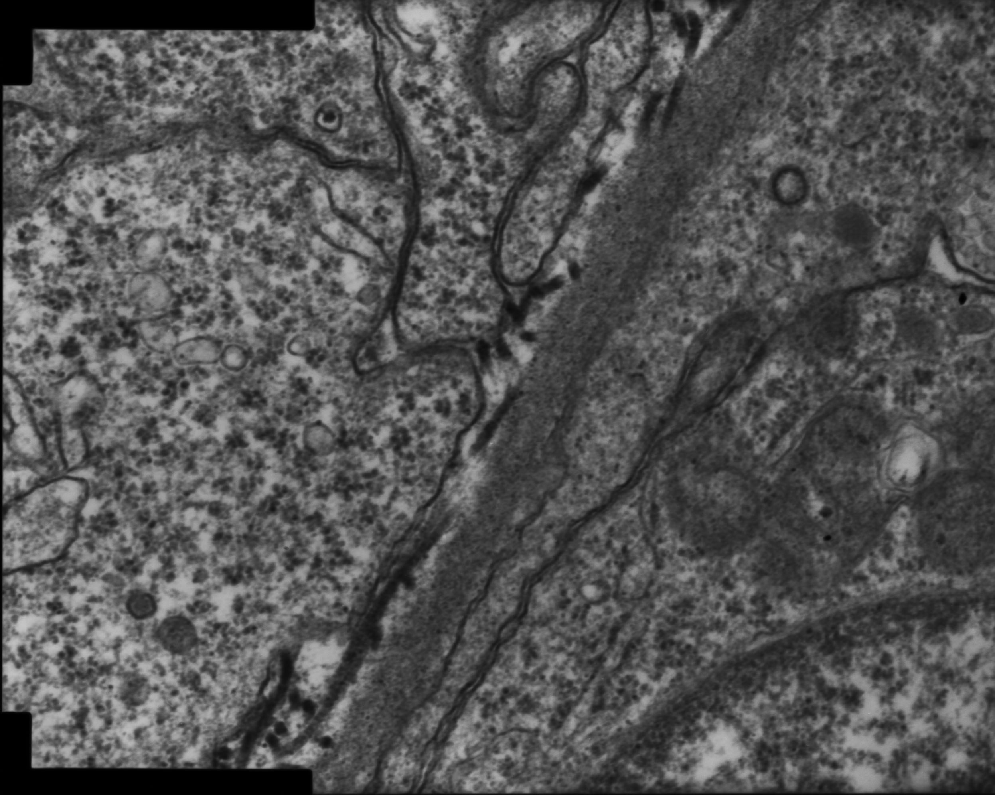
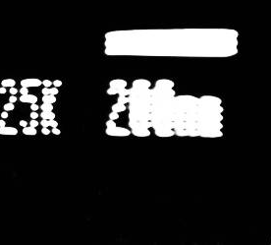
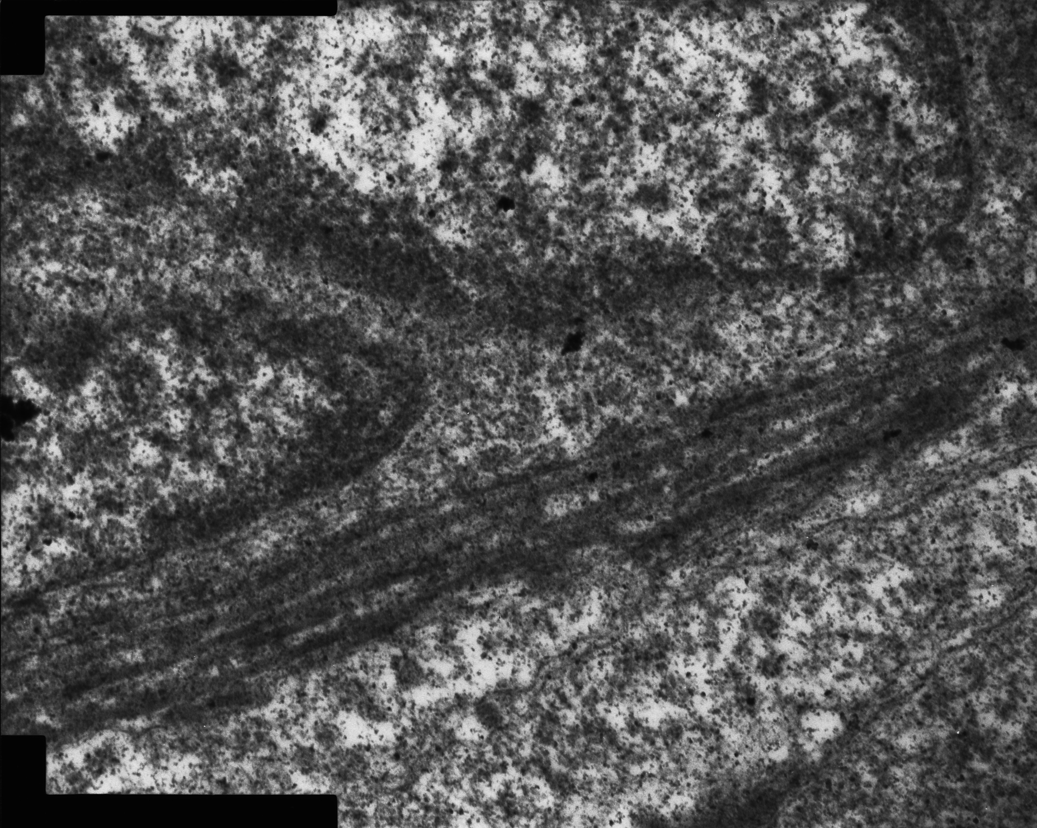
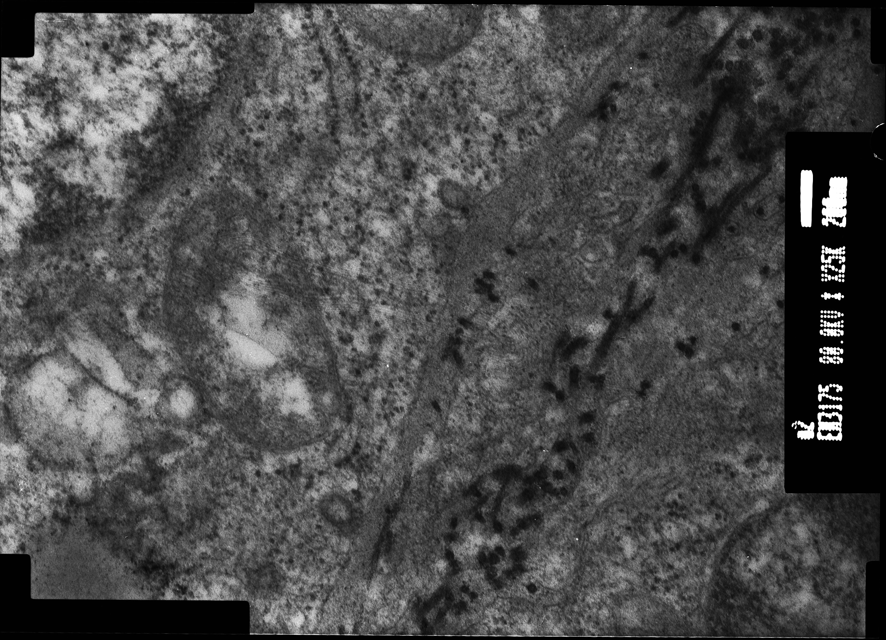
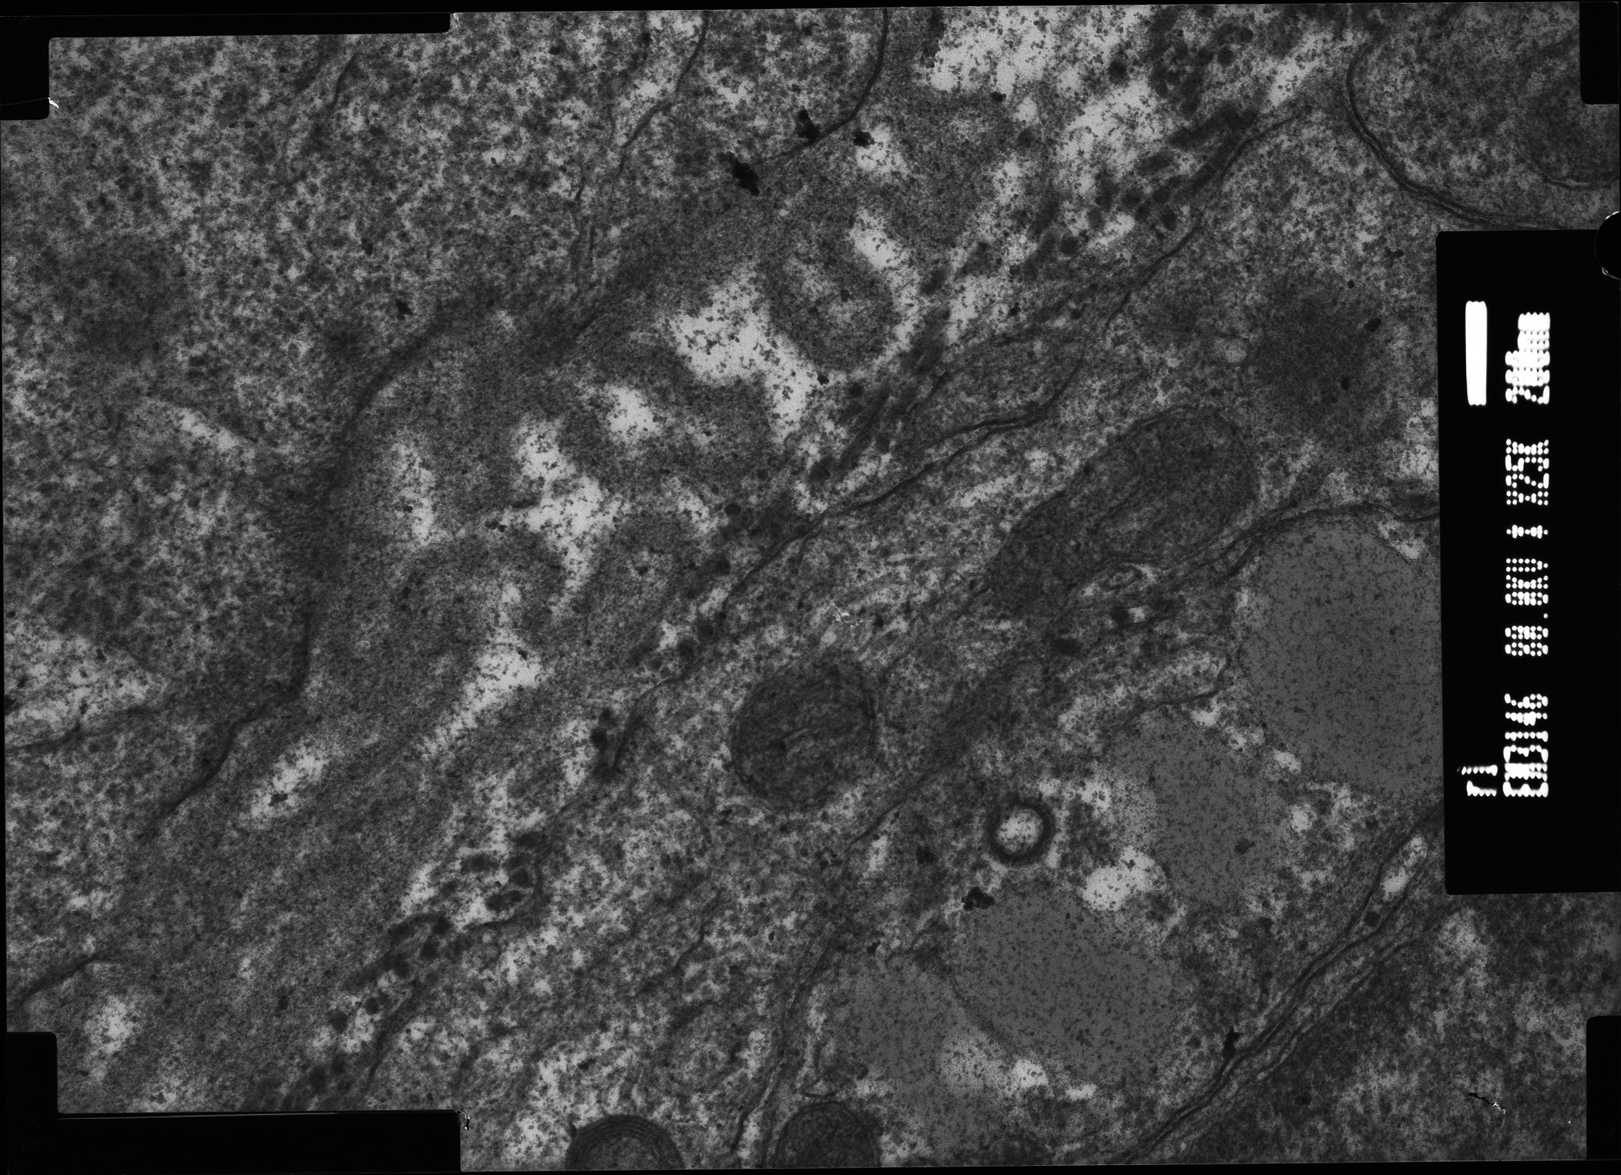
A
Conventional
Conventional
Thick
G
G
G
200nm
200nm
200nm
Multilayer
Indistinct
Loopy
G
G
G
200nm
200nm
200nm
B
Mutant SOF
Mutant
C
Mutant SOF
Mutant
MOF
MOF
Fig. 6
2 column

Slide 7
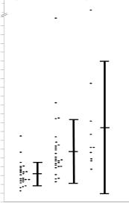
A
***
B
140
*
s.d of each follicles’s BL .measurements
100
B
**
90
80
70
60
50
40
30
20
25
25
9
10
Control
Mutant SOF
Mutant MOF
Control
Mutant SOF
Mutant MOF
C
1 s.d.
mean
1 s.d.
Control:
Mutant SOFs:
1 s.d.
mean
1 s.d.
Mutant MOFs:
1 s.d.
mean
1 s.d.
Fig. 7
1.5 column

Slide 8
A
B
C
D
Fig. 8
1 column
Oocyte
Granulosa cell
Theca cell
Conventional FBL
Thick FBL

