Slide 1

Timing the integration of utterance duration and task shift in a case of genetic anomaly implicating 7q31 with language disorders
P. García-Bellido,
A.Benítez-Burraco,
K.Park
B. Molineaux

Slide 2
Sound Day
March 5, 2011
University of Oxford
Oxford

Slide 3
Question
Is the estimation of interval timing in the 110ms- to- 2s range significantly different in our subject of interest A compared to the control C ?

Slide 4
Two clocks
Temporal Reproduction Time of the utterance CLOCK I TASK SHIFTS
|____|____|____|_____|
CLOCK II Temporal Reproduction Time of each individual task

Slide 5

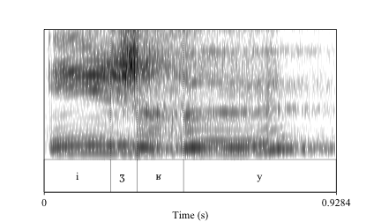
Tutor’s Utterance for C

Slide 6
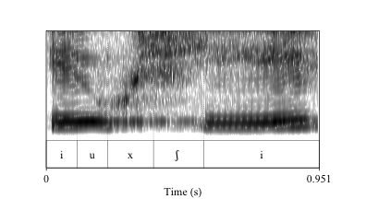
C’s Utterance

Slide 7
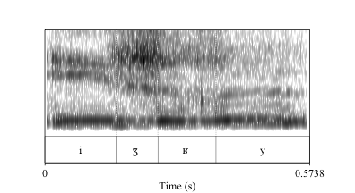
Tutor’s Utterance for A

Slide 8
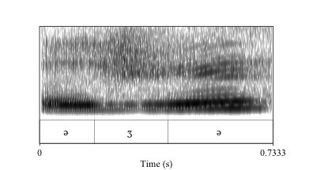
A’s Utterance

