Slide 1
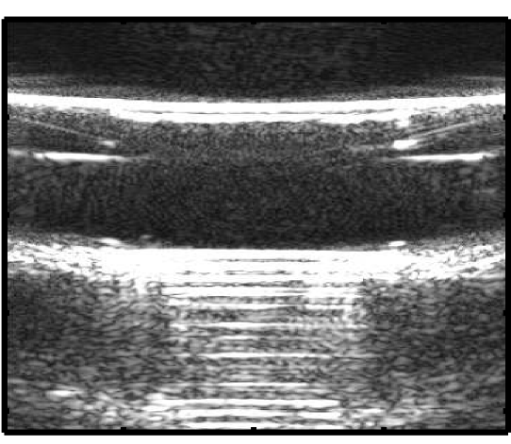
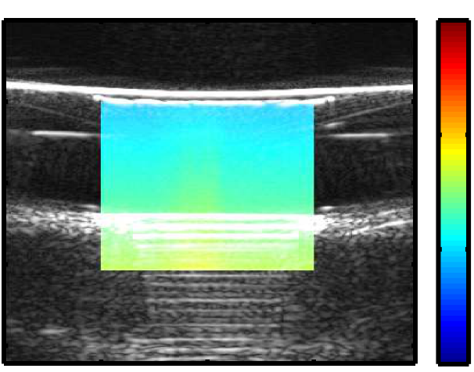
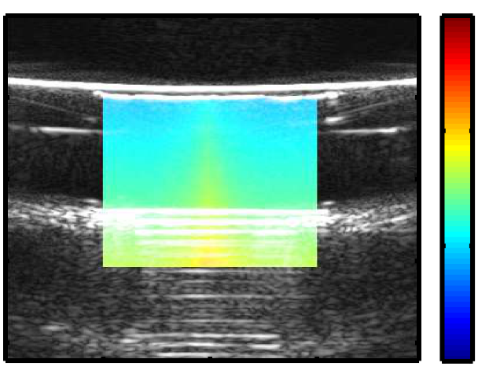
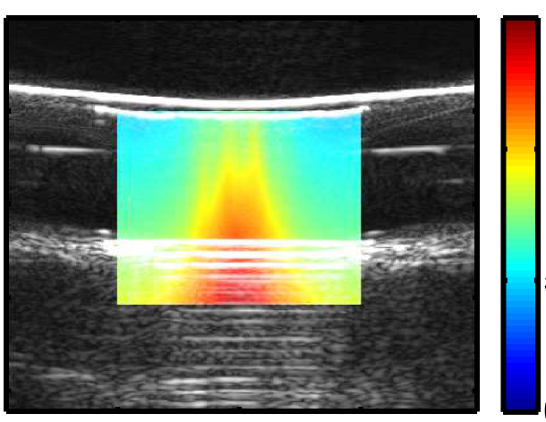
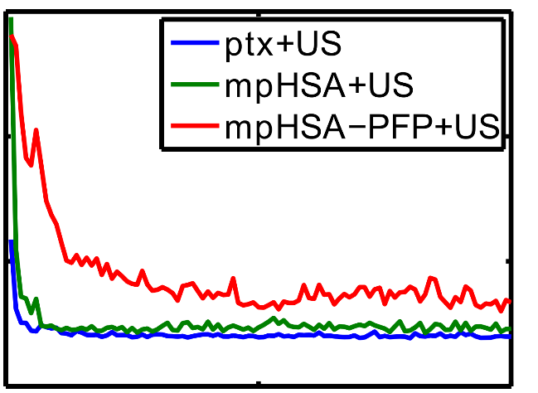
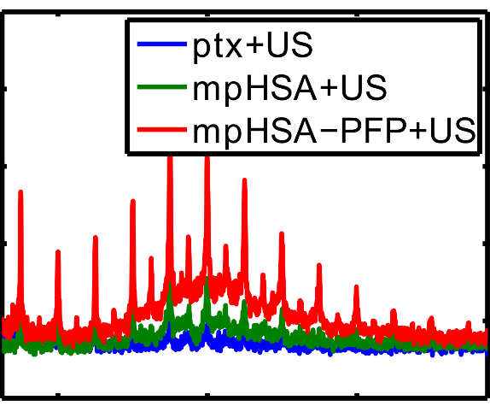
a
b
B-mode
PTX+US
50
Lid
50
150
60
Sample
60
100
Max 91.8609
Mean 65.9385
Std 11.3782
Axial (mm)
Axial (mm)
70
70
80
Magnet
80
50
90
90
0
-10
0
10
-10
0
10
Transverse (mm)
Transverse (mm)
c
mpHSA+US
d
mpHSA-PFP+US
50
150
50
150
60
100
60
100
Max 100.0595
Mean 67.3015
Std 12.1136
Axial (mm)
Axial (mm)
Max 140.6751
Mean 81.4507
Std 20.7643
70
70
80
50
80
50
90
0
90
0
-10
0
10
-10
0
10
Transverse (mm)
Transverse (mm)
e
f
3
PTX+US
mpHSA+US
mpHSA-PFP+US
0.1
PTX+US
mpHSA+US
mpHSA-PFP+US
Max1 2.8133
Mean1 0.8820
0.08
2
0.06
Max2 2.9552
Mean2 0.5113
Cavitation power (AU)
FFT Magnitude (AU)
1
0.04
0.02
Max3 1.1738
Mean3 0.4205
0
0
0
50
100
2
4
6
Frame
Frequency (MHz)

