Slide 1
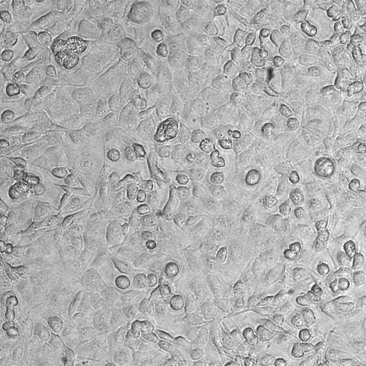
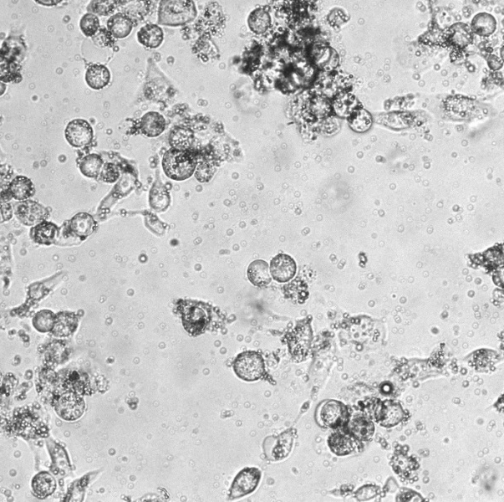
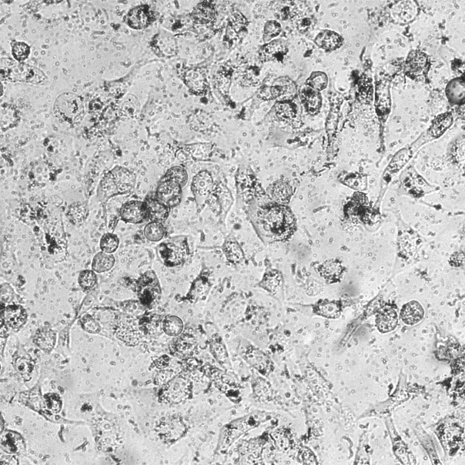
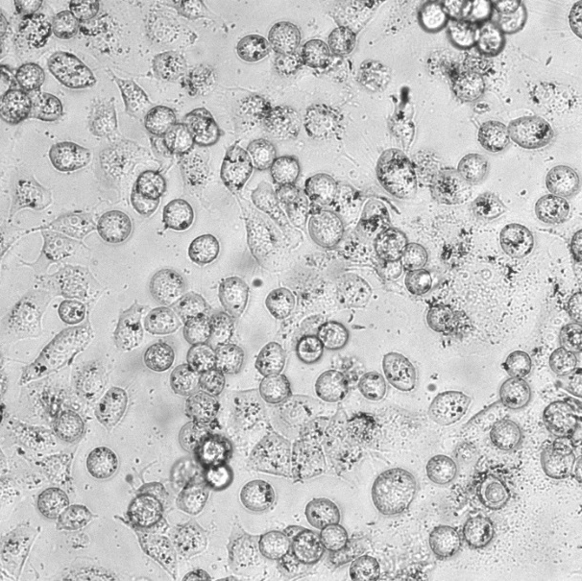
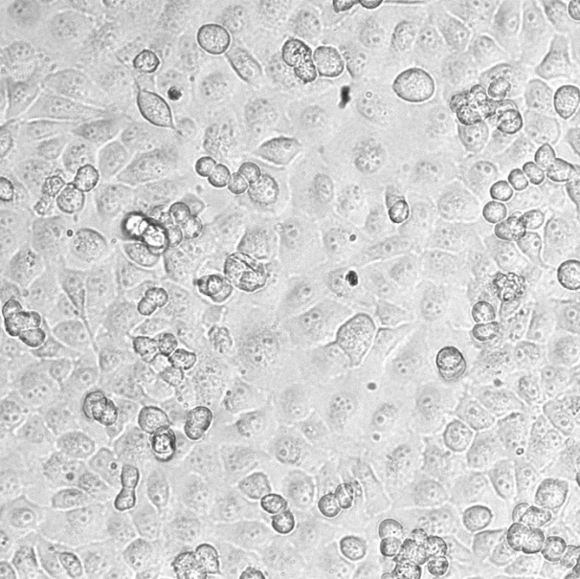
Cells
mpHSA-PFP+US
mHSA-PFP+US
a
mpHSA+US
ptx+US

Slide 2
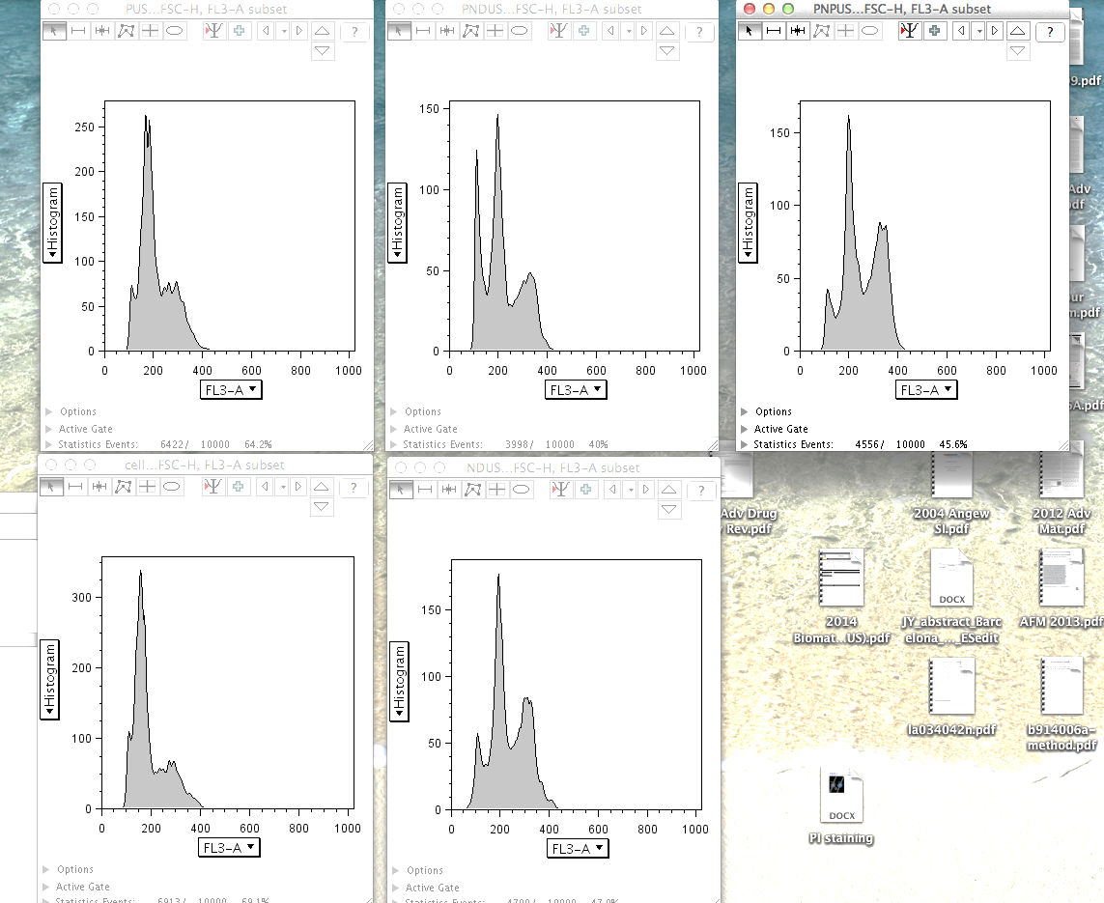
b
Cells
mpHSA-PFP+US
mHSA-PFP+US
Sub G1
6.23%
G2/M
27.4
Sub G1
26.4%
G2/M
30.5
Sub G1
11.6%
G2/M
40.9
Cell count
mpHSA+US
ptx+US
Sub G1
11%
G2/M
46.4
Sub G1
6.31%
G2/M
31.3
Fluorescent intensity

