Slide 1
a
Ultrasound exposure
Before
15 sec
45 sec
mHSA-PFP
200 μm
HSA-PFP
mDTAB-PFP
b
Before
15 sec
45 sec
25.1 %
33.1 %
71.5 %
Concentration (%)
mHSA-PFP
HSA-PFP
mDTAB-PFP

Slide 2
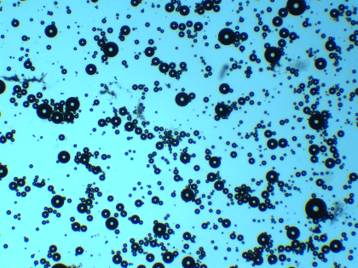
a
Ultrasound exposure
Before
1 min 45 sec
3 min
mHSA-PFP
HSA-PFP
mDTAB-PFP
b
Before
1 min 45 sec
3 min
Normalized concentration
mHSA-PFP
HSA-PFP
mDTAB-PFP
Notes:
Figure S1

