Slide 1
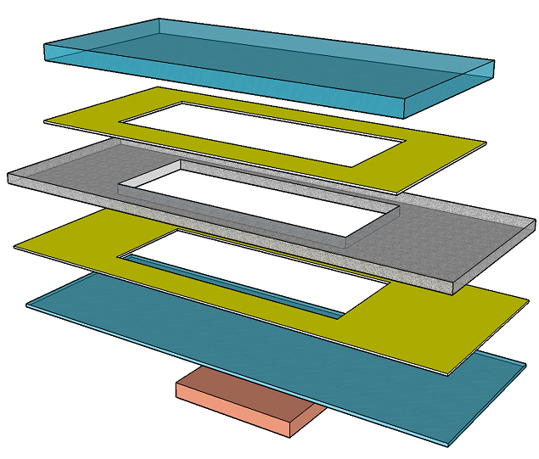
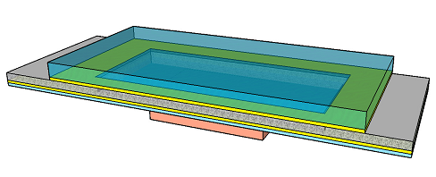
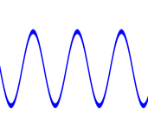
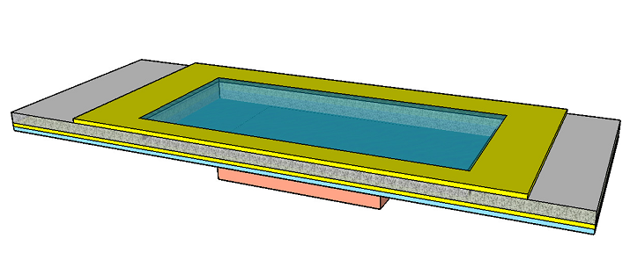
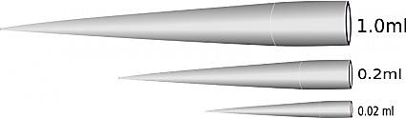
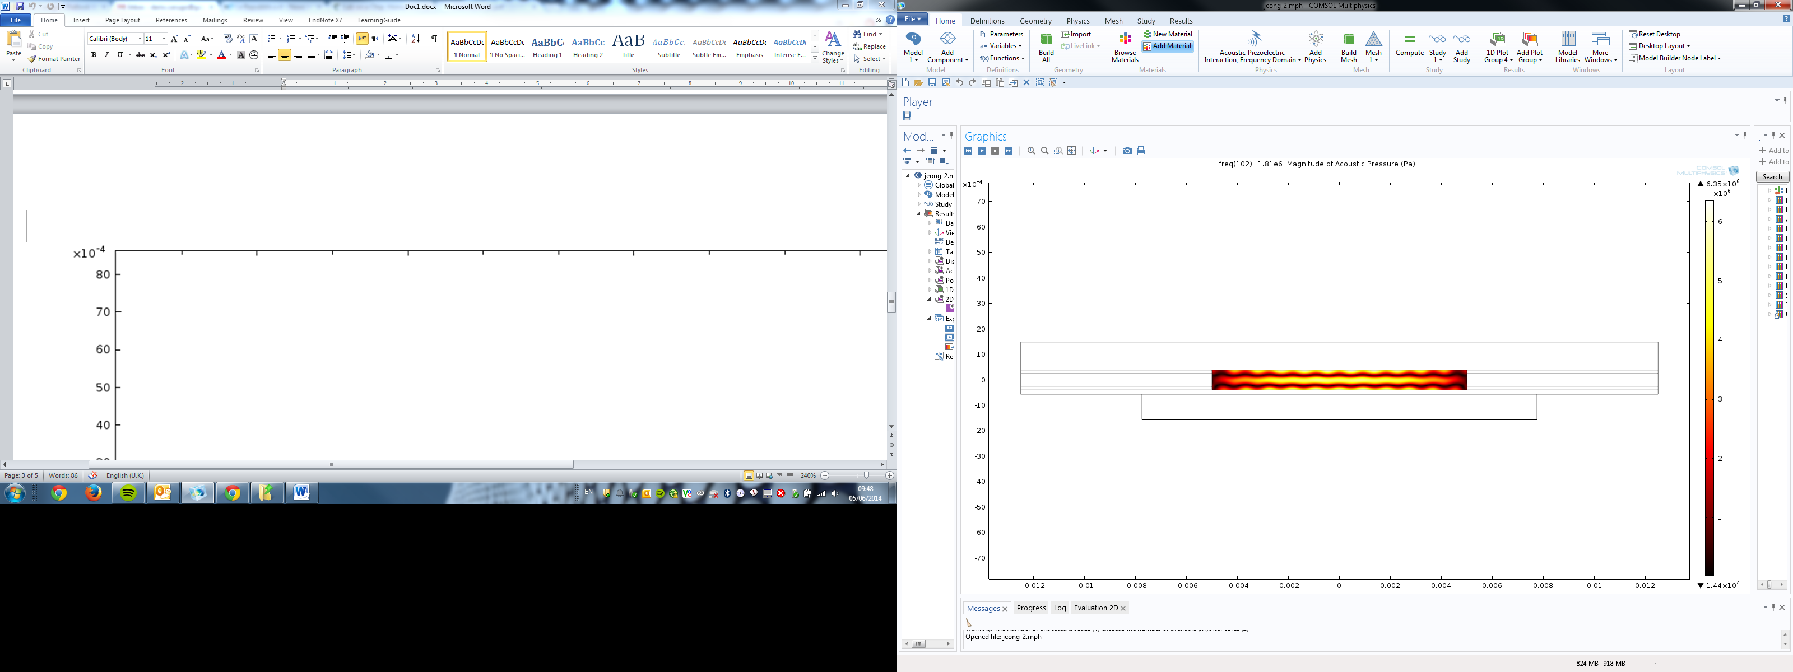
a
b
1
Glass reflector
Ultrasound exposure
1
Polycarbonate spacer
Double-sided adhesive
membrane
z
y
2
Sample extraction
1
x
Transducer
Glass carrier
c
d
z
1000
1
y
500
Acoustic energy density (J/m³)
0.5
0
1.6
1.8
2
2.2
Magnitude of Acoustic Pressure
Frequency (MHz)
0

